Slide 1

2008 SNA Implementation
Webinar Day 1
22 February 2023
Pinar Ucar
SIAP

Slide 2
Countries (31 countries)
Australia | Malaysia | South Korea
Azerbaijan | Maldives | Sri Lanka
Bangladesh | Tonga | Tajikistan
Cambodia | Mongolia | Thailand
China | Nauru | Timor Leste
Georgia | Pakistan | Türkiye
India | Palau | Uzbekistan
Indonesia | Philippines | Vanuatu
Iran | Republic of Armenia | Vietnam
Kazakhstan | Russian Federation
Lao PDR | Singapore

Slide 3

Nominees (around 150)
National Statistical Offices
Ministry of Finance/Trade/Economic development
Planning departments
Training and research institutes
Academia
International organizations
Statistician (Junior to Senior)
Specialist/Expert/Consultant
Researcher/Engineer
Division head
Deputy director/Director

Slide 4
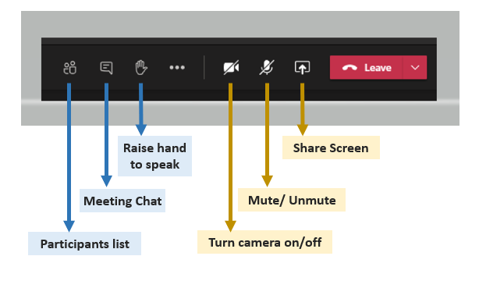

Slide 5
Outline
Introduction
Global implementation programme for the 2008 SNA and supporting statistics
Current status of implementation in UN Member States
Major challenges
ADB- Technical and training support in 2008 SNA Implementation

Slide 6
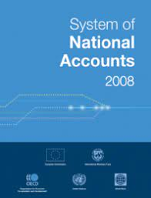
2008 SNA
At its 40th session (2009), the UNSC adopted the 2008 SNA and supported the Implementation Strategy proposed by the Intersecretariat Working Group on National Accounts (ISWGNA).

Slide 7
Implementation of the 2008 SNA is assessed in terms of:
Scope
Quality
Compliance

Slide 8
Three dimensions
Countries’ compliance with 2008 SNA can be monitored in terms of
  Scope of national accounts they compile
  Extent of 2008 SNA important concepts they have adopted
The scope of national accounts countries compile can be assessed using
  A set of six milestones supplemented by
  Three data sets describing (a) the minimum set of accounts that need to be compiled (MRDS); (b) a recommended set of accounts; and
  (c) a desired set of accounts
The milestones and data sets are available in annexes 1 and 2
Information to determine the scope comes from annual national accounts questionnaire submitted to UNSD

Slide 9
Three dimensions
The extent to which important concepts in the 2008 SNA affecting the level of GDP, gross capital formation and gross national income have been implemented is assessed using a compliance questionnaire, supplemented by country reports
Compliance questionnaire is available in annex 3
The quality of the national accounts dimension was assessed using the IMF quality assessment framework

Slide 10

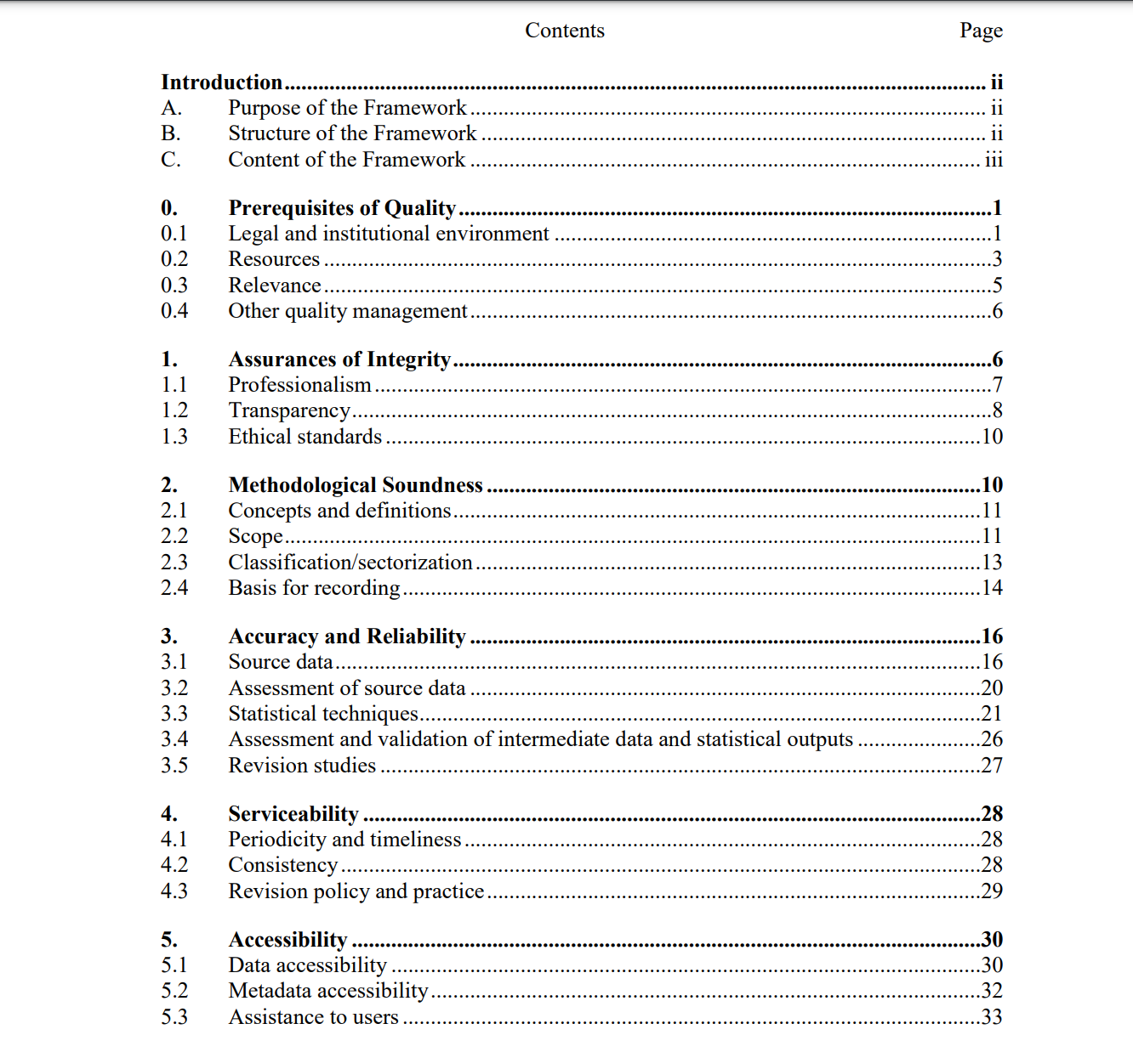
IMF Data Quality Assessment Framework for National account Statistics-DQAF
Right click> open link

Slide 11
Programme
Efficiency and sustainability of the programme rest on the agreed principles
  Strategic planning
  Coordination, monitoring and reporting
  Improving statistical systems

Slide 12
Regional implementation programme for the 2008 SNA
Regional commissions
Have prepared respective regional programmes and strategies which are broadly aligned with the objectives and principles of the global programme
Examples
  ECA’s African Strategy on the implementation of the 2008 SNA
  ECE’s Implementation of the 2008 SNA in Eastern Europe, Caucasus and Central Asia, South East Europe and Mongolia
  ECLAC’s 2008 SNA and SEEA 2012 implementation plan for Latin America and the Caribbean
  ESCAP’s Regional Programme for the Improvement of Economic Statistics in Asia and the Pacific will help to produce a core set of economic statistics for compiling national accounts under the 2008 SNA
  ESCWA’s Implementation Strategy for 2008 SNA and Economic Statistics in the Arab Region

Slide 13
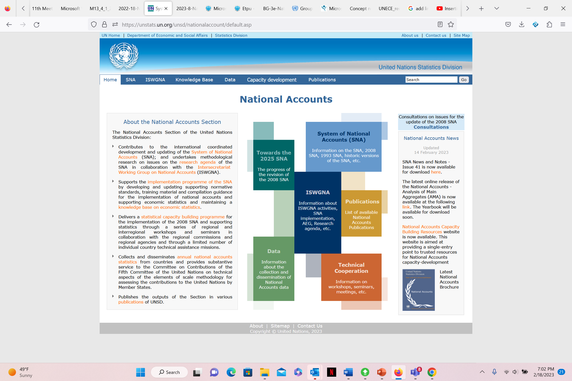
Right click> open link

Slide 14
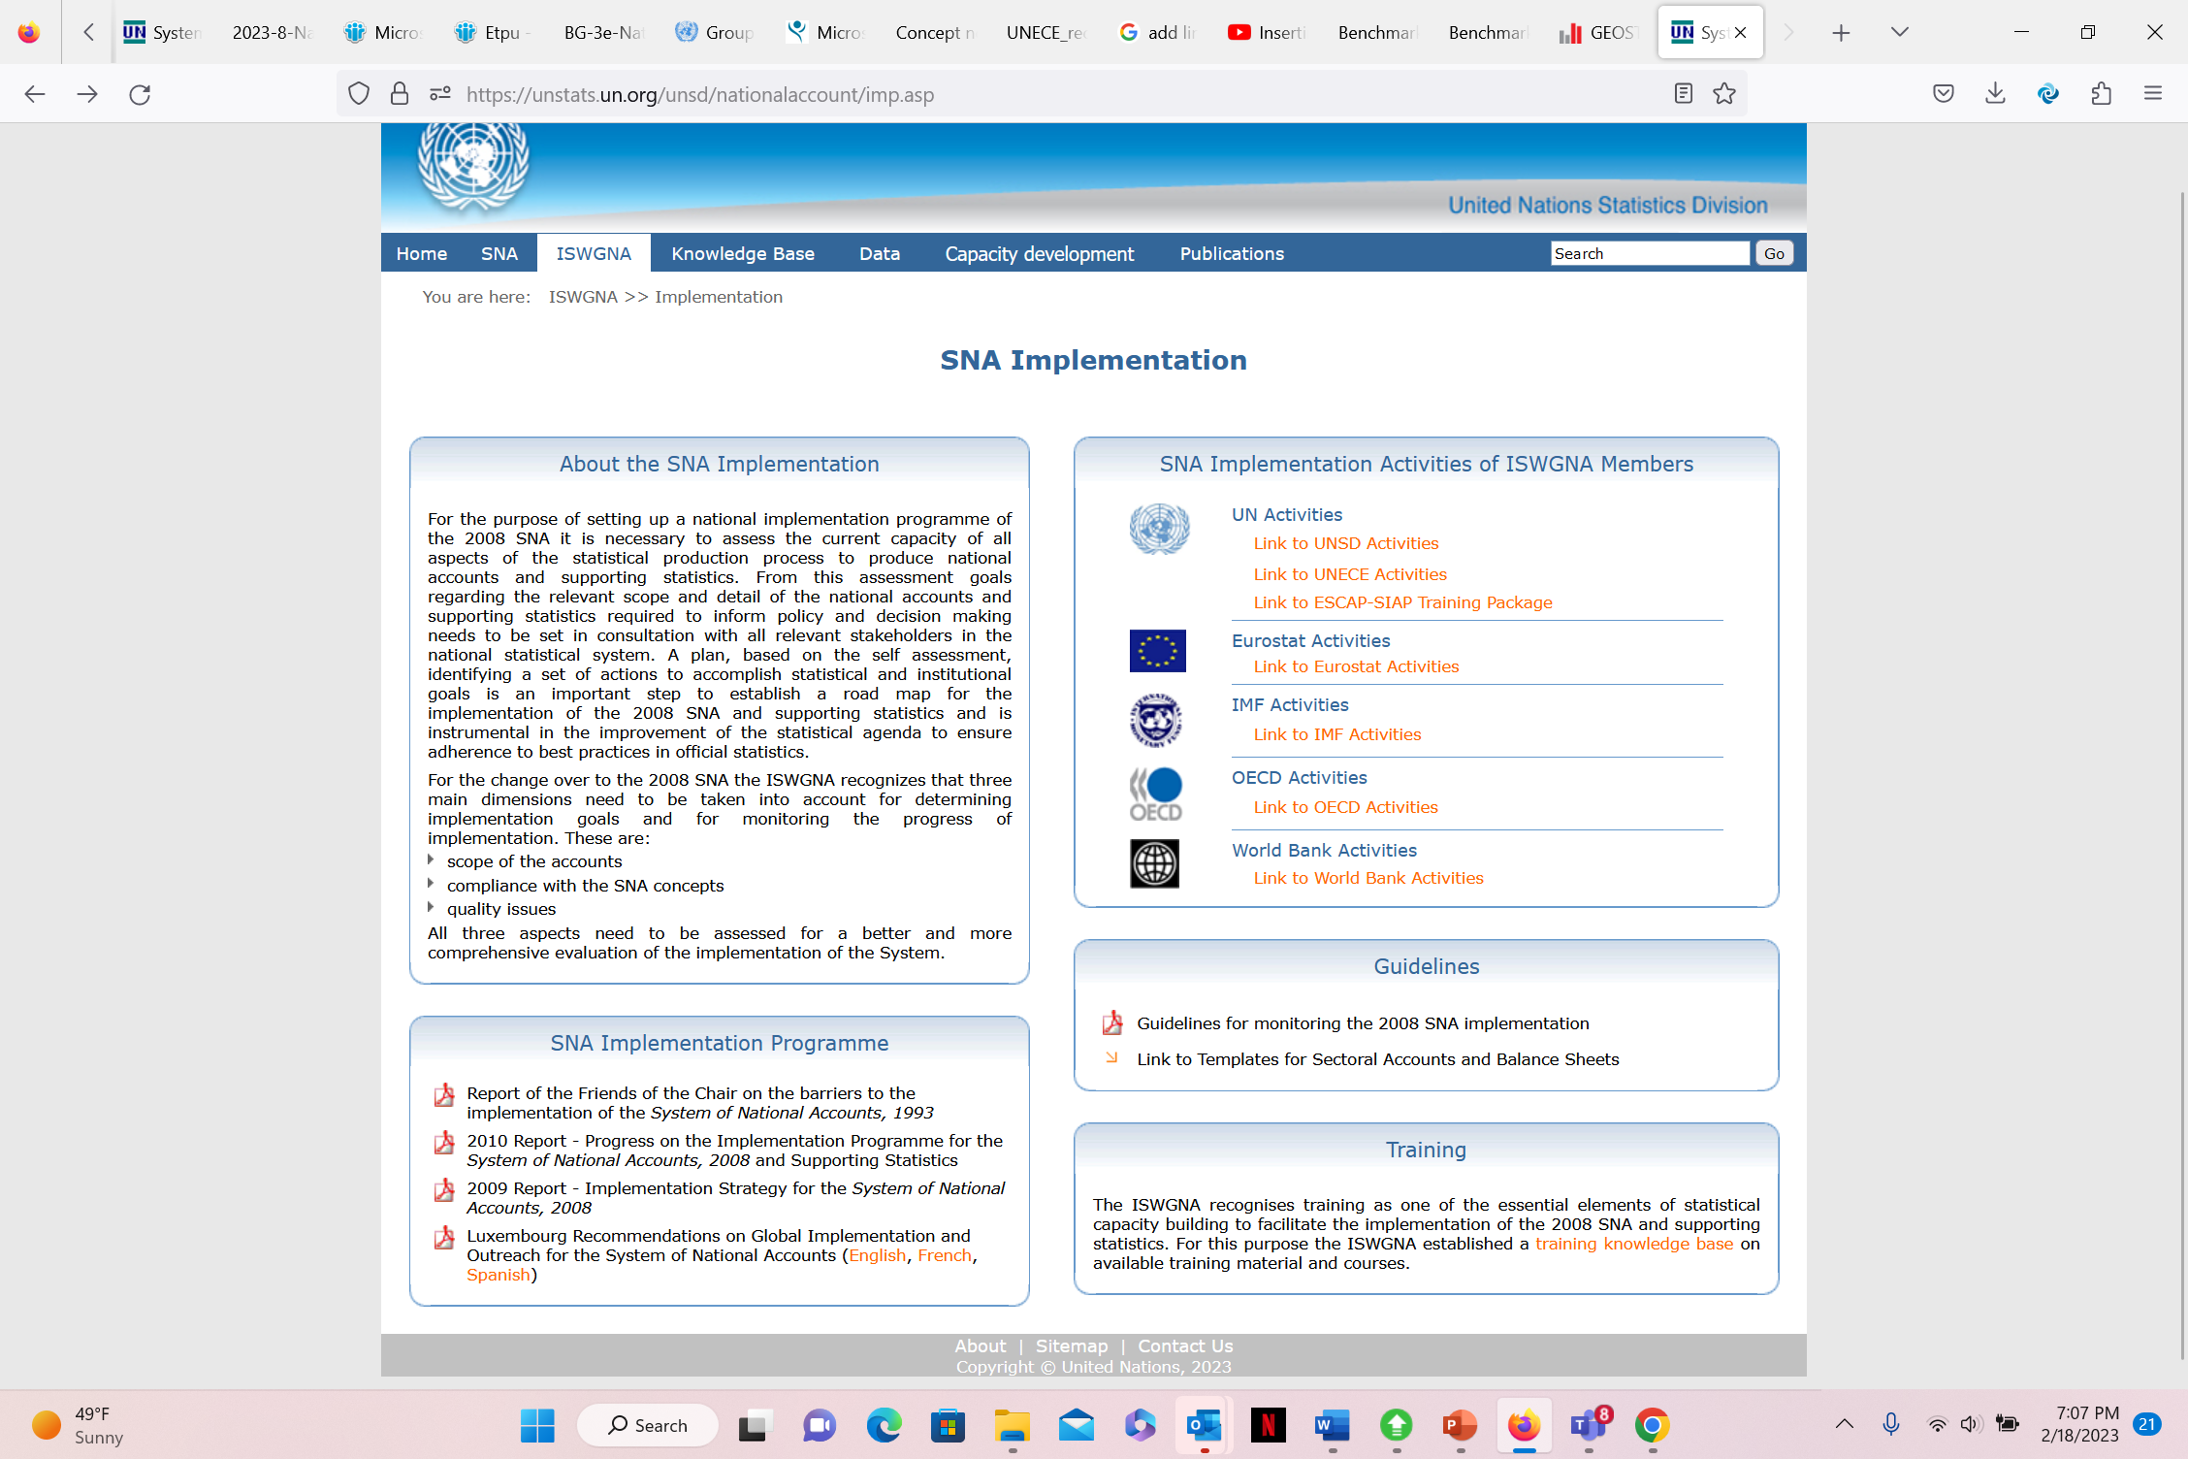
Right click> open link

Slide 15
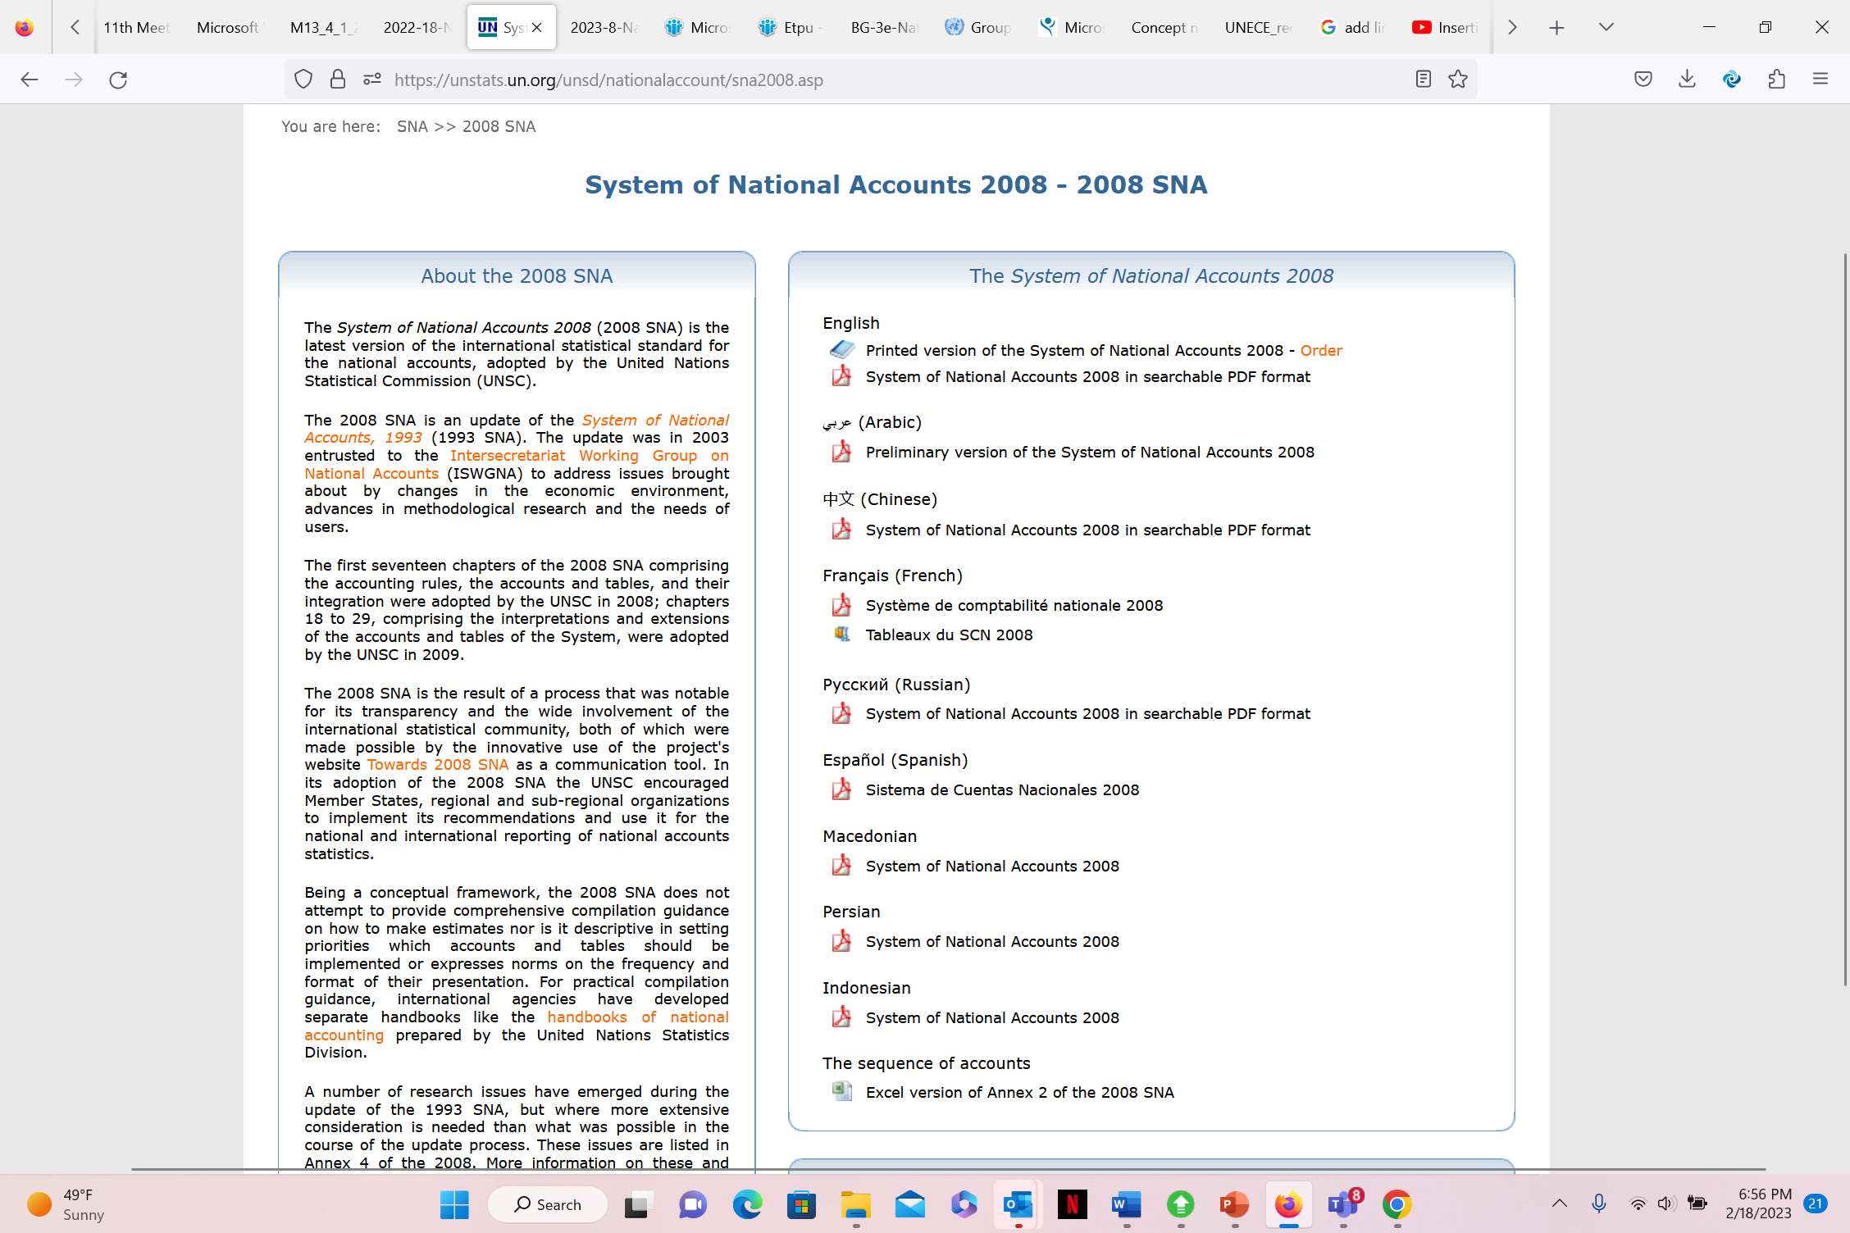
Right click> open link

Slide 16
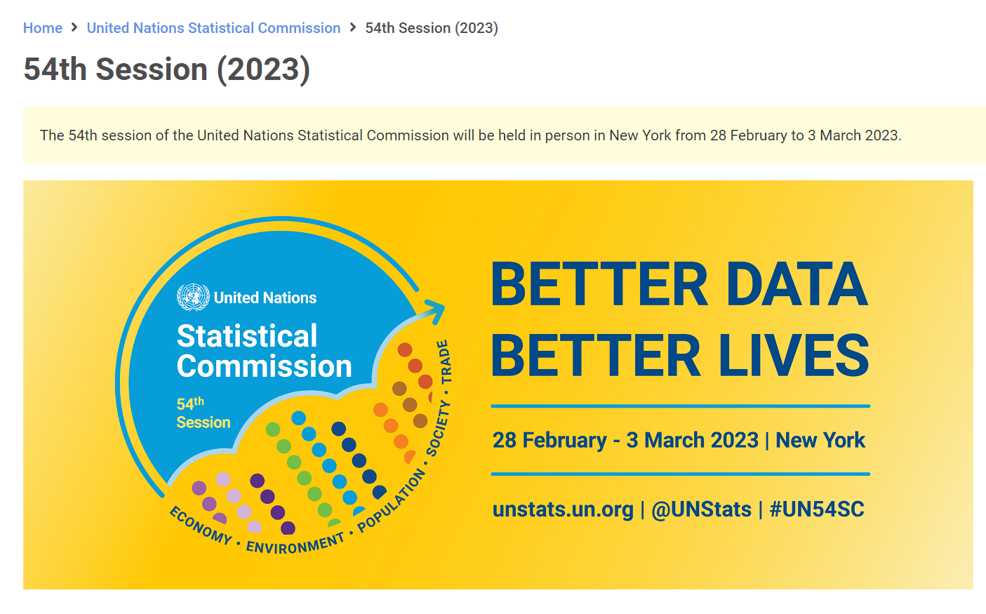
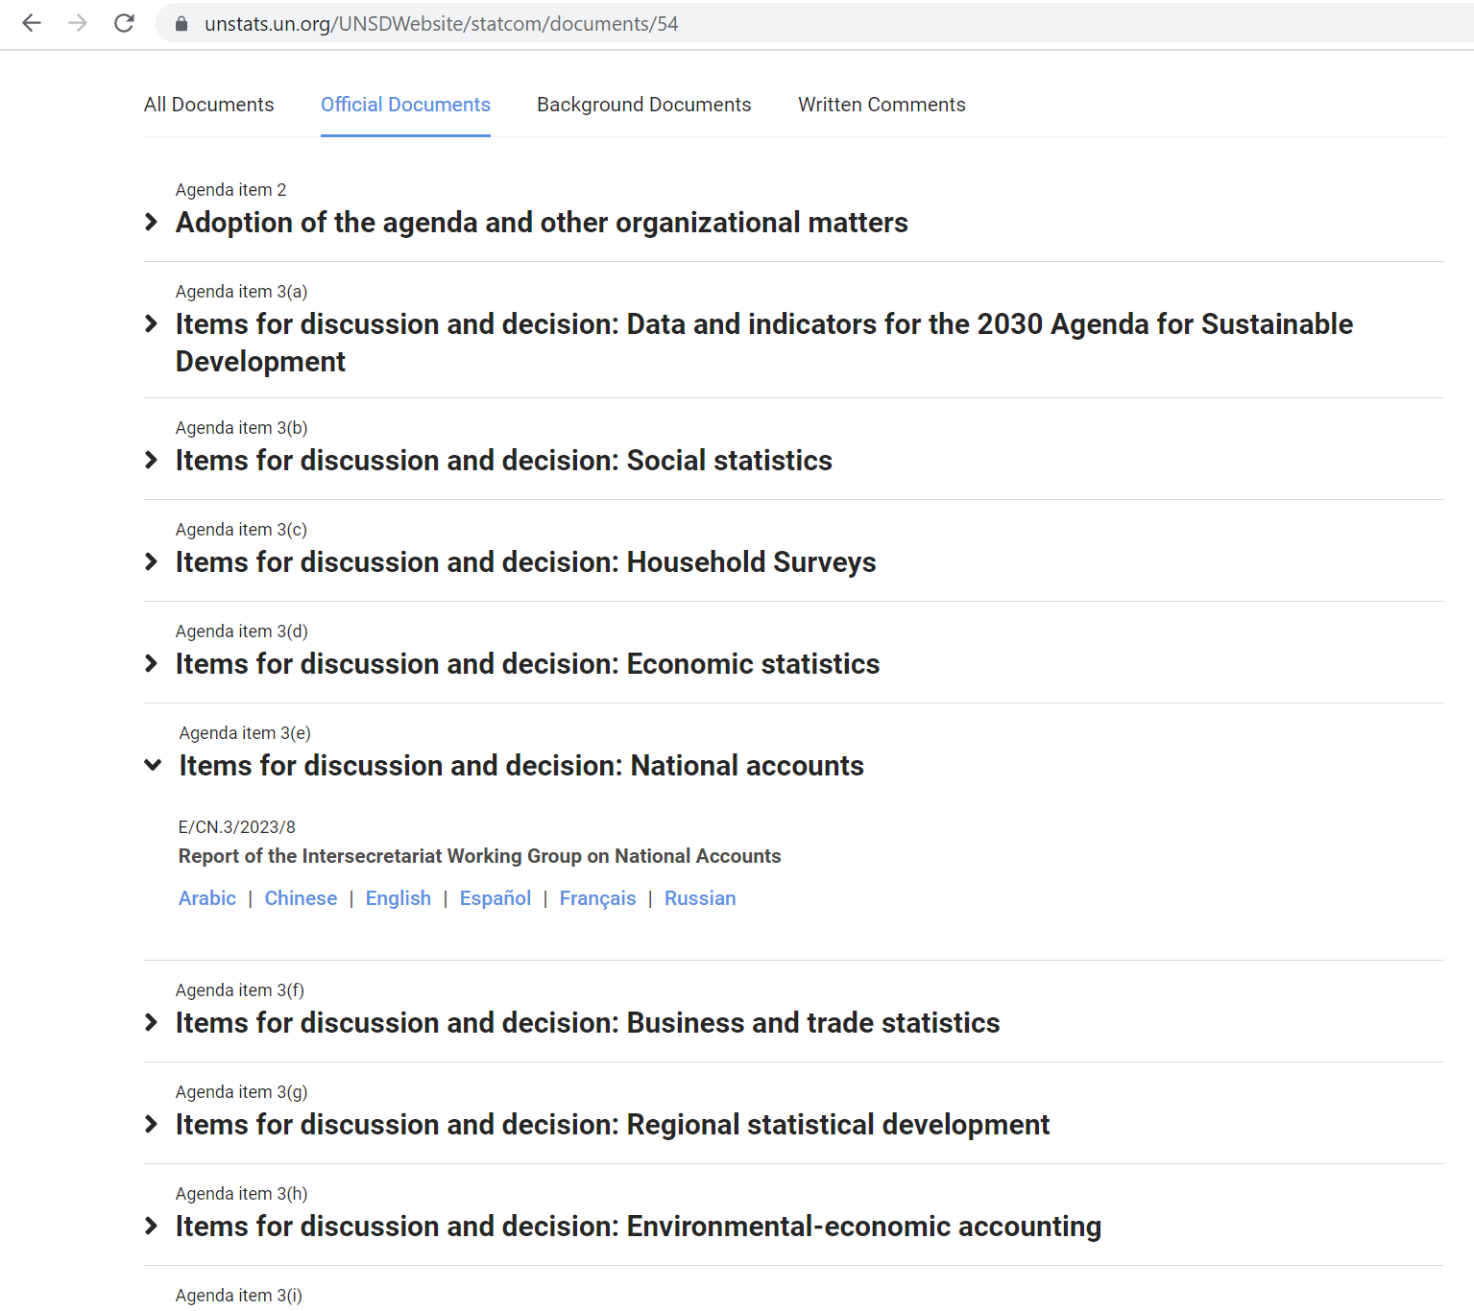
Right click> open link

Slide 17
Reporting of annual national accounts data
54th UNSC (2023)
The evaluation is limited to the availability and scope of official annual national accounts data.

Slide 18
Reporting of annual national accounts data
54th UNSC (2023)
National accounts data were submitted to the Statistics Division by 165 Member States during the 2022 reporting period.
  170 received during the 2021 reporting period.
Notes:
It should be noted that the same Member States do not always report every year. The timeliness of data in the 2022 reporting period has remained the same as in the 2021 reporting period, with 115 Member States submitting data for the year 2021.

Slide 19
Reporting of annual national accounts data
54th UNSC (2023)
There is still a relatively large number of Member States that do not comply with the minimum required scope and detail of national accounts data.
Most of these Member States also have outdated benchmark estimates, which severely impact the quality of their national accounts data.

Slide 20
Conceptual compliance with either the 1993 or the 2008 SNA
188 Member States in 2022, with 123 Member States having implemented the 2008 SNA as at the end of 2022.
97 Member States in 2007
Only five Member States are deemed to compile their national accounts according to the 1968 SNA.
Notes:
The first group includes Member States that have implemented the 2008 SNA without necessarily having implemented the 1993 SNA.

Slide 21
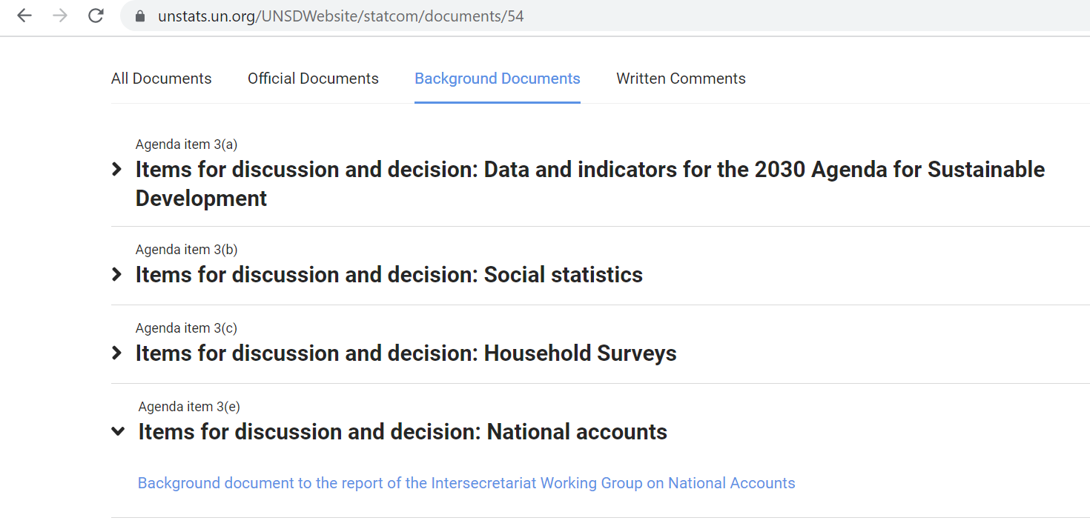
Right click> open link

Slide 22
UNSC 54th -Background document
(2018-2022)
Considering the responses in any of the last five reporting periods (2017 to 2021)
95 per cent of the Member States (184 countries) reported national accounts data to the UNSD.
*includes all developed countries and 94 per cent of developing countries

Slide 23
UNSC 54th -Background document
(2018-2022)
In the 2021 reporting period, seven Member States submitted national accounts data according to the 2008 SNA for the first time.
Bangladesh, Belize, Botswana, Chad, Saint Vincent and the Grenadines, Seychelles and Tunisia implemented the 2008 SNA.

Slide 24
UNSC 54th -Background document
(2018-2022)
Reported data shows that 97 per cent of Member States (188 countries) have implemented the 1993 SNA or the 2008 SNA up to the 2021 reporting period.
  Of those, 123 Member States have submitted national accounts data compiled according to the 2008 SNA.

Slide 25
UNSC 54th -Background document
(2018-2022)
All developed economies and 138 of the 143 (97 per cent) developing countries have reported national accounts data according to the 1993 SNA or 2008 SNA methodology.
Specifically,
52 (96 per cent) African countries;
33 (100 per cent) Latin American and Caribbean countries;
41 (93 per cent) Asian countries; and
12 (100 per cent) Oceanic countries have implemented the 1993 SNA or the 2008 SNA.
The rate of implementation the 1993 SNA or the 2008 SNA by the least developed countries (LDC), landlocked developing countries (LLDC), and small island developing states (SIDS) have been progressing significantly, and stood at with 93 per cent, 100 per cent and 100 per cent respectively in 2021.

Slide 26
Major challenges
Political support and commitment
Data limitations
How to do backcasting
How to communicate changes

Slide 27
Major challenges
Political support and commitment
Senior government officials may lack conviction in the value of national accounts data for economic policy due to misplaced perceptions of their
  Accuracy
  Timeliness
  Frequency
Even governments which understand the importance of national accounts for policy formulation and monitoring may not prioritize funding to national statistical offices
The result is a lack of political support and commitment to invest in sufficient resources to implement 2008 SNA

Slide 28
Major challenges
Data resource limitations
Routine surveys are costly
Survey costs may go higher due to
  Implementation of 2008 SNA to
    Incorporate implementation of standards such as ISIC, CPC, etc.
    Incorporate activities of non-observed economy and informal economy to increase exhaustiveness of GDP
    Collect input data to calculate merchanting and goods for processing
    Collect input data for research and development…
A less costly alternative to surveys is administrative data

Slide 29
Major challenges
Data resource limitations
Countries have difficulty in
  Accessing administrative data (for example, legal constraints in the case of tax data)
  Maintaining business registers which will allow proper identification of enterprises involved in
    Merchanting
    Goods for processing
  Obtaining value of defense weapons systems (due to confidentiality reasons) and research and development and developing price deflators for these fixed assets
  Collecting input data to calculate value of merchanting and goods for processing and developing price deflators for these activities

Slide 30
Major challenges
Data limitations
All activities within the SNA production boundary should be included
Lack of coverage and data limitations causes problems for users in terms of
  Levels
    GDP and other data biased downward
  Trends
    Biases in trend estimates can be expected if the economic activities missing from GDP grow at different rates from those included
For statisticians, lack of coverage causes imbalances in the internal consistency of the accounts
Affects all countries, but developing ones to a greater extent

Slide 31
How to do backcasting
Implementing 2008 SNA may introduce breaks in the time series data, which implies the need to do backcasting to ensure long consistent time series data
Issues to consider in backcasting include
  What techniques to use
    Recompilation from source data
    Splicing
    Proxy indicators
    A combination of the above techniques
  How far back to backcast
  At what detail to backcast
  Availability of resources and time
  Knowledge of structural changes, business cycles, major economic events, changes in government policy…

Slide 32
How to communicate changes
There is a challenge in identifying which users to communicate the 2008 SNA changes to
Most NSOs have processes in place to communicate national accounting changes to
  Monetary authorities
  Various levels of government
  Large private financial institutions or
  Economic forecasters
However, processes may be lacking in communicating these changes to
  Academia
  Journalists
  Private enterprises and
  General public
New lines of communication may be needed

Slide 33
How to communicate changes
Users will need substantial lead time to incorporate the new national accounts information to
  Adapt their forecasting and analytical models
  Map the new data into their models
  Devote time to understanding the new data to ensure that they maximize their analytical usefulness
Another challenge is to overcome the perception that the 2008 SNA changeover is intended to correct errors within the national accounts

Slide 34
Holistic solution
Adopt a national strategic planning framework
Within the framework, develop national strategic statistical plans which
  Incorporate priorities for the development of national accounts
  Incorporate improvements to national institutional arrangements for compiling national accounts
  Improve source data collection, including overcoming legal and other obstacles to statistical use of administrative data
  Fit with government budget process to improve the chance of securing funding
  Incorporate backcasting techniques
  Incorporate effective communication strategy

Slide 35

ADB (technical assistance and training) in SNA 2008 implementation
Ad hoc or scheduled?
Main areas/topics
Modality: Field visits, ADB premises, e-learning?
Cooperation with other regional/international organizations
Challenges from your perspective

Slide 36
Annex 1 - Milestones
Implementation milestones | Complementary data systems | SNA-related data and development
Pre-SNA phases | Basic data on production, turnover, consumption, investment, exports and imports Consumer and producer price indices Balance of payments goods and services account Monetary survey statistics
Milestone 1. Basic indicators of gross domestic product (GDP) - Final expenditures on GDP current and constant prices - GDP by industry at current and constant prices | Supply and use table worksheets Balance of payments: current, capital and financial accounts Government finance statistics (GFS) transaction accounts
Milestone 2. Gross national income and other primary indicators - For rest of the world, external account of primary incomes and current transfers - Capital and financial accounts | Capital stock statistics International investment position GFS transactions and stocks in assets and liabilities Monetary and financial statistics | Quarterly national accounts Regional accounts Satellite accounts for environment and other satellite accounts Input-output analysis

Slide 37
Annex 1 - Milestones
Implementation milestones | Complementary data systems | SNA-related data and development
Milestone 3. Institutional sector accounts: first step: for all institutional sectors Production account for general government Generation of income, Allocation of primary income, Secondary distribution income, Use of disposable income, Capital and financial accounts | Same as for milestone 2 | Same as for milestone 2
Milestone 4. Institutional sector accounts: intermediate step 1: for all institutional sectors Generation of income Allocation of primary income Secondary distribution of income Use of disposable income Capital accounts | Same as for milestone 2 | Same as for milestone 2
Milestone 5. Institutional sector accounts: intermediate step 2: for all institutional sectors Financial account | Same as for milestone 2 | Same as for milestone 2
Milestone 6. Institutional sector accounts: final step: for all institutional sectors Other changes in assets account Balance sheet | Same as for milestone 2 | Same as for milestone 2

Slide 38
Annex 2 – Data sets
NAQ Table Number |  | Annual Accounts | Quarterly Accounts
GDP, value added and employment
 | Nominal and volume measure of GDP by industry or by expenditure components | Minimum requirement | Minimum requirement
1.1 | Expenditures of the GDP in current prices | Minimum requirement | Optional Minimum Requirement
1.2 | Expenditures of the GDP in constant prices | Minimum requirement | Optional Minimum Requirement
2.1 | Value added and GDP in current prices by industry | Minimum requirement | Optional Minimum Requirement
2.2 | Value added and GDP in constant prices by industry | Minimum requirement | Optional Minimum Requirement
2.3 | Value-added components by industry, current prices | Minimum requirement | Recommended
 | Employment by industry | Minimum requirement | Recommended

Slide 39
Annex 2 – Data sets
NAQ Table Number |  | Annual Accounts | Quarterly Accounts
Integrated accounts and tables, including integrated satellite accounts
1.3 / 4.1 | Accounts for the total economy (until net lending) | Minimum requirement | Minimum requirement
 | Supply and use table | Recommended | Desirable
5.1 | Cross-classification of output/value added by industries and sectors | Recommended
 | Tourism accounts, environmental accounts and other socio-economic accounts | *

Slide 40
Annex 2 – Data sets
NAQ Table Number |  | Annual Accounts | Quarterly Accounts
Purpose classification of expenditures
3.1 | General government final consumption (and other) expenditure by purpose in current prices | Recommended
 | General government final consumption expenditure by purpose at constant prices | *
3.2 | Individual consumption (and other) expenditures by purpose in current prices | Recommended
 | Individual consumption expenditures by purpose at constant prices | *
 | Purpose classification of intermediate and final consumption across all sectors | *

Slide 41
Annex 2 – Data sets
NAQ Table Number |  | Annual Accounts | Quarterly Accounts
Institutional sector accounts (until net lending)
4.2 | Rest of the world accounts (until net lending) | Minimum requirement | Minimum requirement
4.3 | Non-financial corporations sector accounts (until net lending) | Minimum requirement | Recommended
4.4 | Financial corporations accounts (until net lending) | Minimum requirement | Recommended
4.5 | General government sector accounts (until net lending) | Minimum requirement | Recommended
4.6 | Household sector accounts (until net lending) | Minimum requirement | Recommended
4.7 | Non-profit institutions serving households sector accounts (until net lending) | Minimum requirement | Recommended
Financial accounts
4.1 – 4.7 | Financial accounts for all sectors | Recommended | Desirable
Balance sheets and other changes in asset accounts
 | Balance sheets, revaluation and other volume changes in asset accounts for all sectors | Recommended | Desirable

Slide 42
Annex 3 – Conceptual Compliance Questionnaire for the 2008 SNA
Question: Does your country’s reported national accounts data currently include estimates for: | Yes | No | Partly | na
Elements affecting the level of GDP
Gross capital formation (GCF)/output
1. the entire defence expenditure incurred by government included in the GCF?
2. consumption of fixed capital measured on all government fixed assets (airfields, roads, hospitals, docks, dams and breakwaters and other forms of construction except structures) including military weapon systems?
3. the expenditure on Research and Development included in the output and GCF?
4. all (successful and unsuccessful) mineral exploration expenditure capitalized?
5. purchases of computer software expected to be used for more than a year included in GCF?
6. expenditure on software development on own account expected to be used for more than a year and for sale included in GCF and output?
7. the expenditure on all databases expected to be used for more than a year, whether purchased on the market or developed in-house, included in the GCF and output?

Slide 43
Annex 3 – Conceptual Compliance Questionnaire for the 2008 SNA
Question: Does your country’s reported national accounts data currently include estimates for: | Yes | No | Partly | na
8. expenditure on entertainment, literary or artistic originals included in the GCF and on their development included in the output?
9. expenditure on valuables included in the GCF?
10. the natural growth of cultivated forests included in output in GCF?
11. the output of financial intermediation services indirectly measured (FISIM) calculated on loans and deposits only using interest rates on deposits and loans and a reference rate of interest?
12. the output of FISIM allocated to users?
13. the production of all goods that are produced by households whether for sale or not —included in the output?
14. the activity of the own-account money lenders included in the output?
15. the value of output of goods and services produced by households and corporations for own final use, when estimated on cost basis, include a return to capital?
16. the output of non-life insurance services in the event of catastrophic losses estimated using adjusted claims and adjusted premium supplements?

Slide 44
Annex 3 – Conceptual Compliance Questionnaire for the 2008 SNA
Question: Does your country’s reported national accounts data currently include estimates for: | Yes | No | Partly | na
17. the output of the Central Bank estimated separately for financial intermediation services, monetary policy services and supervisory services overseeing financial corporations?
18. the unit undertaking purely ancillary activity, located in a geographically separate location from establishments it serves, treated as a separate establishment?
19. the output of the activity of non-autonomous pension funds and unfunded pension schemes separately recognised?
Volume estimates
20. volumes estimated using a chaining procedure on an annual basis?
Social contributions/insurance
21. unfunded social contributions (for sickness, unemployment, retirement etc.) by enterprises imputed as compensation of employees and included as contributions to social insurance?
22. non-life insurance estimates include premium supplements rather than being based just on premiums less claims?
23. life insurance estimates include premium supplements rather than being based just on premiums less claims?

Slide 45
Annex 3 – Conceptual Compliance Questionnaire for the 2008 SNA
Question: Does your country’s reported national accounts data currently include estimates for: | Yes | No | Partly | na
Elements affecting GNI
24. reinvested earnings estimates included in the rest of the world account?
25. foreign workers’ remittances excluded from GNI?
Elements not affecting the level of GDP/GNI
Valuation of output
26.a output and value added measured at basic prices? ª
26.b output and value added measured at producers’ prices? ª
26.c value added measured at factor cost? ª (not part of the 2008 SNA)
27. the goods for processing recorded on a net basis?

Slide 46
Annex 3 – Conceptual Compliance Questionnaire for the 2008 SNA
Question: Does your country’s reported national accounts data currently include estimates for: | Yes | No | Partly | na
Final consumption
28. government final consumption expenditure broken down into individual and collective consumption?
Status of implementation of the 2008 SNA
29. the 2008 SNA has not been implemented in officially reported national accounts, when does the country plan to implement and release data based on the 2008 SNA? (Specify the year.)

Slide 47
Sources
Sim, B., (2017). Status of global and regional implementation of the 2008 SNA and the major challenges. Presented at Regional Workshop on National Accounts and the development of Economic Statistics Infrastructure within the SDGs Framework. 15-18 May, Amman-Jordan.
https://www.unescwa.org/sites/default/files/event/materials/3-2008_sna_implementation.pdf
Di Matteo, I., (2015). Overview of the Implementation of National Accounts at Global Level. Presented at National Accounts Seminar for Latin America and the Caribbean: Regional Implementation of the National Accounts System and the Satellite Accounts. 1-3 December, Santiago-Chile.
https://www.cepal.org/sites/default/files/events/files/2015-semcn-s2-unsd-ilaria-di-matteo.pdf

