Slide 1

Overview:
Towards the 2025 SNA
Webinar Day 2
23 February 2023
Pinar Ucar
SIAP

Slide 2
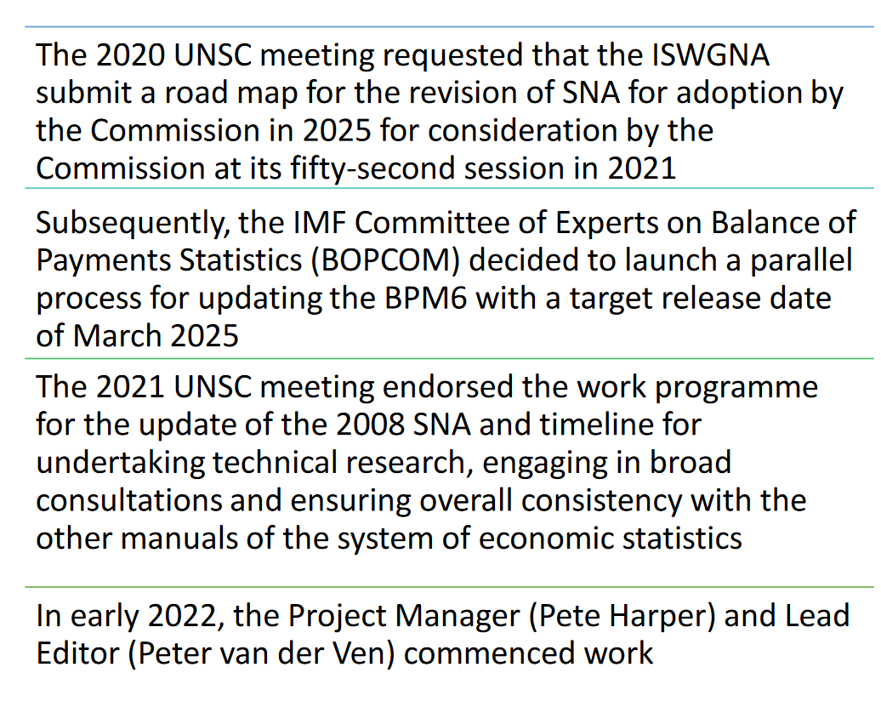
Broad Overview
Notes:
https://unstats.un.org/unsd/nationalaccount/workshops/2022/China/lod.asp

Slide 3
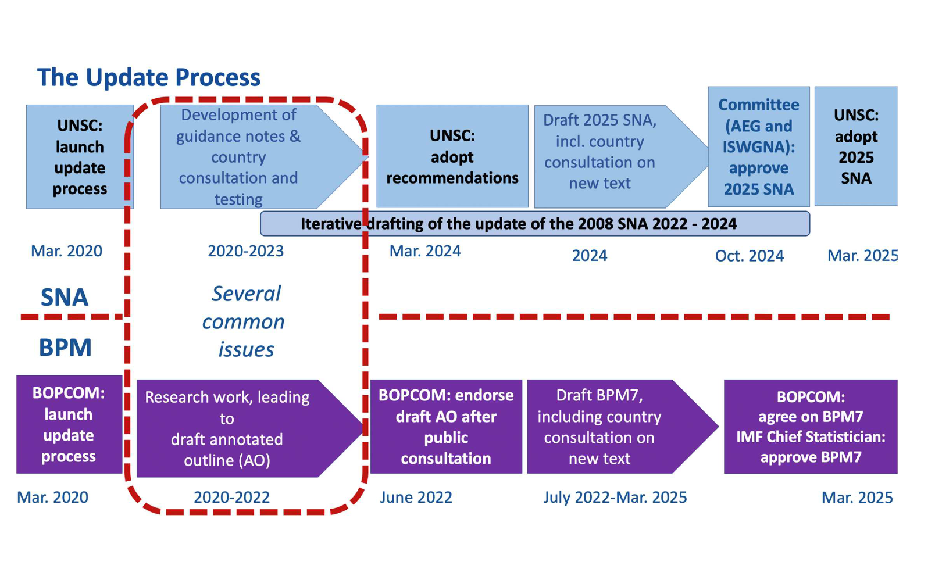
Notes:
https://unstats.un.org/unsd/nationalaccount/workshops/2022/China/lod.asp

Slide 4
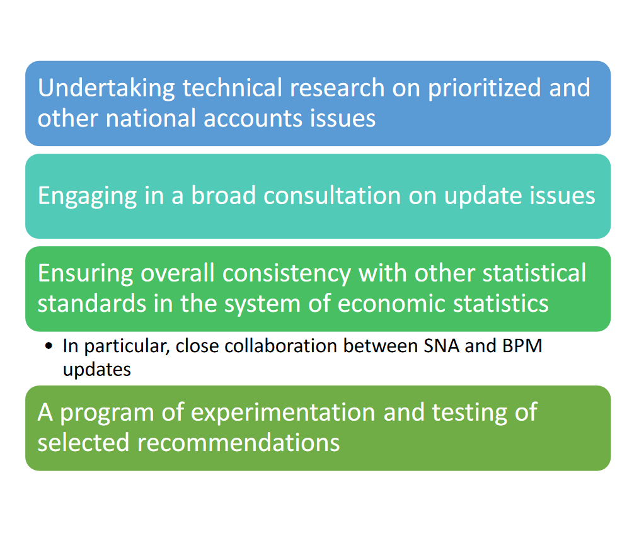
Key features of the Update Process
Notes:
https://unstats.un.org/unsd/nationalaccount/workshops/2022/China/lod.asp

Slide 5
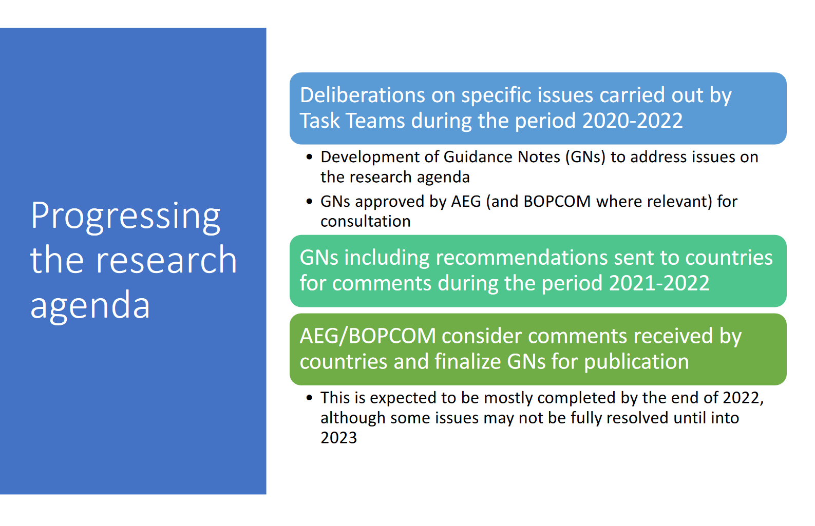
Notes:
https://unstats.un.org/unsd/nationalaccount/workshops/2022/China/lod.asp

Slide 6
Outreach
(a) to keep countries informed and updated on the process of updating the 2008 SNA;
(b) to foster global consultation on recommendations for the update of the 2008 SNA through consultation on the guidance notes, as well as consultation on the draft of the
updated SNA itself; and
(c) to work with countries on the testing and early implementation of new recommendations arising from the guidance notes. The
outreach is supported by dedicated web pages
https://unstats.un.org/unsd/nationalaccount/towards2025.asp

Slide 7
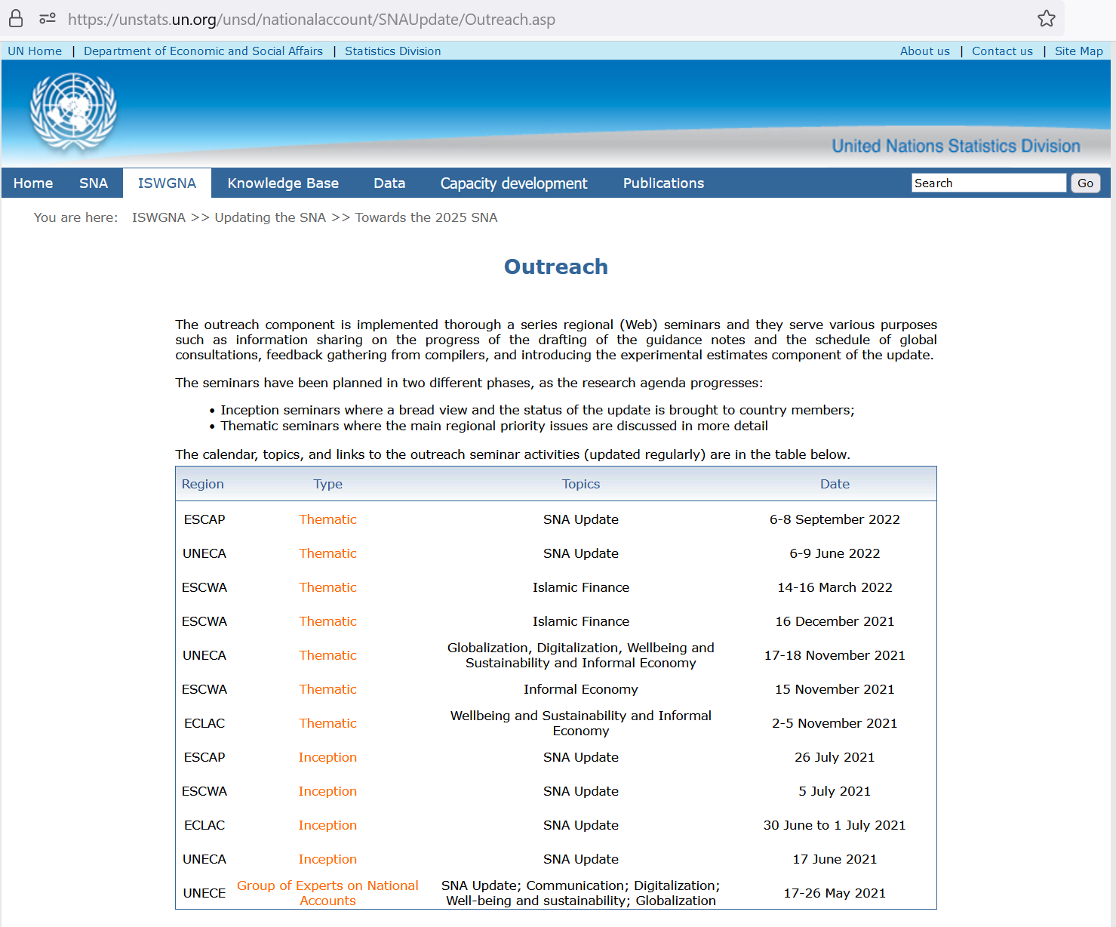
Outreach activities
Right click> open link
Notes:
https://unstats.un.org/unsd/nationalaccount/SNAUpdate/Outreach.asp

Slide 8
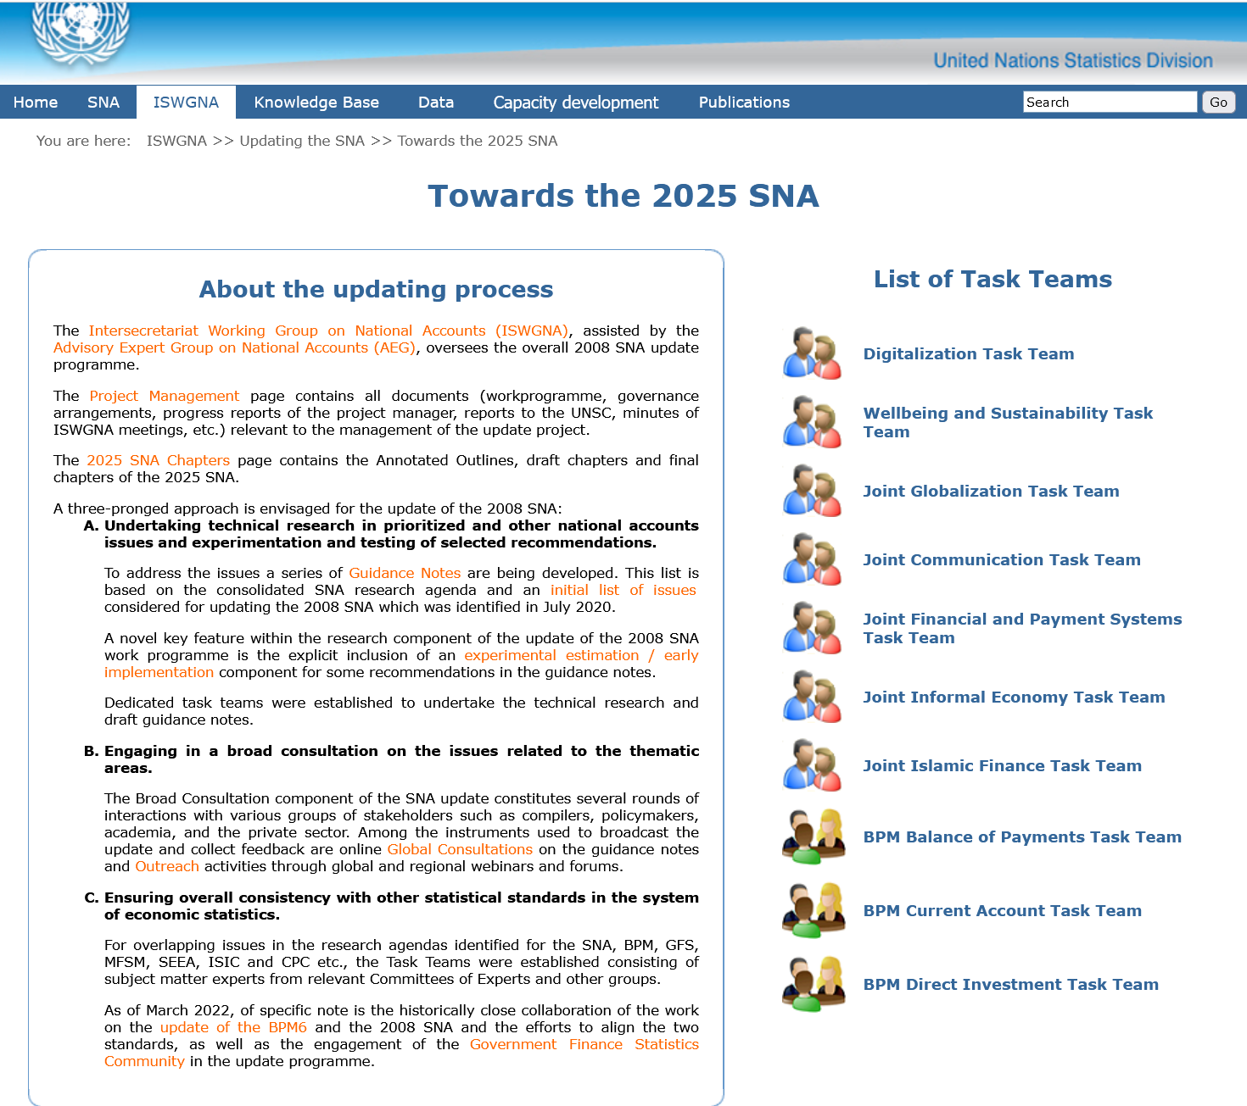
Right click> open link
Notes:
https://unstats.un.org/unsd/nationalaccount/Towards2025.asp

Slide 9
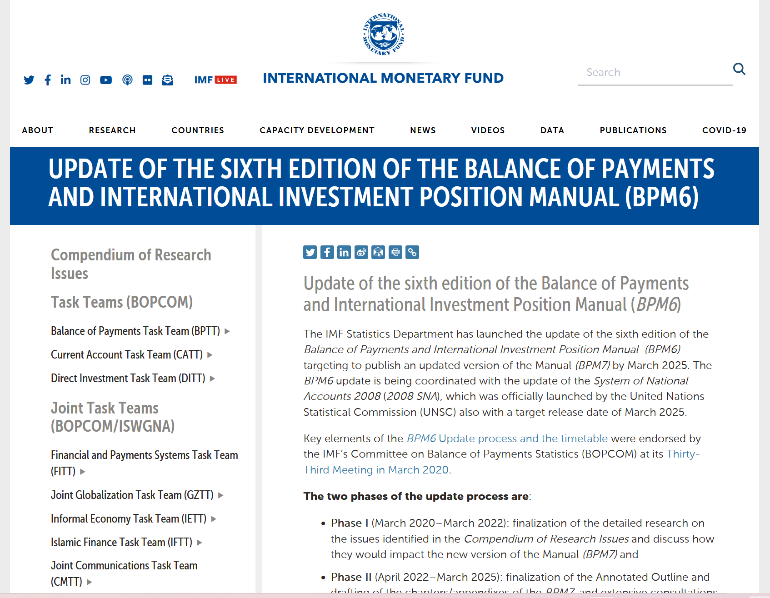
Right click> open link
Notes:
https://www.imf.org/en/Data/Statistics/BPM

Slide 10
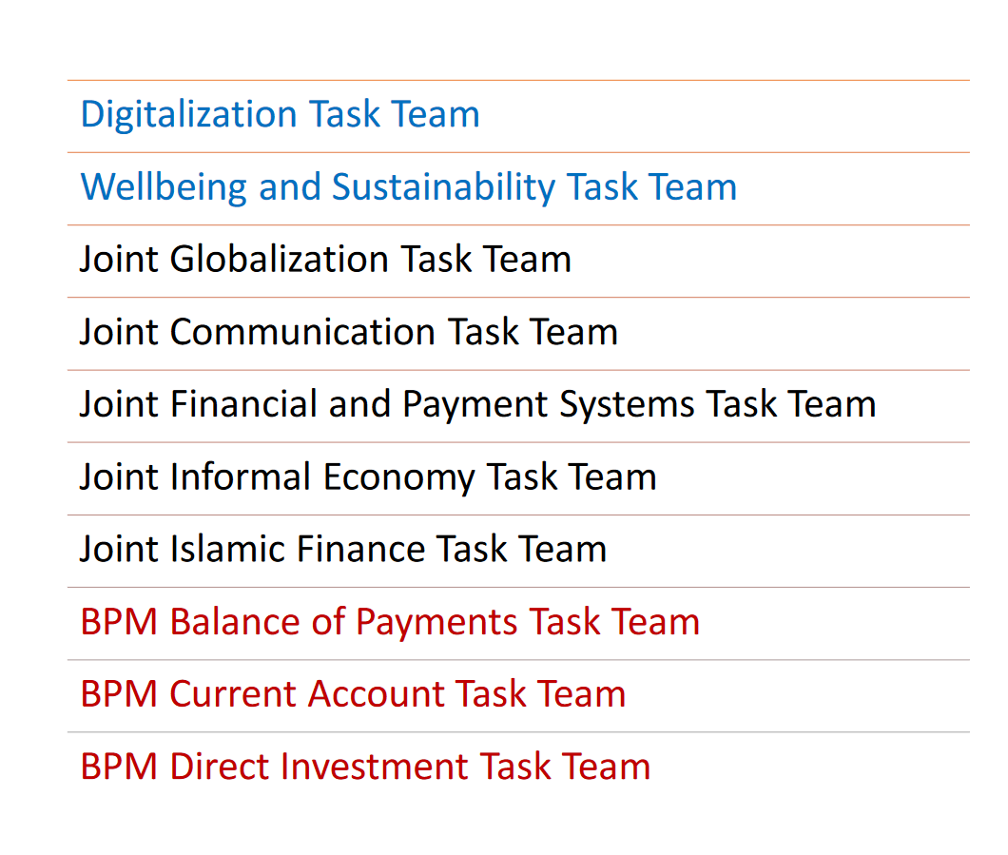
List of Task Teams
Notes:
https://unstats.un.org/unsd/nationalaccount/Towards2025.asp

Slide 11
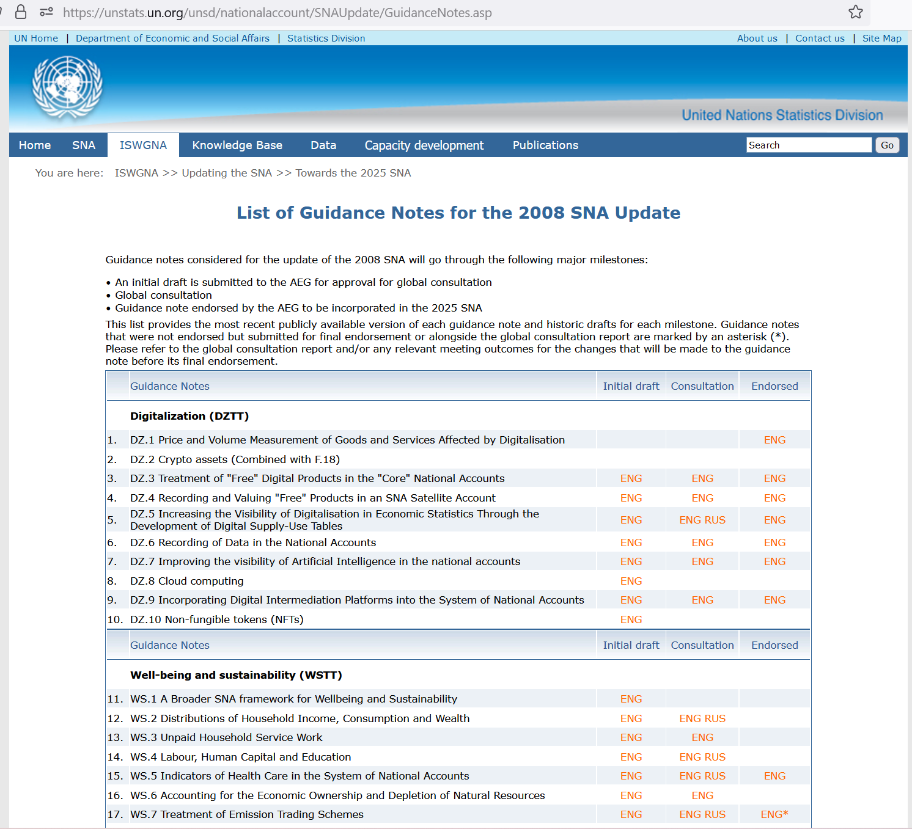
List of GNs
Right click> open link
Notes:
https://unstats.un.org/unsd/nationalaccount/SNAUpdate/GuidanceNotes.asp

Slide 12
Progress of Guidance notes-AEG meeting
17 October 2022, Washington
65 Guidance Notes
33 are finalized or are in the process of being finalized
• For a further 24 GNs, Global Consultation has been completed
• 8 GNs are yet to undergo Global Consultation
Notes:
https://unstats.un.org/unsd/nationalaccount/aeg/2022/M21/M21.asp
https://unstats.un.org/unsd/nationalaccount/aeg/2022/M21/M21_1_Project_Manager_Report_Pres.pdf

Slide 13
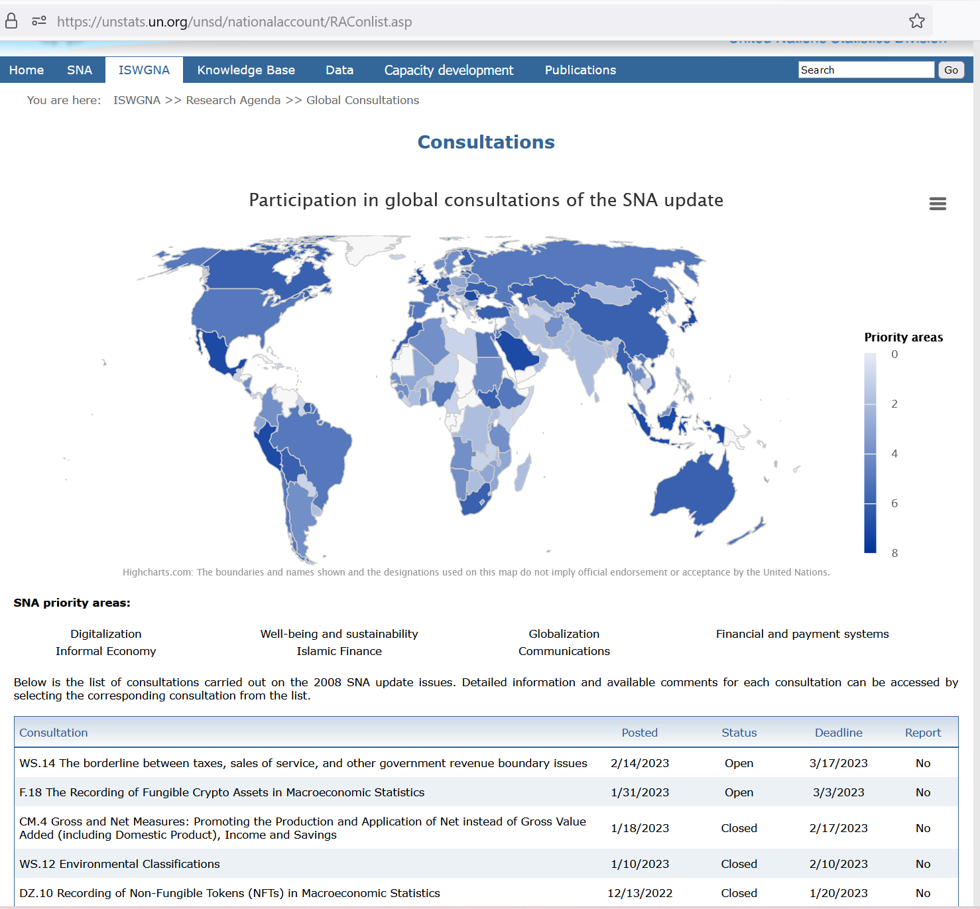
Consultations
Right click> open link
Notes:
https://unstats.un.org/unsd/nationalaccount/RAConlist.asp

Slide 14
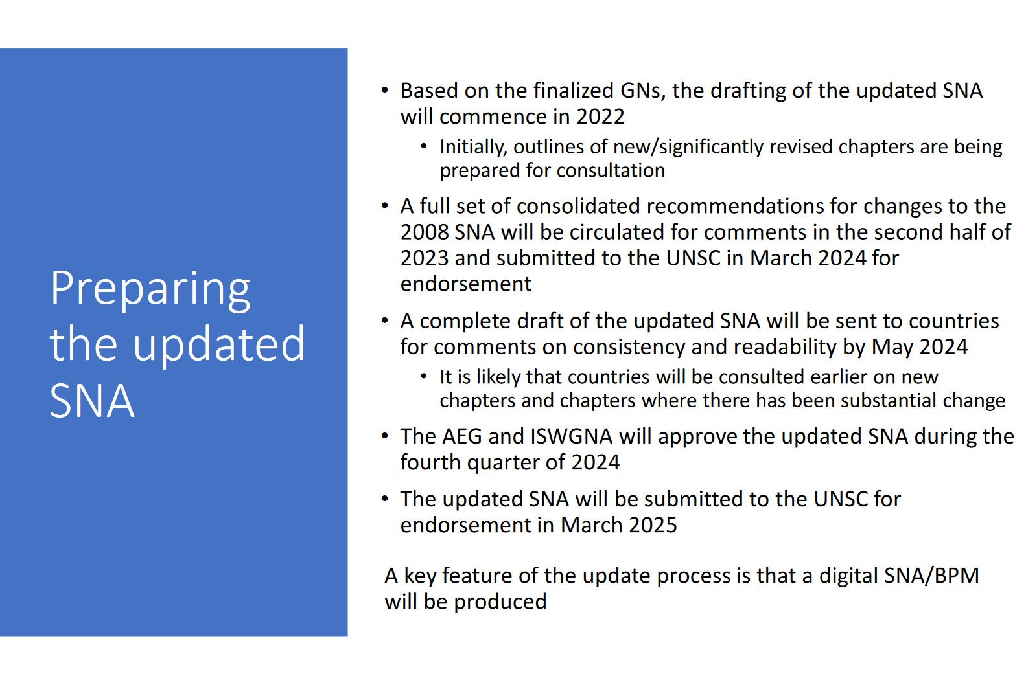
Notes:
https://unstats.un.org/unsd/nationalaccount/workshops/2022/China/lod.asp

Slide 15
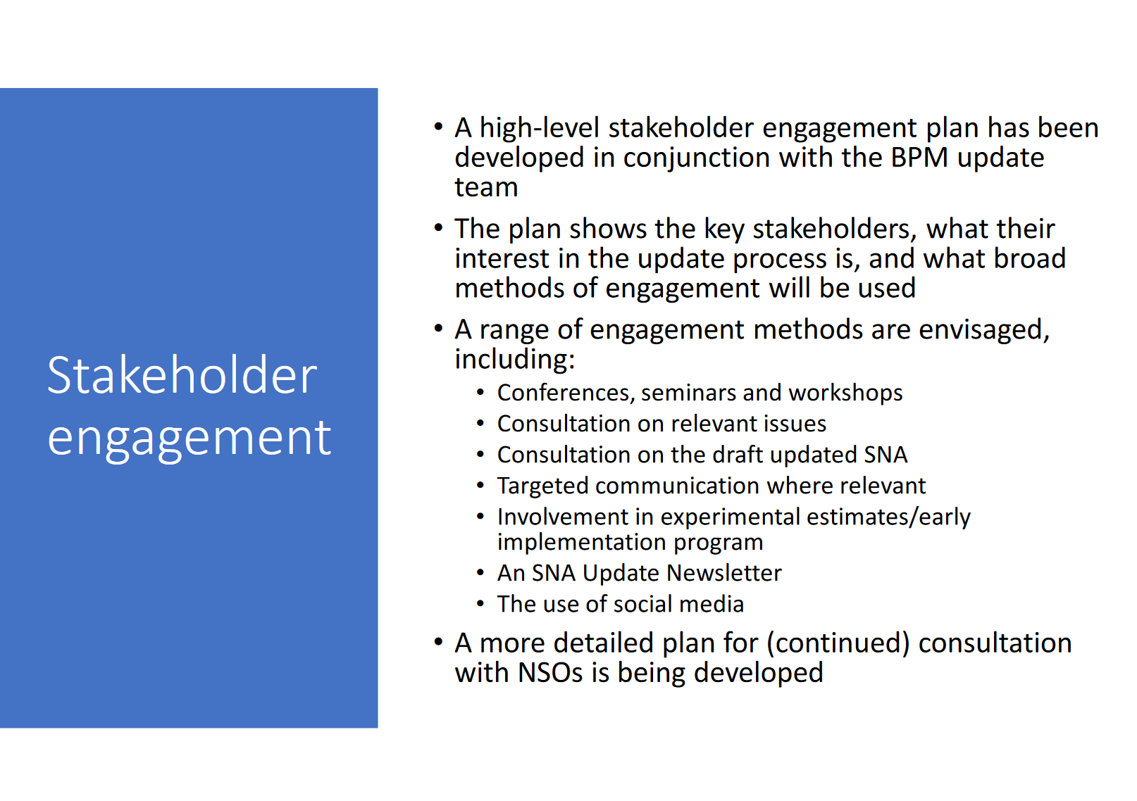
Notes:
https://unstats.un.org/unsd/nationalaccount/workshops/2022/China/lod.asp

Slide 16
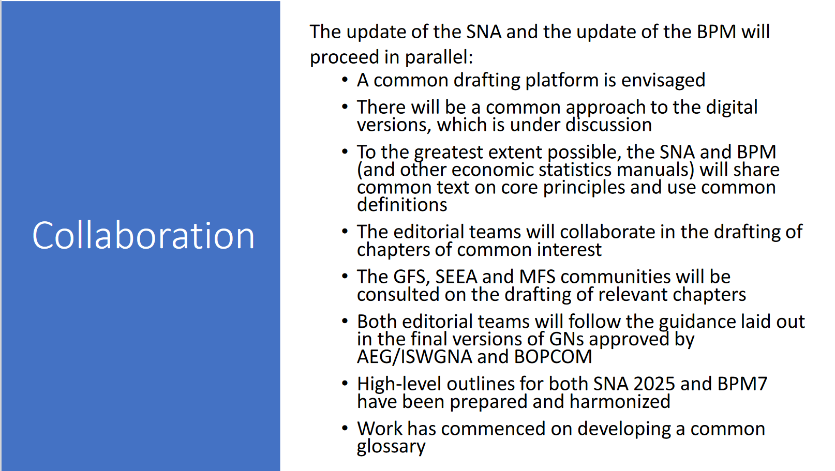
Notes:
https://unstats.un.org/unsd/nationalaccount/workshops/2022/China/lod.asp

Slide 17
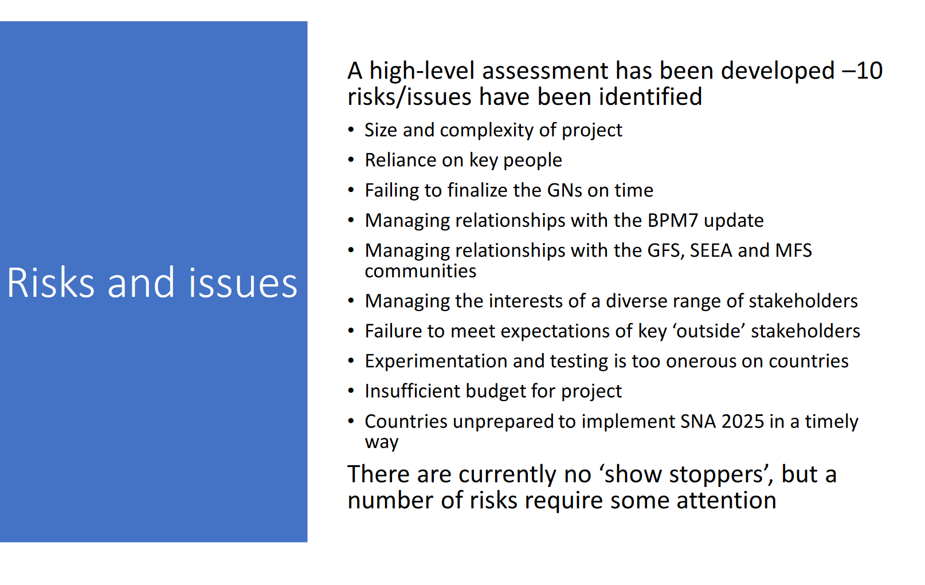
Notes:
https://unstats.un.org/unsd/nationalaccount/workshops/2022/China/lod.asp

Slide 18
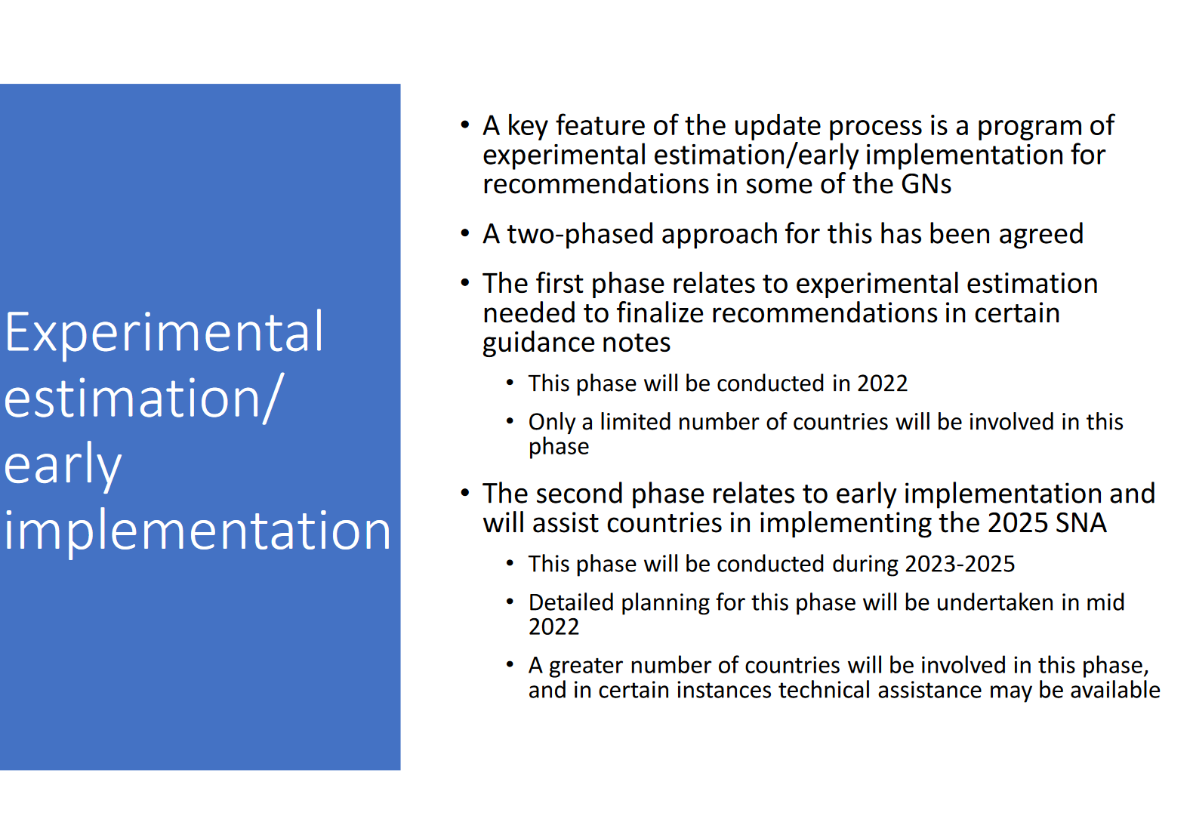
Notes:
https://unstats.un.org/unsd/nationalaccount/workshops/2022/China/lod.asp

Slide 19
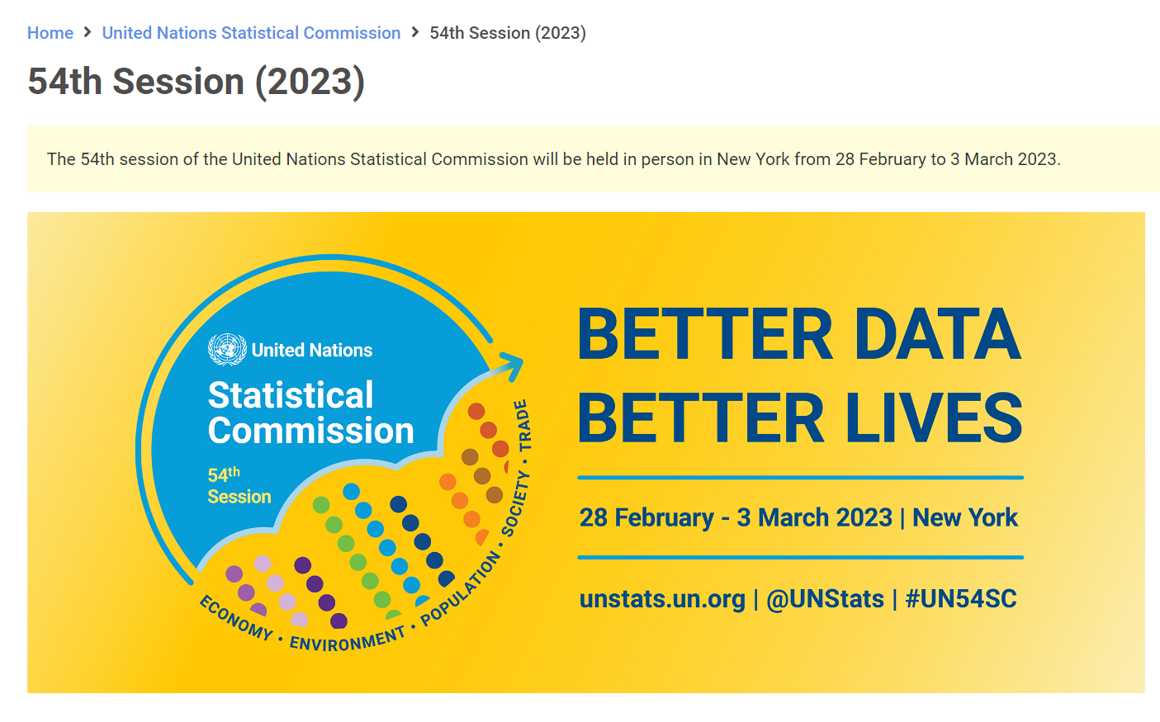
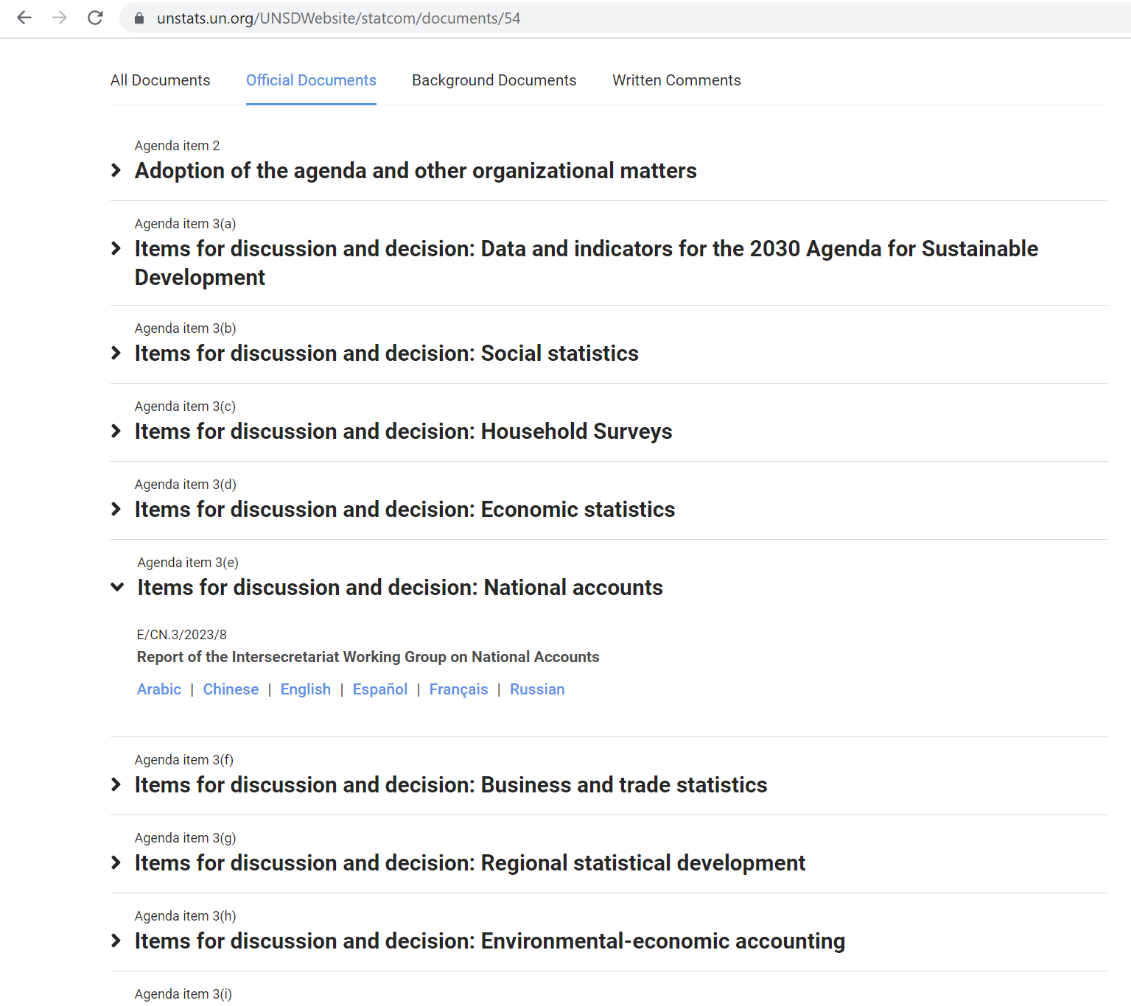
Right click> open link
Notes:
https://unstats.un.org/UNSDWebsite/statcom/54

Slide 20
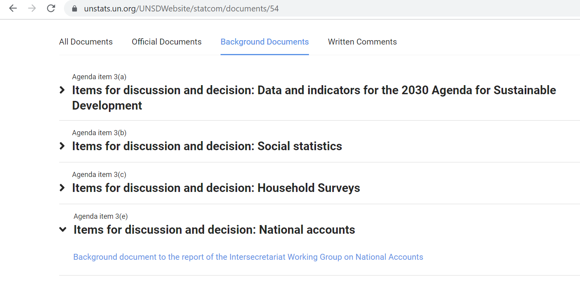
Right click> open link
Notes:
https://unstats.un.org/UNSDWebsite/statcom/54

Slide 21
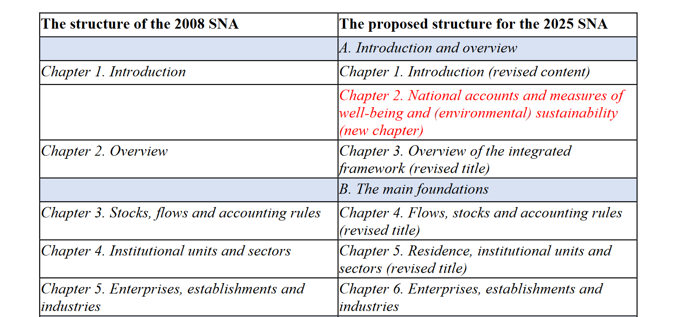
Table: Proposal for the overall structure of the 2025 SNA
New chapters are highlighted in red, while chapters requiring substantial revisions are highlighted in green.
Notes:
https://unstats.un.org/UNSDWebsite/statcom/session_54/documents/BG-3e-NationalAccounts-E.pdf

Slide 22
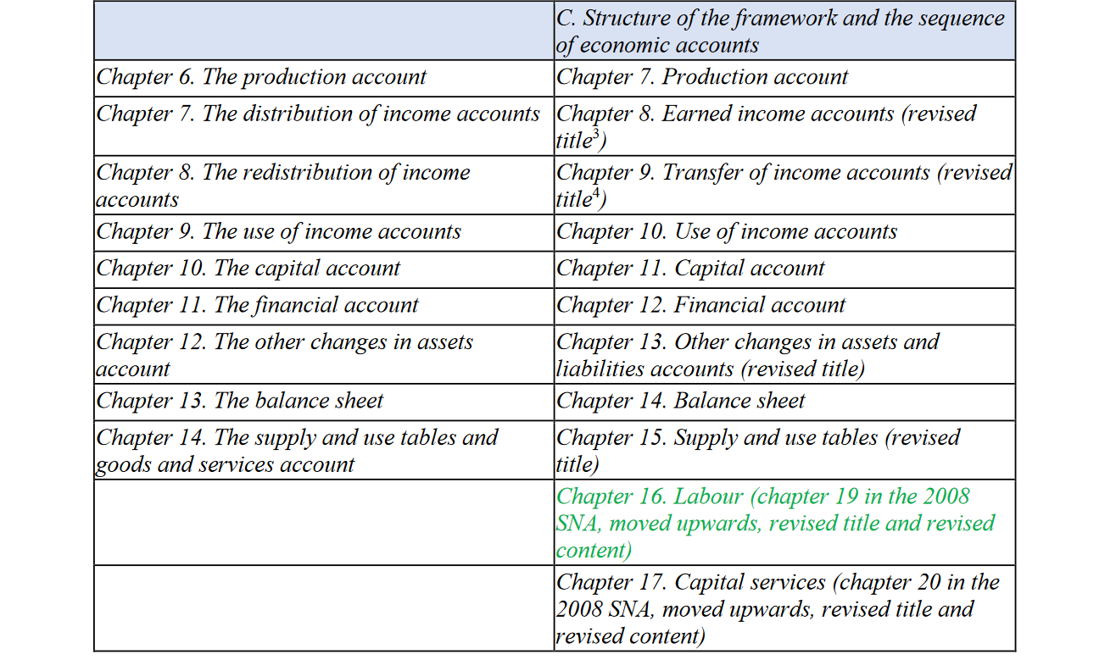
Proposal for the overall structure of the 2025 SNA
New chapters are highlighted in red, while chapters requiring substantial revisions are highlighted in green.
Notes:
https://unstats.un.org/UNSDWebsite/statcom/session_54/documents/BG-3e-NationalAccounts-E.pdf

Slide 23
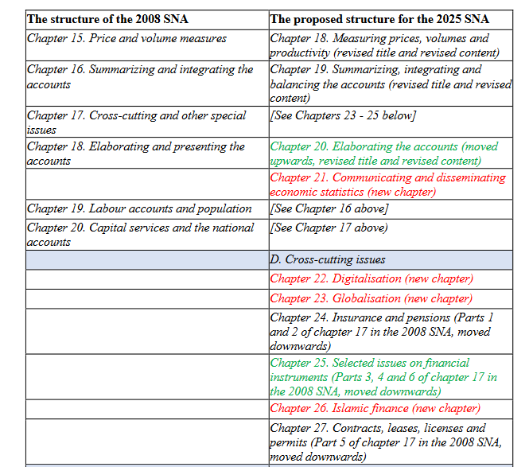
Proposal for the overall structure of the 2025 SNA
New chapters are highlighted in red, while chapters requiring substantial revisions are highlighted in green.
Notes:
https://unstats.un.org/UNSDWebsite/statcom/session_54/documents/BG-3e-NationalAccounts-E.pdf

Slide 24
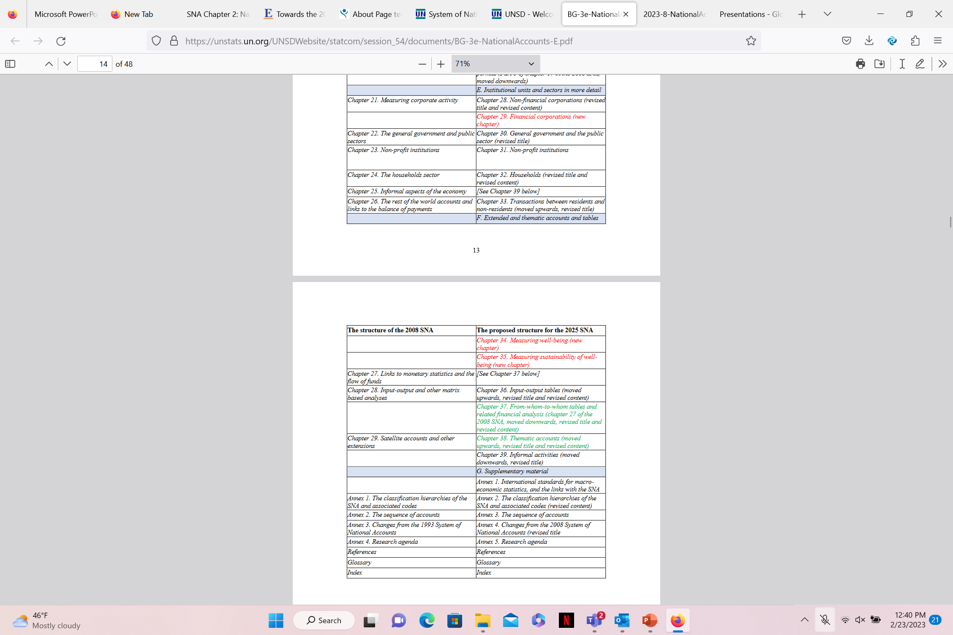
Proposal for the overall structure of the 2025 SNA
New chapters are highlighted in red, while chapters requiring substantial revisions are highlighted in green.
Notes:
https://unstats.un.org/UNSDWebsite/statcom/session_54/documents/BG-3e-NationalAccounts-E.pdf

Slide 25
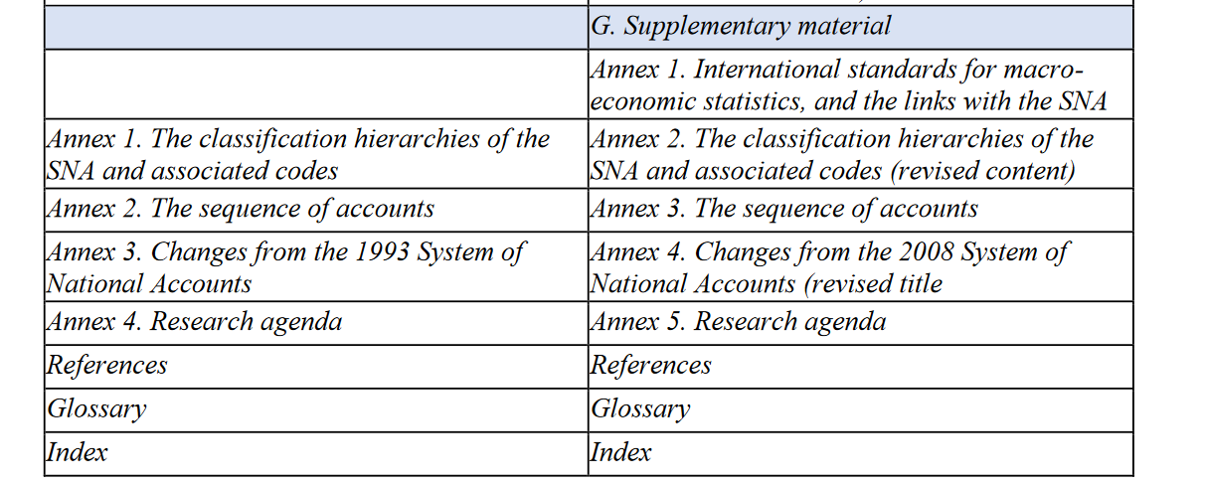
Proposal for the overall structure of the 2025 SNA
Notes:
https://unstats.un.org/UNSDWebsite/statcom/session_54/documents/BG-3e-NationalAccounts-E.pdf

Slide 26
Summary of activities during 2022 and expected activities in 2023-Meetings, training seminars, courses, handbooks, etc
Statistical office of the European Union (Eurostat)
International Monetary Fund (IMF)
Organization for Economic Cooperation and Development (OECD)
United Nations Economic Commission for Africa (ECA)
United Nations Economic Commission for Europe (ECE)
United Nations Economic Commission for Latin America and the Caribbean (ECLAC)
Economic and Social Commission for Asia and the Pacific (ESCAP)
United Nations Economic and Social Commission for Western Asia (ESCWA)
United Nations Statistics Division (UNSD)
World Bank
https://unstats.un.org/UNSDWebsite/statcom/session_54/documents/BG-3e-NationalAccounts-E.pdf
Notes:
https://unstats.un.org/UNSDWebsite/statcom/session_54/documents/BG-3e-NationalAccounts-E.pdf

Slide 27
Summary of activities during 2021 and expected activities in 2022-Meetings, training seminars, courses, handbooks, etc
Statistical office of the European Union (Eurostat)
International Monetary Fund (IMF)
Organization for Economic Cooperation and Development (OECD)
United Nations Economic Commission for Africa (ECA)
United Nations Economic Commission for Europe (ECE)
United Nations Economic Commission for Latin America and the Caribbean (ECLAC)
Economic and Social Commission for Asia and the Pacific (ESCAP) and SIAP
United Nations Economic and Social Commission for Western Asia (ESCWA)
United Nations Statistics Division (UNSD)
World Bank
https://unstats.un.org/UNSDWebsite/statcom/session_53/documents/BG-3n-NationalAccounts-E.pdf
Notes:
https://unstats.un.org/UNSDWebsite/statcom/session_53/documents/BG-3n-NationalAccounts-E.pdf

Slide 28
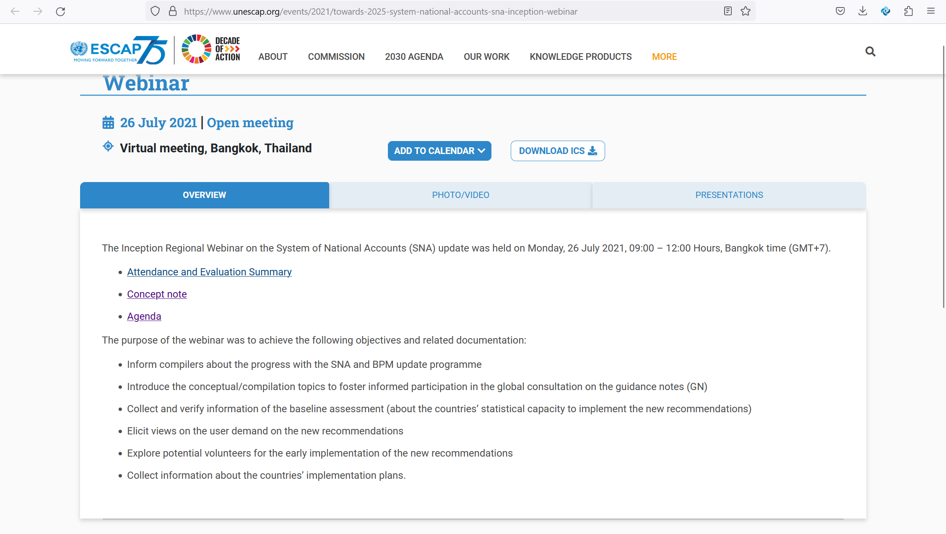
The Inception Regional Webinar on SNA update
Right click> open link
Notes:
https://www.unescap.org/events/2021/towards-2025-system-national-accounts-sna-inception-webinar

Slide 29
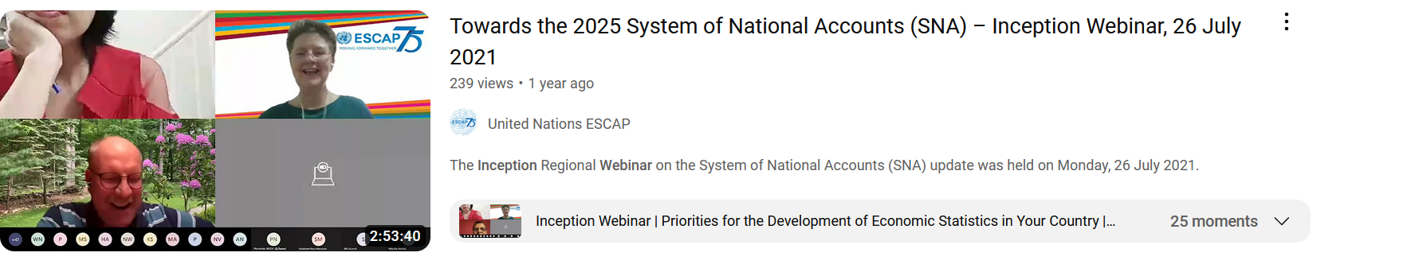
ESCAP -Towards the 2025 SNA – Inception
(around 3 hours)
Right click> open link
Notes:
https://www.unescap.org/events/2021/towards-2025-system-national-accounts-sna-inception-webinar

Slide 30
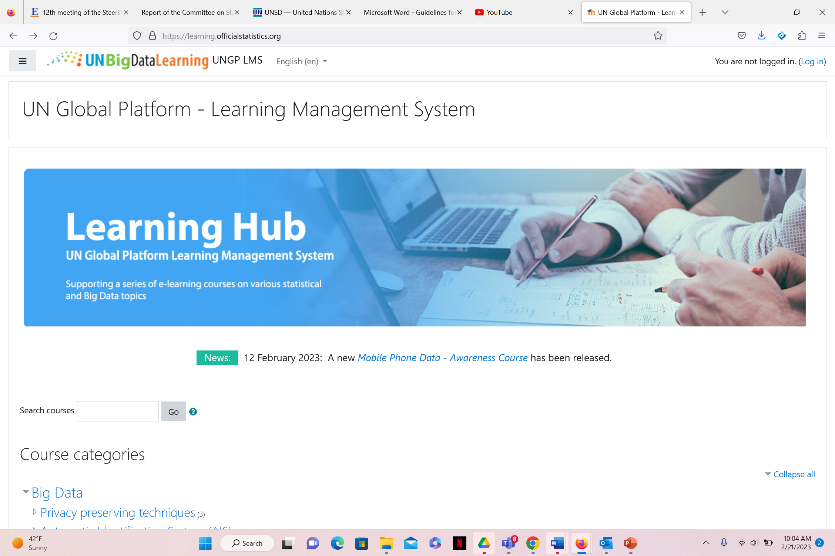
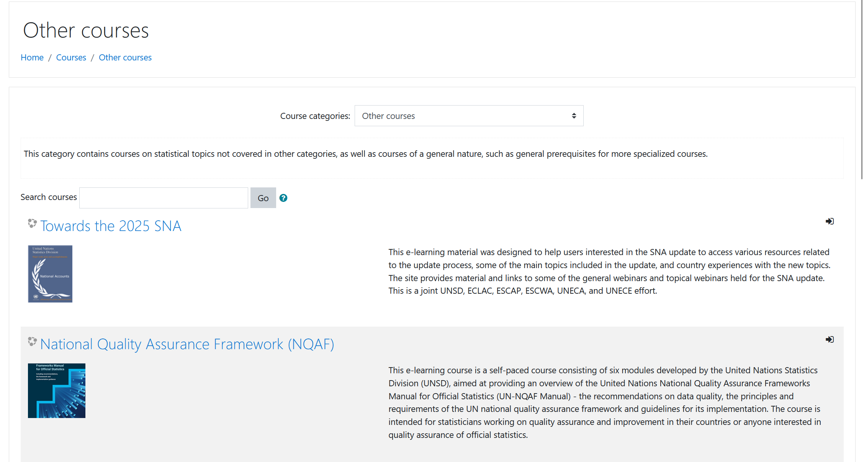
UN Global Platform-LMS
Right click> open link
Notes:
https://learning.officialstatistics.org/
https://learning.officialstatistics.org/course/index.php?categoryid=4

Slide 31
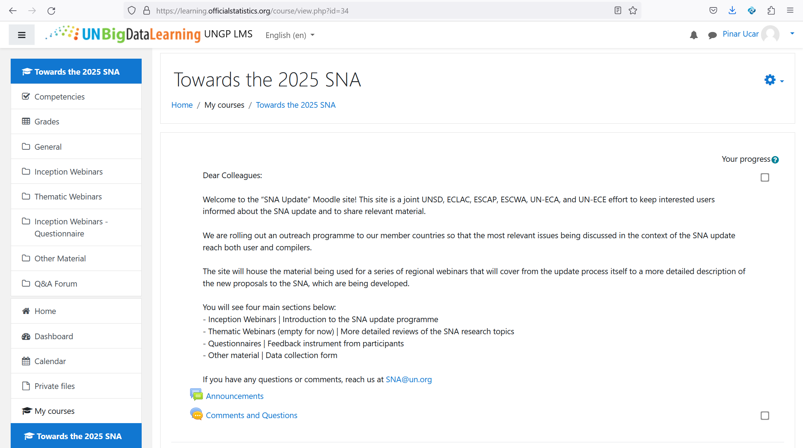
UN Global Platform-Towards the 2025 SNA

Slide 32
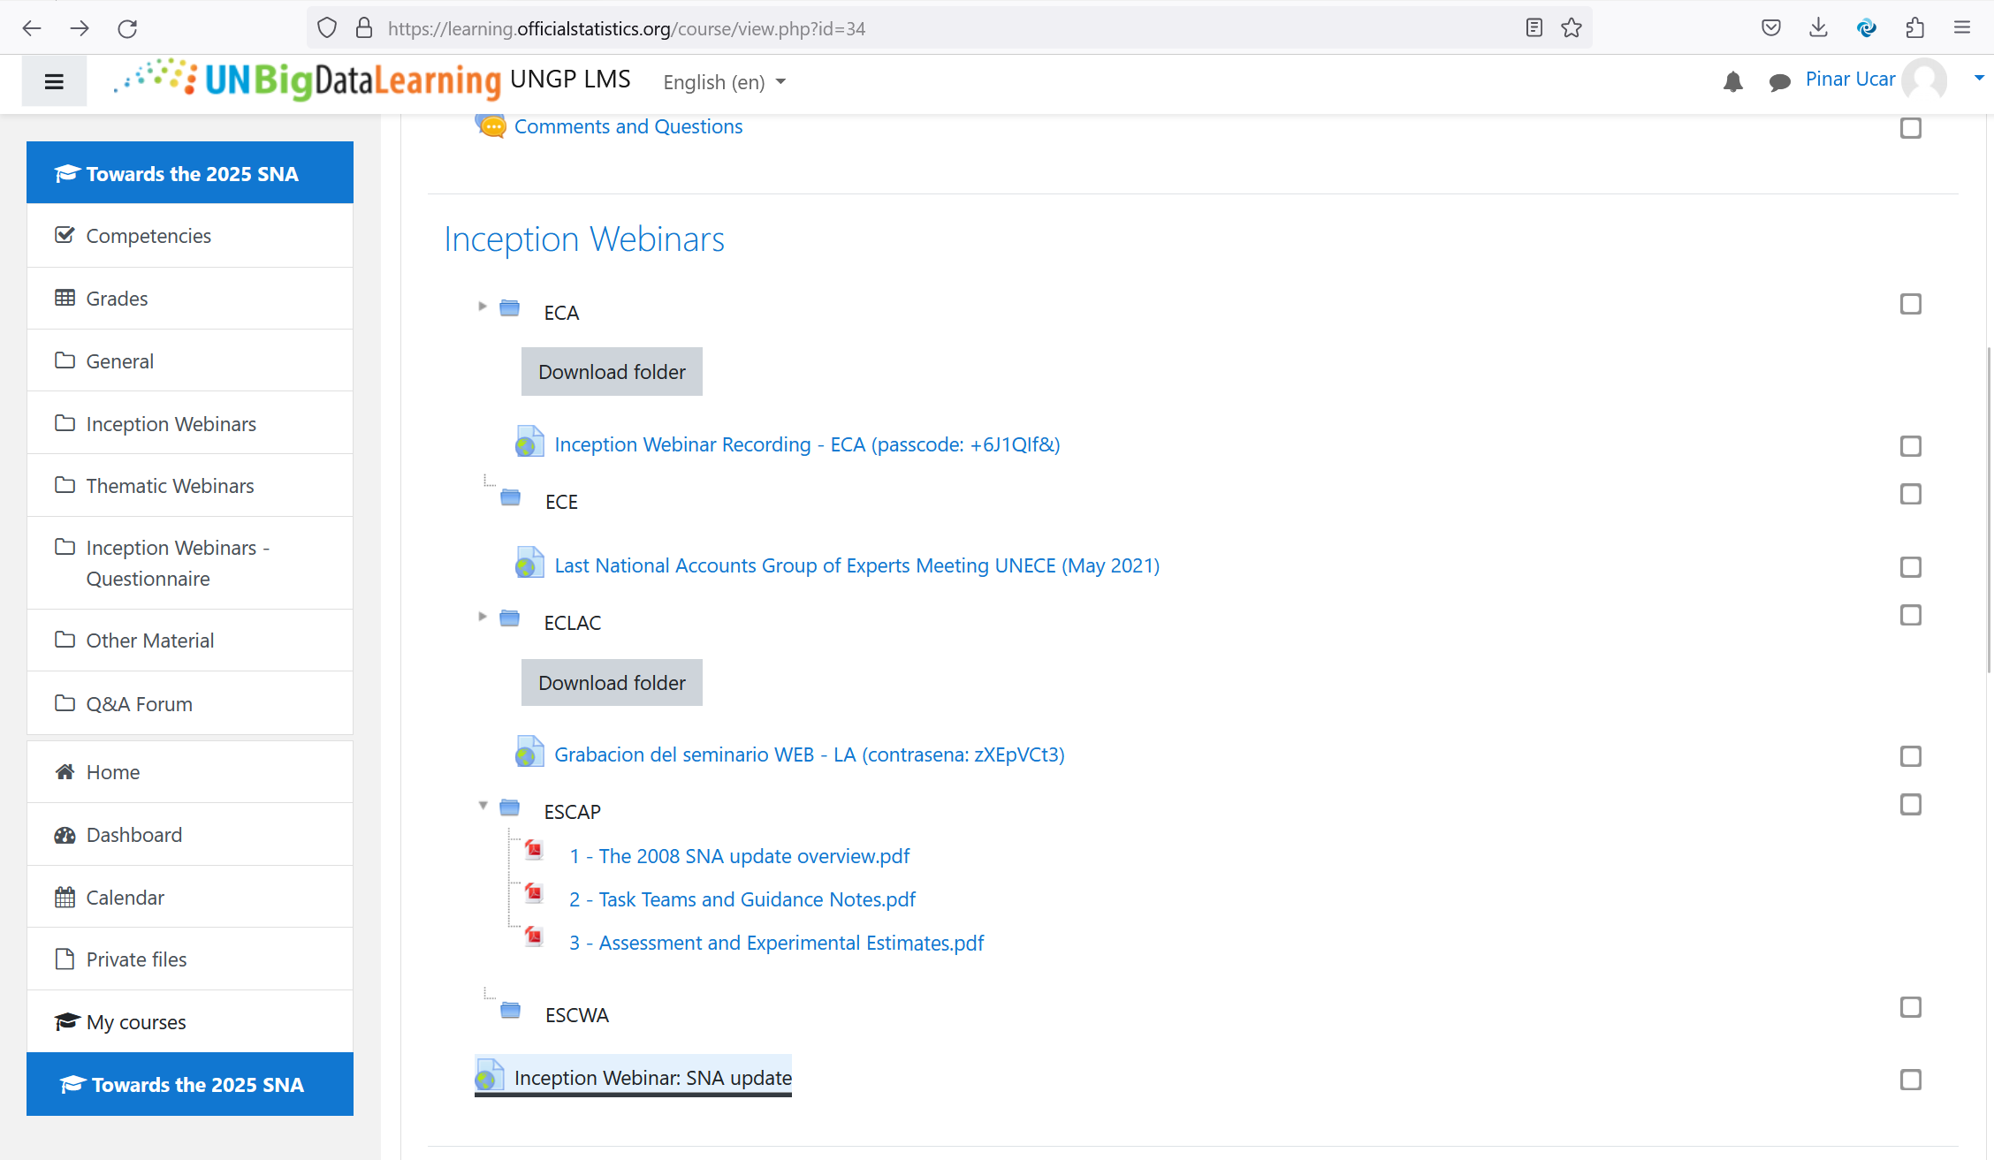

Slide 33
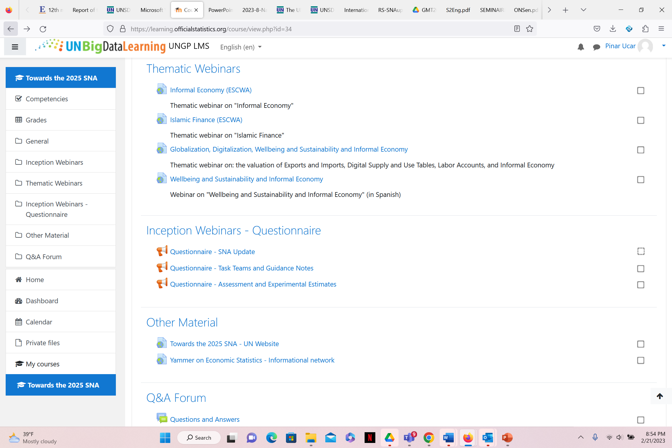

Slide 34
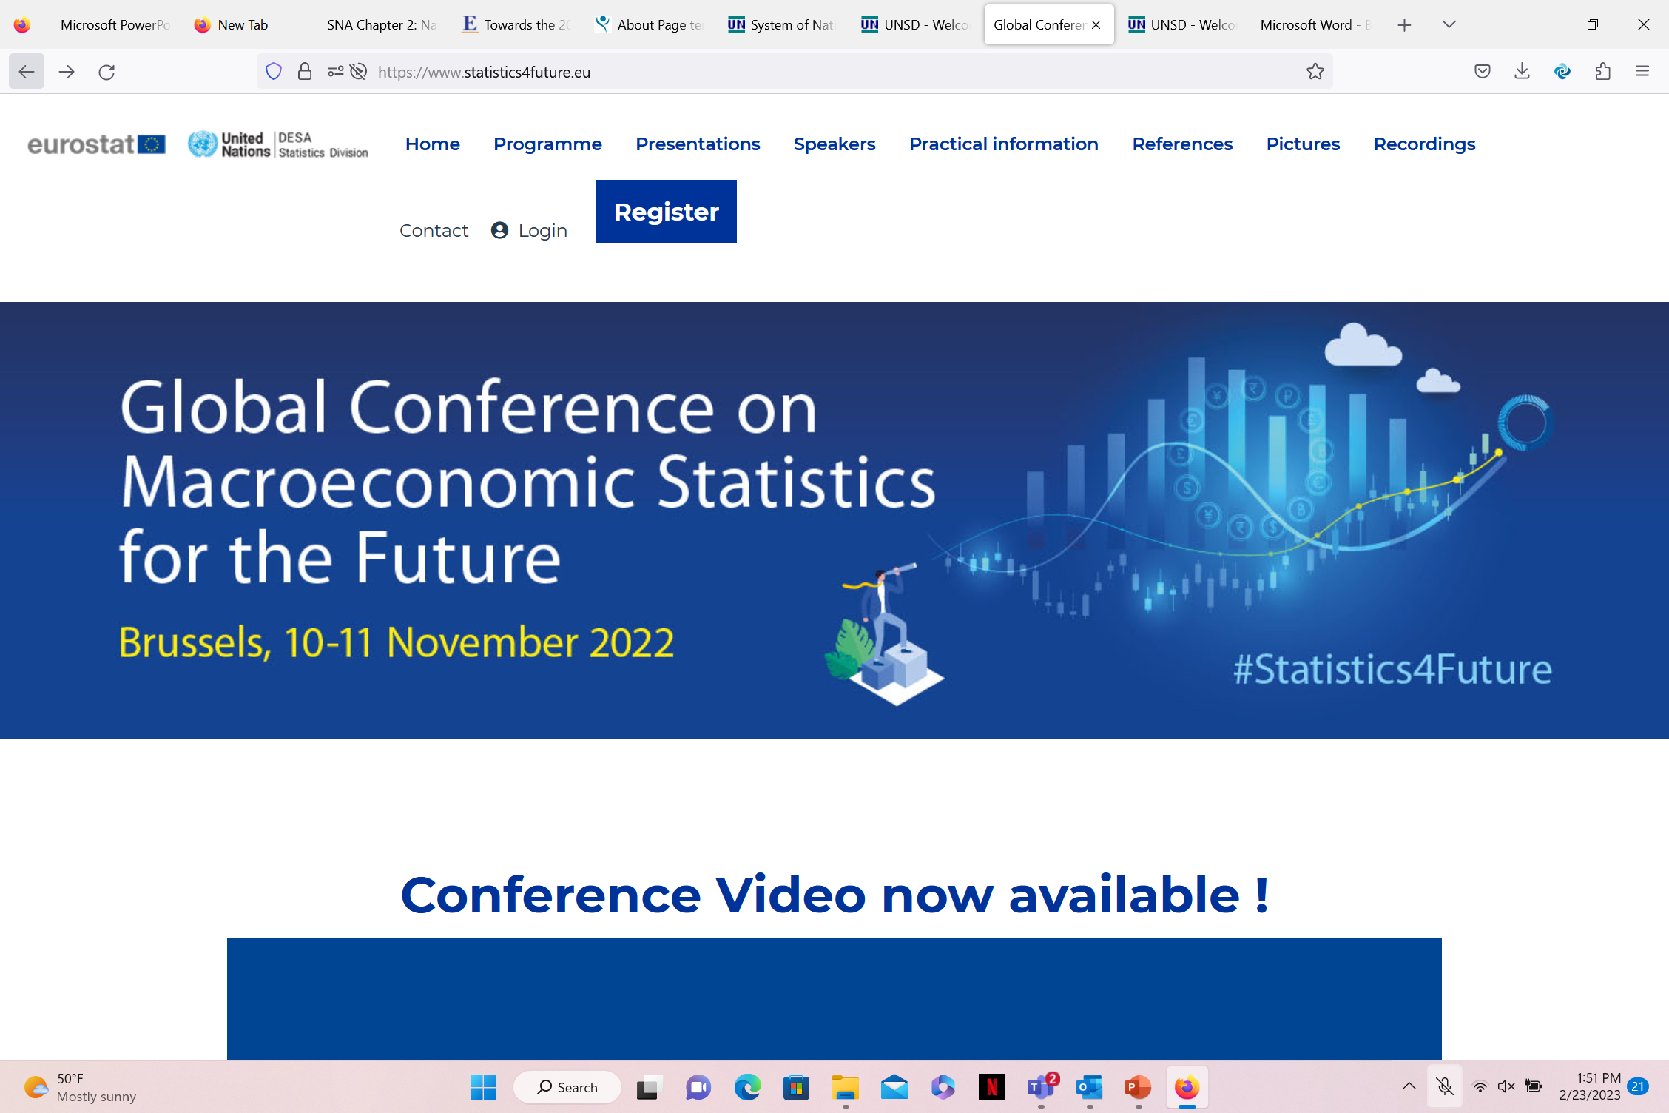
Right click> open link
Notes:
Priority areas of discussion were: Sustainability and Beyond GDP, Digitalisation, Globalisation and Communication.
https://www.statistics4future.eu/

Slide 35
Sources
Harper, P., (2022). Progress of the 2008 SNA update programme. Presented at International Workshop on the Update of the System of National Accounts, 2008. 6-8 September, Kunming-China.
https://unstats.un.org/unsd/nationalaccount/workshops/2022/China/S3_Progress_2008_Harper.pdf
Smith, H., (2022). The 2008 SNA Update. Presented at National accounts annual seminar for Latin America and the Caribbean: Emerging issues and new challenges in the measurement of economic statistics: an agenda for change, 3-6 October, Virtual meeting.
https://www.cepal.org/sites/default/files/presentations/unsd-sna-2025-updating-economic-statistics.pdf

