Slide 1
Regional Course on
Statistical Business Registers
Introduction to Statistical Business Registers
The role of an SBR as a live register

Slide 2
Statistical Business Registers
Statistical business registers are built for statistical use.
They play a central role in the production of economic statistics, both in terms of the way statistical units are defined, and in terms of the content and quality of the statistical data.
The availability of SBRs is essential to the compilation of consistent and comparable economic statistics.
They enable statisticians to retrieve a common set of units, across different subject areas, and referencing a specific date.
This results in data that are timely, coherent, and comparable, and a data collection process that is facilitated in a cost-efficient manner.

Slide 3
SBRs as a Statistical Infrastructure
The SBR’s main role is regular maintenance of a repository of data - a “live” register.
The validation and integration of data from various input sources
The alignment of definitions of the units between data sources, while keeping linkages to source units
The harmonization of the characteristics describing the units
Continuous updates of the information on the units, while keeping a history of their previous information
Extraction of data for further use

Slide 4
The role of an SBR as a live register
What is a live register?
The ability to extract subsets of data from the SBR.
A foundation for creating frames for surveys aimed at the production of business and economic statistics.
A live register is dynamic and is being updated constantly.

Slide 5
Live register
Live register refers to the ability to extract subsets of data from the SBR. It serves as a foundation for creating frames for surveys aimed at the production of business and economic statistics. A live register is dynamic and is being updated constantly. Maintenance is a continuous process in which the composition and characteristics of units continuously change over time.

Slide 6
Essential Functions of a Live Register
To create and maintain statistical units.
In the live register, data from multiple sources are brought together and enable the NSO to continuously identify new statistical units, update information on existing units, and deactivate closed units in the population.
Assigning unique SBR identifiers allows the SBR to track units throughout their lifecycle, and across different data sources, and helps avoid double counting.
Integrating multiple sources helps improve the quality and richness of information in the SBR even before collecting data from surveys.

Slide 7
Essential Functions of a Live Register
To harmonize concepts and definitions.
With harmonization, data can be compared across domains.
To assist in the production of business and economic statistics, SBRs need to match their coverage. This can be done if the populations for the domains are obtained and used similarly during processing.

Slide 8
Highlights from Live Register
The first function is to create and maintain statistical units. In the live register, data from multiple sources are brought together and enable the NSO to continuously identify new statistical units, update information on existing units, and deactivate closed units in the population.
Assigning unique SBR identifiers to statistical units allows the SBR to track them throughout their lifecycle and across different data sources, and helps to avoid double counting. Integrating multiple sources helps improve the quality and richness of information in the SBR even before collecting data from surveys.

Slide 9
Highlights from Live Register
The live register also functions to harmonize concepts and definitions. When the coverage and content of SBRs are harmonized in terms of concepts and definitions, even if each statistical domain is different, data can be compared across domains.
Business and economic statistics describe economic and financial production processes and transactions in various statistical domains. To assist in the production of these statistics, SBRs need to match their coverage. This can be done if the populations for the domains are obtained and used similarly during processing.

Slide 10
Snapshots and Frozen Frames
Snapshots
Comprises all statistical units that are active, or potentially active, or active within the previous reference year.
Includes administrative units that are linked to these statistical units.
Frozen Frames
A subset of the snapshot which aims to include all units and all characteristics that are used by subsequent processes.
A trimmed-down version of the snapshot that is easier to manipulate.

Slide 11
Frozen frame
In some literature on this topic, a frozen frame is called a master frame, or a common frame. This is because, typically, several survey frames are derived from this single common extraction from the live register, thereby coordinating the survey frames at a particular point in time.

Slide 12
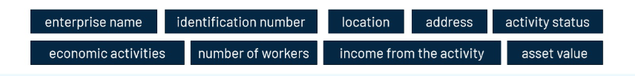
Example: Mongolia
Created its first SBR from the result of the 1998 Establishment Census.
Frozen frames are stored quarterly and used for quarterly dissemination of statistical units and statistics to the public, organization of enterprise-based sample survey, and cross-checking with the databases of other government organizations.
Updated regularly from official data sources (establishment census, quarterly statistical report of the SBR, annual, quarterly, and monthly reports of economic statistics, etc.).
The frozen frames contain indicators of statistical units (establishment and legal unit level or administrative units) retrieved from the taxation office.

Slide 13
Historical Register
When an SBR produces sets of frozen frames at various reference periods, they constitute a historical register, which allows statisticians to reconstruct the history of the units contained within.

Slide 15
Regional Course on
Statistical Business Registers
Introduction to Statistical Business Registers
The role of an SBR as a coordinator of surveys

Slide 16
Survey Frames
Survey frames are subsets of the frozen frame, comprising the set of statistical and linked administrative units that match the specification of the survey target population and are active during the survey reference period.

Slide 17
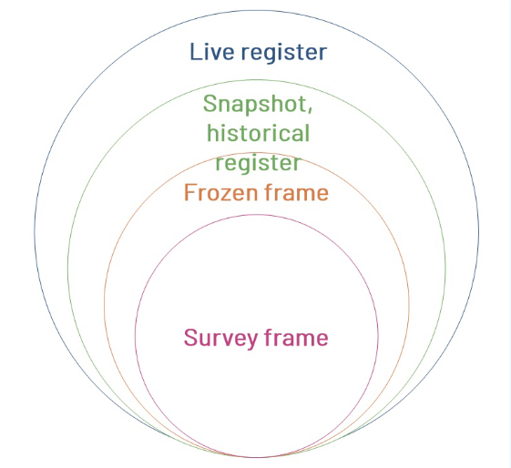
Survey Frames
A survey frame is a listing of statistical units in scope of a particular survey.
It contains the characteristics of those units required for stratification and sampling, and, for the selected units, the information required to contact and communicate with them.

Slide 18
Frame specification
The frame specification defines the reference period to which the frame should refer, the type of sampling unit, the population of units to be included, the data items that are required for sample selection, and (for the sampled units only) the contact data items required for conducting the survey.
In the case of large and complex enterprises, the specification also includes the requirements for additional information about other types of statistical units associated with the enterprise.

Slide 19
Frame Specification
Frame Specification
The reference
period
Type of sampling unit
Population of units
Data items
Contact data items
Large enterprises: the requirements for additional information about other types of statistical units associated with the enterprise.

Slide 20
Example
A survey on employment will only include active units that are employers. Non-employers will be excluded.
A survey on manufacturing will include active units that have a NACE code in the manufacturing group, whether they have employees or not.
Thus, the frames for different surveys for a given reference period are different from one to another, even though they are extracted from the same common set of units, namely the population in the master frame.

Slide 21
SBR Significance for Statistics
The main sources of information for any statistical analysis conducted on the business population.
Useful to achieve consistency of statistics.
Supports the coordination, consistency, comparability, and efficiency of annual, quarterly, or monthly surveys.
Essential for establishing efficient statistical survey frames.
Helps make the national statistical system more efficient and reduce the reporting burden on businesses.

Slide 22
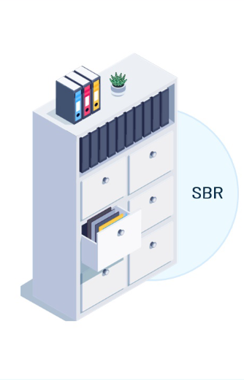

SBR Significance for Statistics
Provide frames for all relevant surveys
Multiple surveys can refer to the updated information in the SBR.

Slide 23
Mexico INEGI Example
A frozen frame of the SBR is provided once a year to the technical department of the National Institute of Statistics and Geography of Mexico (INEGI) to be used as a master frame to derive survey frames for several surveys.

Slide 24
Surveys conducted by INEGI
Establishment Level
  Monthly Survey on the Manufacturing Industry
  Monthly Survey on Services
  Other Surveys
Enterprise Level
  Monthly Survey on Trading Enterprises
  National Survey on Construction Enterprises
  Other Surveys

Slide 25
Surveys conducted by other agencies
Establishment Level
  National Survey of Business Financing, by the National Banking and Securities Commission
  Survey on Information and Communication Technologies, by the National Council for Science and Technology
  Survey on Research and Technological Development, by the National Council for Science and Technology

Slide 26
Survey Support Functions
Data collection- provide information about the observation unit.
Registration - keep track of units participating in surveys.
Ownership - monitor submission of reporting units and response rates, administration of reminders.
Response burden management - reduce or spread the burden and survey holidays.

Slide 27
Data Collection
Before the survey, SBRs provide information on the content of statistical units, including links with the administrative unit type (for example, legal units), observation and reporting units, and all information needed to contact and communicate with them.
In addition to this, SBRs can store information that can be used to optimize the survey design.

Slide 28
Data Collection
An observation unit is a unit about which data can be obtained. In most cases, a statistical unit is equal to a unit on which data are available in the bookkeeping systems of a business. In these cases, an observation unit is equal to a statistical unit.
A reporting unit is a unit that reports data on certain observation units for a particular survey to a statistical institute. For each statistical unit, a reporting unit is assigned. A reporting unit can be another organization, for example, an accountancy firm.

Slide 29
Registration
SBRs can also maintain a list of all the surveys in which any given enterprise has participated and has responded to, and determine the current status of these responses.

Slide 30
Ownership
Monitoring submission status of reporting units, the overall response rates, and administration of reminders. To monitor the data collection processes, reporting units in the survey frame should be monitored throughout the collection process. The administration of reminders or attempts to contact reporting units may be recorded not only to ensure that follow-up is efficiently conducted, but also to support any potential subsequent enforcement of a response.

Slide 31
Response burden management
SBRs can also monitor survey response status and durations, which can then be used to measure overall response burdens, which can be used later to alleviate them. Units that are involved in different surveys, or on repeated occasions in the same survey, can be the subject of a policy to reduce and/or spread the response burden.
For example, there could be a policy to observe small enterprises only once every 2 years or to participate in no more than one survey per year. In addition, enterprises that have already participated in surveys may be given a survey holiday (a period in which they are excluded from data collection).

