Slide 1
Efforts for Further Development and Enhancement of Statistical Business Register in Japan - Improvement of Update Frequency -
KUREMATSU Ryosuke,
YAGI Masahiko
Statistics Bureau,
Ministry of Internal Affairs and Communications
Government of Japan

Slide 2
Contents
Introduction to JSBR
Brief Recap of Maturity Model
Efforts to Improve JSBR
Schedule

Slide 3
Ⅰ. Introduction to JSBR

Slide 4



Introduction to JSBR
Data Sources of JSBR
Statistical Business Register in Japan
(JSBR)
Survey Results
・Economic Census for Business Frame
(EC-BF)
・Economic Census for Business Activity
(EC-BA)
・Annual Business Survey
(ABS)
*Profiling Activity: At the National Statistics Center, dedicated personnel assigned to each major 5,000 companies regularly grasp corporate information and support the above surveys.
Governments
Items
Conduct
Surveys
・Name
・Location
・Number of Employees
・Industry Type
・Capital Amounts
・Sales, etc.
Annual Frame
Establishment / Enterprise Inquiry (EEI)
Grasping New Establishments and Closing Establishments with Administrative data（Labor Insurance Data, Commercial and Corporation Registration）
Produce
Statistics

Slide 5
Images of Each Record in JSBR
Enterprise: Legal Unit
Enterprise as the statistical unit
A
 | ID | Name | Address | Industry | Sales | ・・
1
Head office
B
C
D
branches
Establishment as the statistical unit
 | ID | Name | Address | Industry | Sales | ・・
A
B
C
D
Establishments: Local Unit

Slide 6
Data Source: Economic Census
Economic Census
Business Frame (EC-BF)
Gathering information for the basic structure of business units
Focusing on the number of establishments, enterprises, employees, etc.
Business Activity (EC-BA)
Identifying the details of economic activities of businesses.
Focusing on the amounts of sales, costs, value added, etc.

Slide 7
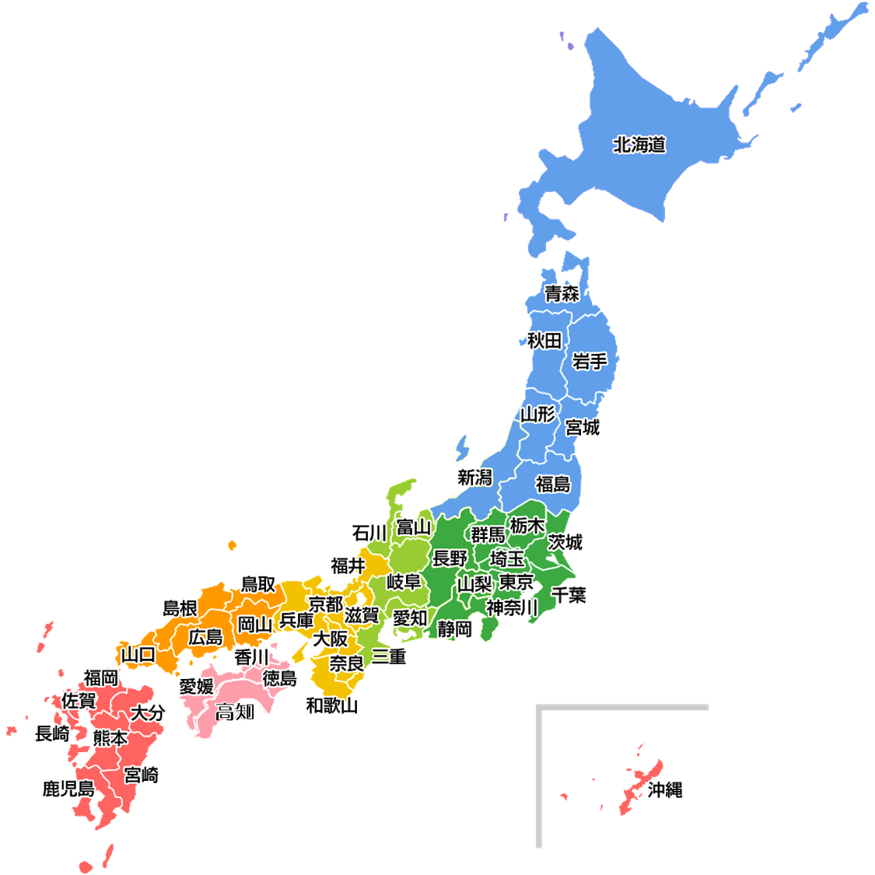


Data Source: Economic Census（cont.)
Target: ALL Enterprises and Establishments (as of 1st July in every five years)
● Survey Methods:
・Up-to-date-list of enterprises/establishments was extracted from SBR
→ Mailing, Online, enumerators
- Existing enterprises/establishments : Mainly mailing/online
- “New” enterprises/establishments (and small enterprises such as individual proprietorships) :Enumerator
● Questionnaire Items :
Number of persons engaged, Business activity, Financial items, etc
Mailing
Enumerator
ONLINE
approx. 70,000

Slide 8
Data Source: Annual Business Survey (ABS)
For the years in which the EC-BA is not conducted, we conduct Annual Business Survey (ABS) .
This survey covers all enterprises above a certain scale in all industries.
a five-year cycle.
2019 2020 2021 2022 2023 2024 2025 2026
EC-BF
EC-BA
EC-BF
EC-BA
ABS
ABS

Slide 9
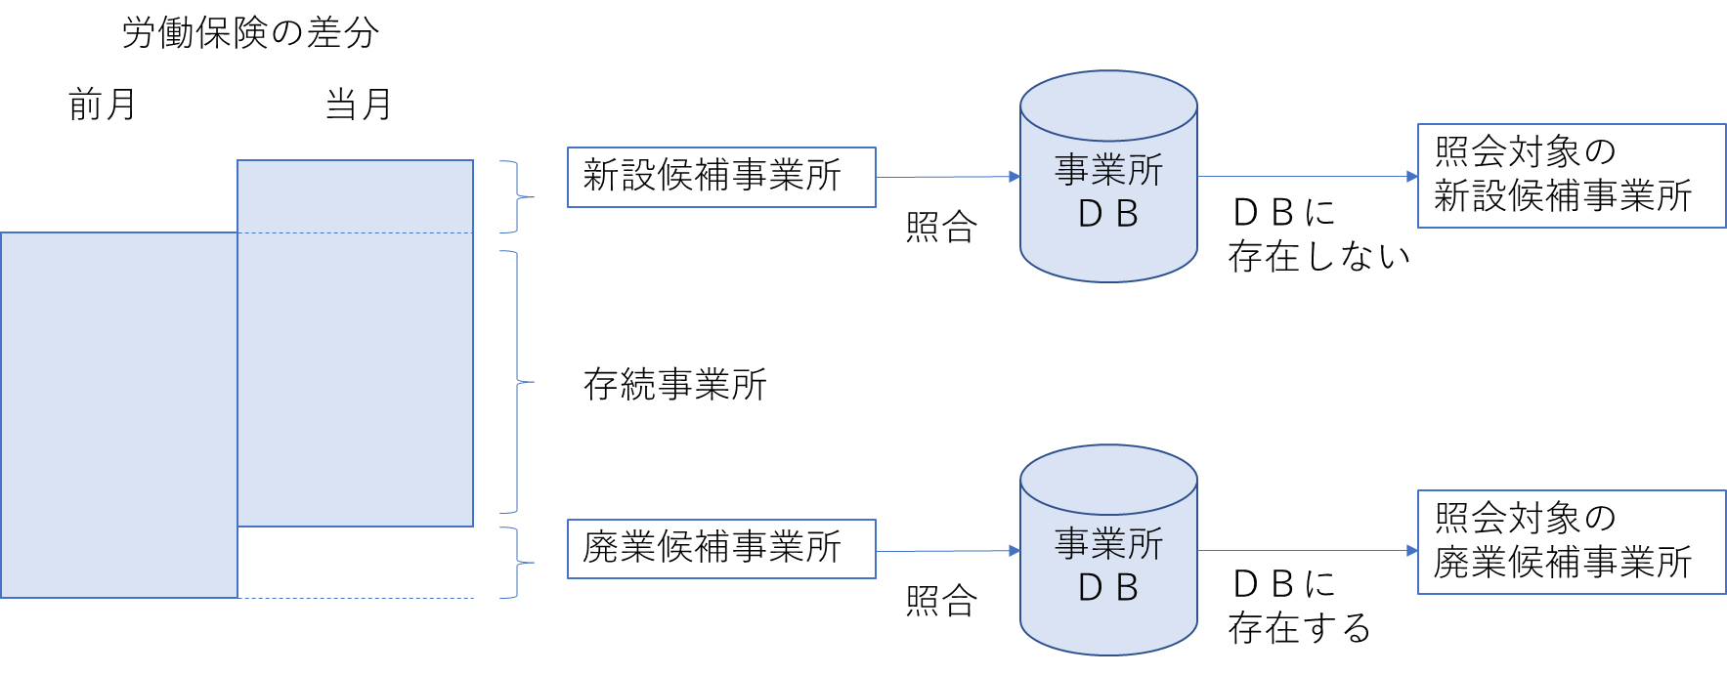
Data Source: Establishment / Enterprise Inquiry (EEI)
We find the clue of newly started or closed business establishments with the administrative data, "Labor Insurance Data" and "Commercial and Corporate Registration.“
We conduct the EEI targeting the newly started business establishments to grasp the status of business activities and basic items.
We conduct the EEI targeting the closed business establishments to grasp the status of business activities.
eg. the EEI using Labor Insurance Data
The difference of “Labor Insurance Data” between last month and this month
last month
this month
Conduct the EEI targeting the establishments
Newly started establishments
JSBR
Not exist
in JSBR
Existing establishments
Closed establishments
Conduct the EEI targeting the establishments
JSBR
Exist
in JSBR

Slide 10
Ⅱ. Brief Recap of Maturity Model

Slide 11
Brief Recap of Maturity Model
Maturity model is supposed to be a tool to:
- share knowledge and best practices
determine the current state of your SBR
determine possible next steps for development
find help and guidelines to actually be able to take those steps

Slide 12
Structure of Maturity Model
Maturity model consists of a set of 7 dimensions and 4 stages of development for each dimension.
IV. Advanced
Improvement
measures
III. Mature
II. Early
Dimensions
Legal and institutional framework
Data sources
Maintenance and update
Coverage
Use
IT environment
Interoperability
I. Preliminary

Slide 13
JSBR Details in Seven Dimensions
1. Legal and institutional framework
Following provisions are in the statistical law *rough translation
-Establishment and maintenance of SBR
-User of the SBR : government, local government, etc
-Limitation of use :only statistical purpose
-For statistical purpose, the head of the ministry may make a request to the heads of other ministries for the provision of administrative records.
2. Data sources
-Economic censuses, Statistical surveys,
-Administrative data (business registration, labor insurance data, etc.) with SBR Maintenance surveys
(Profiling data)
3. Maintenance and update
Frequency (frequency of output of frozen frame) : Once in every year

Slide 14
JSBR Details in Seven Dimensions
4. Coverage
-Coverage: All enterprises and establishments*¹ except for some specific industries*²
*¹Around 4 million enterprises, 6million establishments
*²such as unincorporated ones(individual proprietorships) that fall under Agriculture, Forestry and Fisheries.
-Variables: Location(Address), Number of persons engaged, Sales (Income), Total expenses, Startup date etc.
5.USE
To provide frozen frame
6.IT
Database structure
7 Interoperability
ID within government : Corporate number
ID within SBR uses : - ID per establishments
- ID per enterprises

Slide 15
Ⅲ. Efforts to Improve JSBR

Slide 16
Efforts to Improve JSBR
2013
2019
2023
1st Effort
2nd Effort
Start of JSBR
Coverage Expansion of JSBR using Administrative Data
Improvement of Update Frequency of JSBR
Dimension2:
Data Source
Dimension3:
Maintenance and update

Slide 17
1st Effort: New Data Source - Corporate Number -
The National Tax Agency in Japan publishes the “Corporate Number” on its website with the name and the location of the head office or principal office of corporations.
“Corporate Number” is a 13-digit number, which is freely available administrative data to anyone.
1st Effort
In 2019, we compared corporations in JSBR with the ones in the Corporate Number website.
We added 1.6 million corporations to JSBR.
We conducted 2019 EC-BF to capture the activity of the 1.6 million corporations.
We confirmed the status of 1.0 million corporations, which results in expanding the coverage of JSBR.

Slide 18
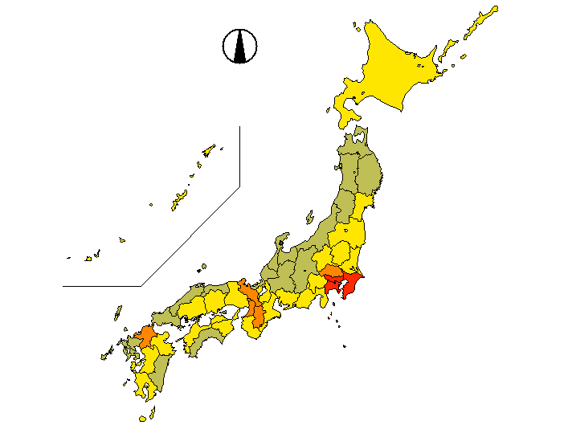

Characteristics of Enterprises added from Corporate Number
Enterprises added from Corporate Number concentrate on Metropolitan areas such as Tokyo and Osaka.
Many of them are located in private residence, apartment, or small buildings, which is difficult to find from outside.
Enterprises in “Real estate and goods rental and leasing” are dominant in terms of numbers and sales.

Slide 19
2nd Effort: New Data Source - New Establishment / Enterprise Inquiry -
We regularly update the basic items of the enterprises of the top 80% of sales in the JSBR with the combination of the ABS and the EEI in the interim years.
From 2023, in addition to the EEI for new or closed establishments, we also started to conduct the new EEI targeting the existing enterprises having multiple establishments.
This results in updating the basic items of the enterprises of the top 90% of sales in the JSBR with the combination of the ABS and the new EEI.

Slide 20
2nd Effort: New Data Source: 2024 Economic Census for Business Frame
Taking the cost effectiveness and alleviating the burden on local governments into account, we decided to exclude individual proprietorships without employees which accounts for only 0.4% of total sales in JSBR.
We still grasp the basic items of the top 99.6% of sales in JSBR.

Slide 21
The Relationship between the Area of the Surveys and Updated Area of JSBR
ABS（Interim Years：Every Year）
EC-BA（EC Year：Every Five Year）
New EEI（Interim Years：Years other than EC-BF）
EC-BF（Interim Years：Every Five Year）
Corporations
【Top 80% of Sales】
Top 80% of sales
Top 90% of sales
Top 99.6% of sales
Corporations other than
the above with
multiple establishments
Single Office Corporations other than the above
Individual proprietorships with employees
Individual proprietorships
without employees

Slide 22
(Ref) Survey Method of 2024 Economic Census for Business Frame
We are going to carry out the Census in an online precedence fashion to boost the online response rate.
* Government goal of online response rate in economic statistical surveys is 80%.
We only apply online and mailing survey, i.e., no enumerator.

Slide 23
Ⅴ. Schedule

Slide 24
Schedule
The Cycle of Surveys Used to Update the JSBR
Base Year | Interim Years |  |  |  | Base Year
2021 （Result） | 2022 （Result） | 2023 （Result） | 2024 （Plan） | 2025 （Plan） | 2026 （Plan）
・EC-BA | ・ABS ・EEI | ・ABS ・New EEI | ・ABS ・EC-BF | ・ABS ・New EEI | ・EC-BA
(100%)*
(80%)
(90%)
(99.6%)
(90%)
(100%)
* The coverage of JSBR

Slide 25
Summary
The data source of JSBR is the hybrid of survey results, Economic Census and Annual Business Survey, and administrative data.
1st effort: we expanded the coverage of JSBR using new data source: Corporate Number.
2nd effort: we developed the EEI and the EC-BF to improve the update frequency of JSBR.

Slide 26
Future Challenge
Grasping individual proprietorships with administrative data
Catching closing business

Slide 27
Thank you for your attention!
Census-kun
Mirai-chan
Statistics Bureau,
the second government office of the Ministry of Internal Affairs and Communications,
19-1, Wakamatsu-cho, Shinjuku-ku, Tokyo 162-8668

