Slide 1
Regional Course on Statistical Business Registers
Session 10: New developments in SBRs

Slide 2
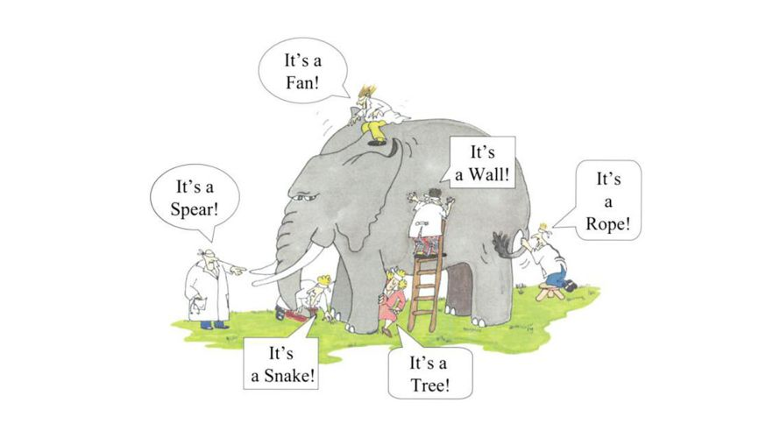
Importance of sharing experiences
There is no standard situation, many difference between countries.
2

Slide 3
SBR bodies
UNCEBTS
Task Team Statistical Business Registers
UN
Wiesbaden Group
UNECE
Expert group on SBR
3

Slide 4
Task Team Statistical Business Registers
The task team focuses on further elaborating all elements of the Statistical Business Register Maturity Model (SBRMM).
The SBRMM is meant to provide countries with a tool to assess the stage of development of their SBRs and identify possible improvements to the SBR, so that no one is behind.
4

Slide 5
Task Team Statistical Business Registers
The maturity model is a live framework that is periodically reviewed and adjusted. Having that in mind, the Maturity Model for Statistical Business Registers (SBRs) aims to be a tool to:
share knowledge and best practices by means of a knowledge base
determine the current state of your SBR by a self assessment questionnaire
determine possible next steps for development
find help and guidelines to actually be able to take those steps.
5

Slide 6
Areas of work – TT SBR
Methodological work (Statistical Business Register Maturity Model)
Capacity building
Other areas, like
Multi National Enterprises
Infrastructure SBR
Knowledge sharing
6

Slide 7
Task Team Statistical Business Registers
Member countries:
Australia | South Africa
Canada | Turkey
Columbia | UK
Egypt | US
France
Georgia | International Organisations
Jamaica | AfDB
Mexico | Eurostat
Netherlands | IMF
Palestine | OECD
Portugal | UNSD

Slide 8
Task Team Statistical Business Registers
Highlights work program 2024
SBR Maturity Model
Completing the toolkit
Implementation ISIC revision
Geospatial information
Country presentations
Big data for SBRs
Artificial Intelligence
Which of the topics have your interest?
Are there any topics missing from the list?
8

Slide 9
Task Team Statistical Business Registers
Next meeting: 2 May 2024
Interested? Please send a mail to Julian, Pedro or Hank.
9

Slide 10
Wiesbaden Group
Every 2 years
Sharing experiences
Meeting colleagues in person
Country progress reports
29th meeting in 2025
Looking for a host
10

Slide 11
28th meeting Wiesbaden group
Country Progress Reports
Profiling complex statistical units
Globalization and Large Case Units
Upcoming ISIC and NACE revision
Workshop Maturity Model
Country Presentations
Advanced country presentations
Geospatial information
New data sources: opportunities and challenges
Redesigning the SBR

Slide 12
Group of Experts on Business Registers
16 – 18 October 2024 Geneva
Country Progress Reports
The use of administrative data, big data, and other data sources
Modernization of the statistical business register
Classification of statistical units in the business register
Producing statistics based on the business register
The statistical business register and the digital and green economy
The maturity model for statistical business registers
Publication and confidentiality
12

Slide 13
Country Progress Reports 2023
28th Wiesbaden Group meeting

Slide 14
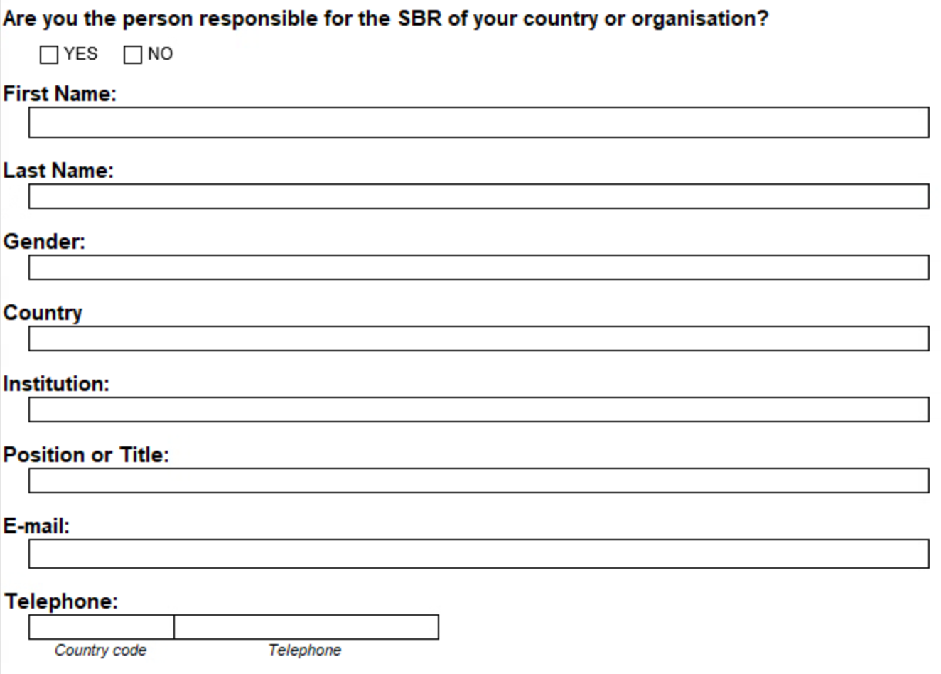
Reporter Data

Slide 15
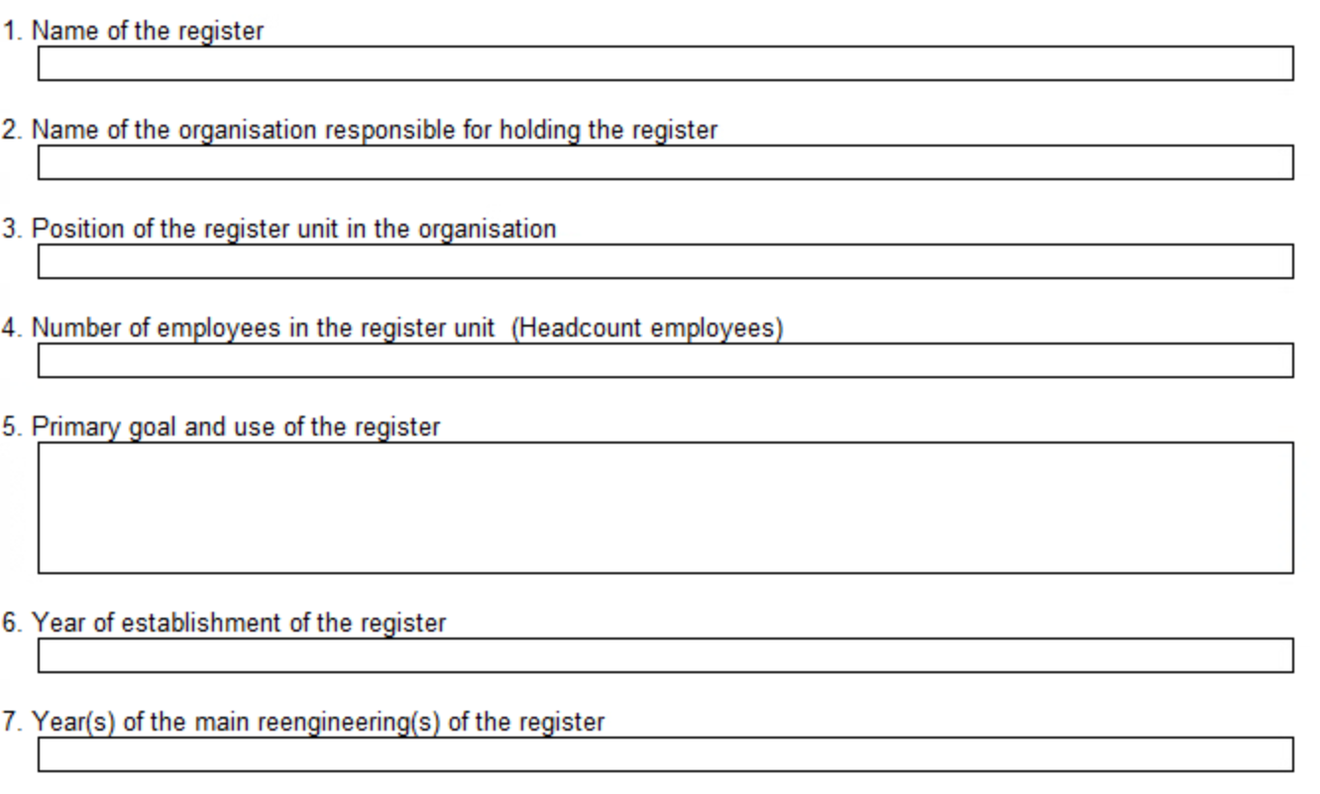
I. Organisation, Population and Usage of the Statistical Business Register
15

Slide 16
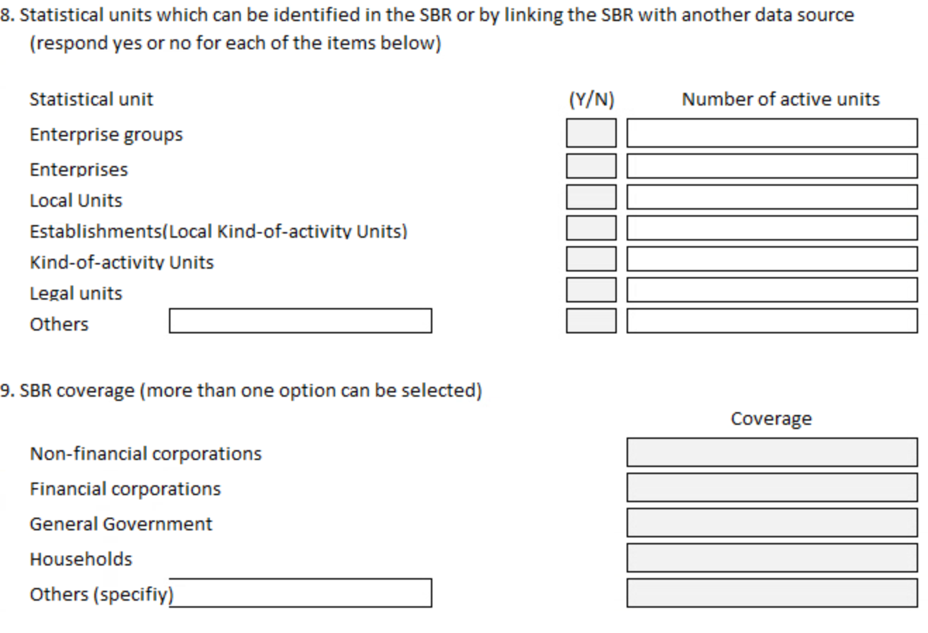
I. Organisation, Population and Usage of the Statistical Business Register (2)
16

Slide 17
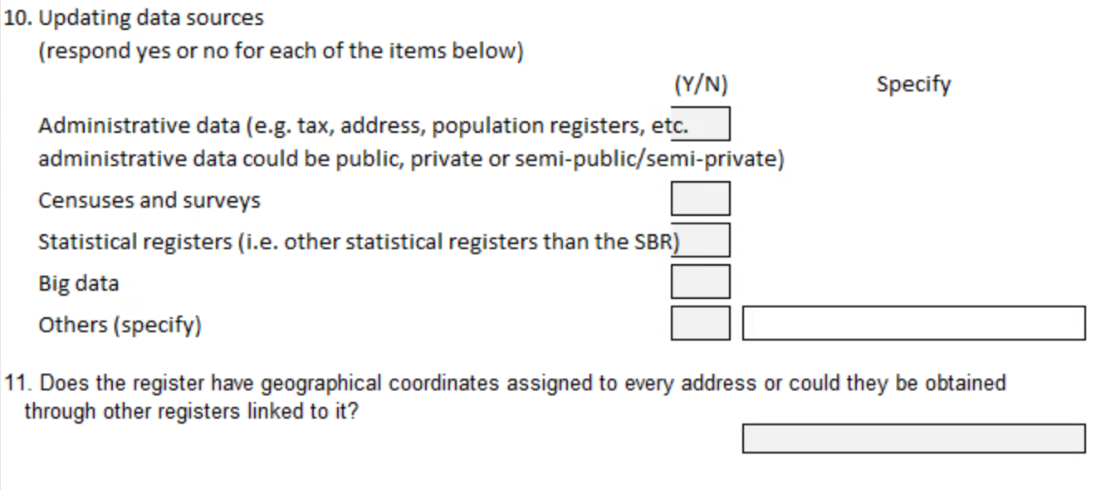
I. Organisation, Population and Usage of the Statistical Business Register (3)
17

Slide 18
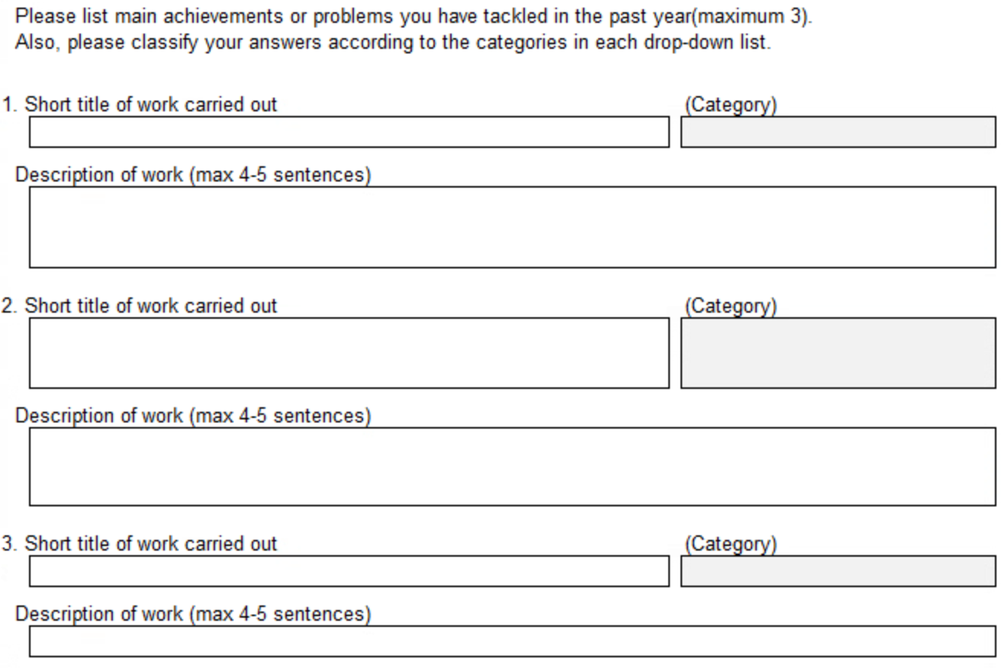
II. Progress and Developments
18

Slide 19
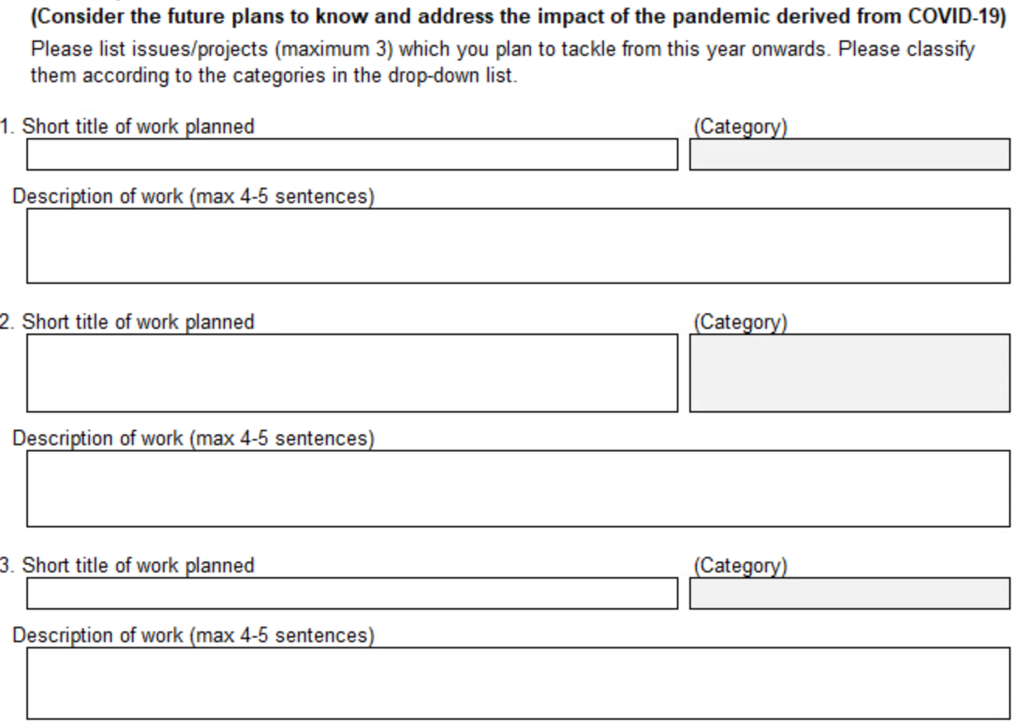
III. Future plans
19

Slide 20
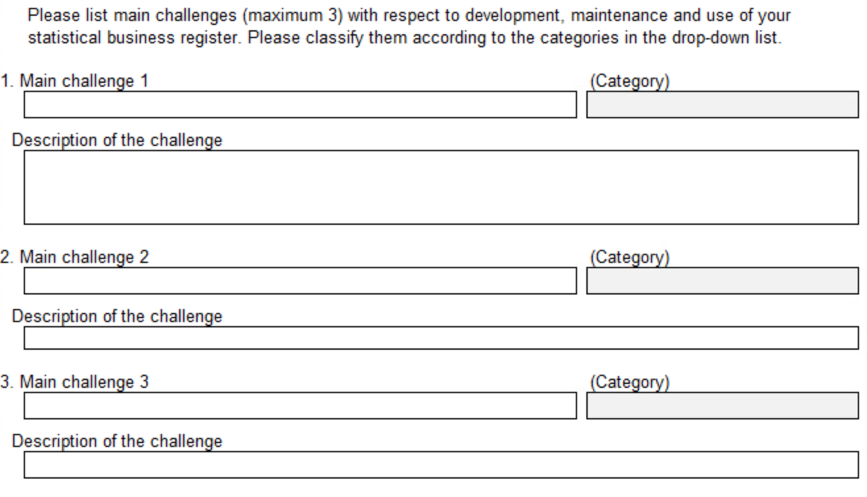
IV. Main challenges
20

Slide 21
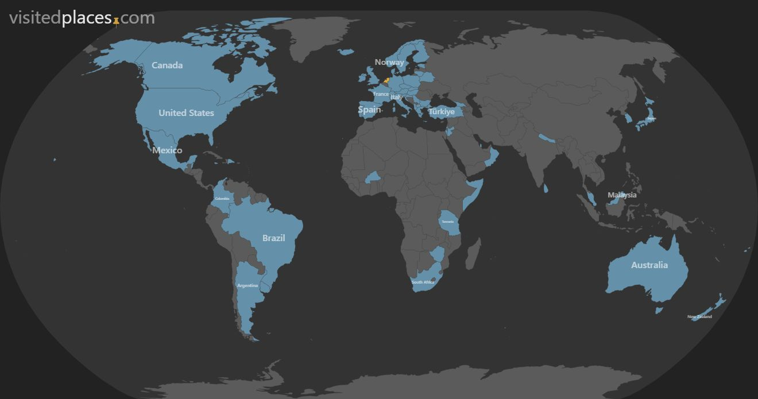
Response overview
Including:
Fiji
Georgia
Nepal
Sri Lanka
Turkey
21

Slide 22
Response compared to 2021
Africa
America
Asia
Europe
Oceania
2021
3
20
5
22
2
2023
5
10
11
31
3
22

Slide 23
Respondents
23

Slide 24
Year of establishment
24

Slide 25
Year of latest reengineering
25

Slide 26
Uses of the SBR
26

Slide 27
Size of SBR departments
27

Slide 28
SBRs by number of enterprises
28

Slide 29
SBR workload
# of enterprises divided by # of employees
29

Slide 30
SBR by type of unit
30

Slide 31
SBRs by coverage
31

Slide 32
Geo Coordinates
32

Slide 33
Sources for maintenance
33

Slide 34
Achievements, Future plans, and Challenges
34

Slide 35
Current work
Global assessment
Based on Self assessment questionnaire
Combine with:
Country Progress Report
Supported by Statistical Commission in March 2024
First time in 2025 (29th Wiesbaden Group meeting)

Slide 36
End of Session 10

