Slide 1
Regional Course on Statistical Business Registers
Session 11: Industry Classification System

Slide 2
Characteristics and Attributes
A Statistical Business Registry is a structured database of economic units and their characteristics or attributes integrated from various sources. It is built, maintained, improved by national statistics agencies through a cyclical process and used for statistical purposes.
Identification and contact
Demographic
Economic/stratification
Links and external references
Notes:
The characteristics are grouped and described in accordance with the following classification:
Identification and contact characteristics, including not only names, addresses and means of communication (telephone numbers, mail addresses, websites and the like) but also specific and unique identifiers (even internal identification numbers that enterprises use in monitoring their affiliates and that are not intended for the general public)
Demographic characteristics, including unit activity start and end dates, current status and continuity markers
Economic stratification characteristics, such as economic variables and classifications, used for sampling survey frames, grossing up sample data and presenting results.
Relationships (links) between units of different types within the SBR
Relationships (links) with units in other registers and data sources, including their specific identification numbers

Slide 3
Identification and contact
Purpose | Characteristics
Uniquely identify statistical units Link them to related legal, administrative or other statistical units Provide contact information for surveys or SBR maintenance | Type of unit Type of and role within enterprise group (if applicable) Identification number(s) Value added tax (VAT) registration number Name(s) Address Communication – phone number, email address, website, mailing address, etc.
Notes:
A set of variables are collected to uniquely identify units, and be able to find and reach out to them for further information (through surveys and censuses) .

Slide 4
Demographic
Purpose | Characteristics
Document the ‘enterprise life cycle’ – birth, structural changes, death Signify the creation of new or updating of existing enterprises Determine the status of enterprises | Date of incorporation, official recognition Date of commencement, final cessation of economic activity Date of merger, takeover, split or break
Notes:
A set of variables determines the status of the unit

Slide 5

Classification or stratification
Purpose | Characteristics
Classification for compiling data and producing statistics Stratification for surveys | Legal form Legal activity status Institutional sector and sub-sector Principal and secondary economic activity Market orientation Consolidated turnover Number of employees or persons employed
Notes:
A set of variables that determine the size, form, and the kind of economic activity the unit engages in

Slide 6
Economic stratification characteristics
Principal economic activity
Purpose: The principal economic activity code of a unit is a key stratification characteristic.
The activity code is based on a classification of economic activities. The recommended international classification for economic activities is ISIC
Secondary economic activity (activities)
Practical guidance in assigning and maintaining principal and secondary economic activity codes is provided in chapter 7 of the SBR guidelines.

Slide 7
Main concepts and application rules of ISIC

Slide 8
Relevant website
UNSD Classification of economic statistics
https://unstats.un.org/unsd/classifications/Econ
International Family of Classifications
https://unstats.un.org/unsd/classifications/Family
ISIC Rev.5
https://unstats.un.org/unsd/classifications/Family/Detail/2095

Slide 9
Main principles
In ISIC, economic activities are subdivided in a hierarchical, four-level structure of mutually exclusive categories.
Sections: The sections are the highest level of aggregation. The sections are labelled alphabetically and listed in figure B1.
Divisions: The next level contains two-digit divisions. Examples are Division 03; Fishing and aquaculture; Division 13: Manufacture of textiles.
Groups: The third level contains three-digit groups. Examples are Group 031 Fishing; Group 131: Spinning, weaving and finishing of textiles.
Classes: The most detailed level contains four-digit classes. Examples are Class 0312: Freshwater fishing; Class 1312: Weaving of textiles.

Slide 10
Main principles
ISIC classifies statistical units according to their principal activity
At each level of ISIC, a statistical unit is assigned to one and only one ISIC code. The set of statistical units that are classified into the same ISIC category is often referred to as an “industry”. Examples are:
The furniture industry – all units classified in ISIC division 31 (Manufacture of furniture).
The construction industry – all units classified in ISIC section F (Construction).

Slide 11
Main principles
Units
Theoretically, all types of units can be classified
However, structure and detail of ISIC is geared toward measuring production and establishment and kind-of-activity unit are the most suitable units
Ideally, units should be homogeneous with respect to activities and location
However, the choice of unit is not really an ISIC issue
Limitations are often set by data availability

Slide 12
ISIC statistical unit model
 |  | Partition by location
 |  | No | Yes
Partition by activity | No | Enterprise | Local unit
 | Yes | Kind-of-activity unit | Establishment (local kind-of-activity unit)

Slide 13
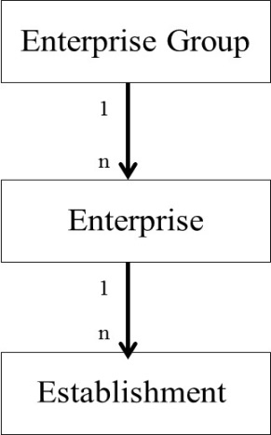
Recommended statistical unit model for SBR

Slide 14
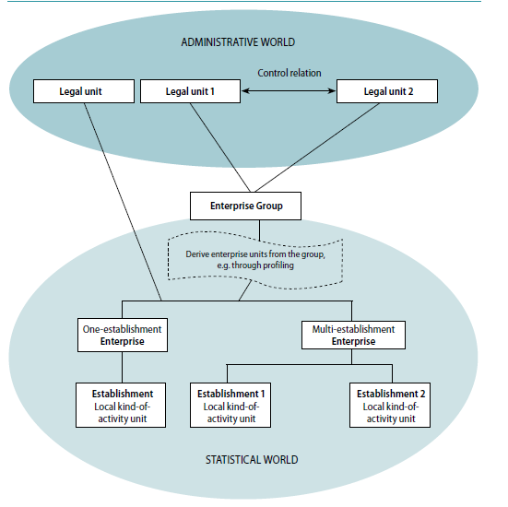
Link between statistical and administrative unit

Slide 15
Main principles
“Activity”
Classification of units is based on their actual activity, not their appearance or setup
E.g. a shipyard that only dismantles ships is classified in 3830 (Materials and other waste recovery) according to its activity (ship-breaking), although similar-looking units are in 3011 (Building of ships and floating structure).
Notes:
All categories at each level of the classification are mutually exclusive.
The principles and criteria that have been used to define and delineate these categories have not changed from previous versions of ISIC and are based on the inputs of goods, services and factors of production; the process and technology of production; the characteristics of outputs; and the use to which the outputs are put. Economic activities that are similar in respect of these criteria have been grouped together in the categories of ISIC.
At the most detailed level of the classification, preference has been given to the process and technology of production to define individual ISIC classes, particularly in the classes related to services.
At higher levels, characteristics of outputs and the use to which outputs are put become more important to create analytically useful aggregation categories. For many analytical purposes and for reasons of historical continuity, a strict application of these criteria has not proven useful. The weight that has been applied to each of these criteria will therefore invariably change throughout the classification. In addition, practical considerations, such as the organization of economic production in most countries and the need for stability of the classification, are factors that have also influenced the way categories have been defined at different levels of the classification.

Slide 16
Main principles
All ISIC categories at each level of the classification are mutually exclusive.
The principles and criteria for delineation are based on
the inputs of goods, services and factors of production;
the process and technology of production; the characteristics of outputs;
and the use to which the outputs are put.
Economic activities that are similar in respect of these criteria have been grouped together in the categories of ISIC.
Notes:
All categories at each level of the classification are mutually exclusive.
The principles and criteria that have been used to define and delineate these categories have not changed from previous versions of ISIC and are based on the inputs of goods, services and factors of production; the process and technology of production; the characteristics of outputs; and the use to which the outputs are put. Economic activities that are similar in respect of these criteria have been grouped together in the categories of ISIC.
At the most detailed level of the classification, preference has been given to the process and technology of production to define individual ISIC classes, particularly in the classes related to services.
At higher levels, characteristics of outputs and the use to which outputs are put become more important to create analytically useful aggregation categories. For many analytical purposes and for reasons of historical continuity, a strict application of these criteria has not proven useful. The weight that has been applied to each of these criteria will therefore invariably change throughout the classification. In addition, practical considerations, such as the organization of economic production in most countries and the need for stability of the classification, are factors that have also influenced the way categories have been defined at different levels of the classification.

Slide 17
Main principles
“Similar” activities are grouped together
Similarity is based on the three defining components for activities
However, at lowest level, emphasis is given to similarities in the process
At higher levels, the analytical use of the categories becomes more important
A strict application of a ranking of the three defining components would often lead to categories that are not useful (e.g. by process in manufacturing)
A pragmatic approach of applying the criteria for grouping has been maintained, as in previous versions of ISIC

Slide 18
Main principles
Although output (products) is related to the activity, it cannot always be used to determine the activity of a unit
However, with some caveats, it provides a good tool
Classes of ISIC are defined so that as far as possible the following two conditions are fulfilled:
(a) The production of the category of goods and services that characterizes a given class accounts for the bulk of the output of the units classified to that class;
(b) The class contains the units that produce most of the category of goods and services that characterize it.

Slide 19
Main principles
Since a unit can carry out several activities, rules are necessary to identify the primary activity of a given unit
This still requires knowledge about the individual activities (elementary activities) of a unit

Slide 20
ISIC – application rules
Concepts
Top-down method
Vertical integration
Outsourcing
Application and impact depends strongly on the selection of units
ISIC does not define units, but provides information and definitions
Int. Recommendations for Industrial Statistics (IRIS 2008) gives guidance
Choice of unit depends on statistics collected and on organizational settings
ISIC can theoretically be applied to all units

Slide 21
Top-down method

Slide 22
Top-down method
Method has not changed from previous versions of ISIC
Applies to units carrying out multiple activities
-> selection of unit is important ! (but this is not an ISIC issue)

Slide 23
Top-down method
The top-down method follows a hierarchical principle:
the classification of a unit at the lowest level of the classification must be consistent with the classification of the unit at the higher levels of the structure.
To satisfy this condition the process starts with the identification of the relevant position at the highest level and progresses down through the levels of the classification in the following way:

Slide 24
Top-down method
Step 1. Identify the section that has the highest share of the value added.
Step 2. Within this section, identify the division that has the highest share of the value added.
Step 3. Within this division, identify the group that has the highest share of the valued added (see below for exception in the case of wholesale and retail trade activities).
Step 4. Within this group, identify the class that has the highest share of value added.

Slide 25
Question – what is the principal activity?
Section | Division |  | Group | Class | Description of the class | Share of value added (percentage)
C |  | 25 | 251 | 2512 | Manufacture of tanks, reservoirs and containers of metal | 7
 | 28 |  | 281 | 2816 | Manufacture of lifting and handling equipment | 8
 |  |  | 282 | 2821 | Manufacture of agricultural and forestry machinery | 3
 |  |  |  | 2822 | Manufacture of metal-forming machinery and machine tools | 21
 |  |  |  | 2824 | Manufacture of machinery for mining, quarrying and construction | 8
 |  | 29 | 293 | 2930 | Manufacture of parts and accessories for motor vehicles | 5
G |  | 46 | 461 | 4610 | Wholesale on a fee or contract basis | 7
 |  |  | 465 | 4659 | Wholesale of other machinery and equipment | 28
N |  | 71 | 711 | 7110 | Architectural and engineering, and related technical consultancy activities | 13

Slide 26
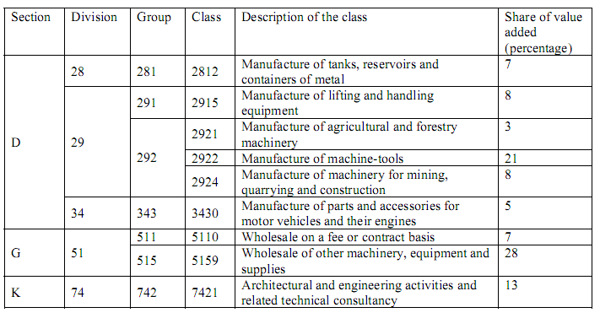
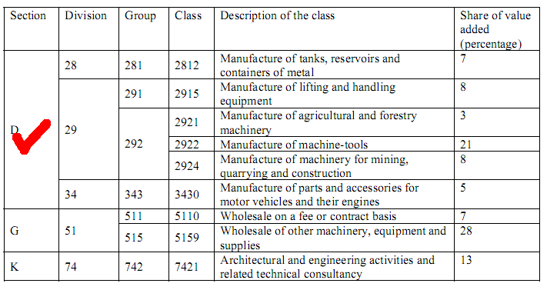
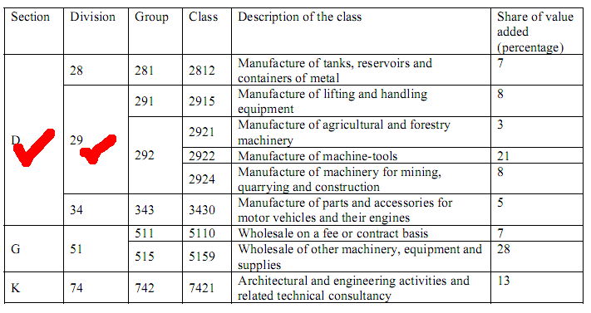
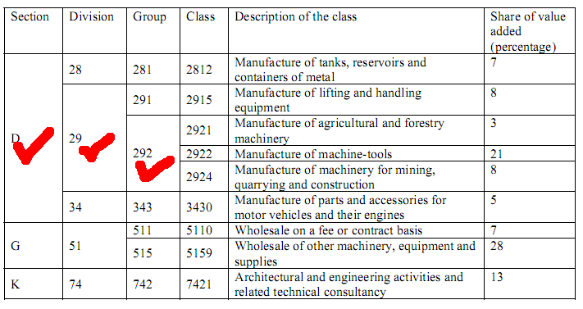
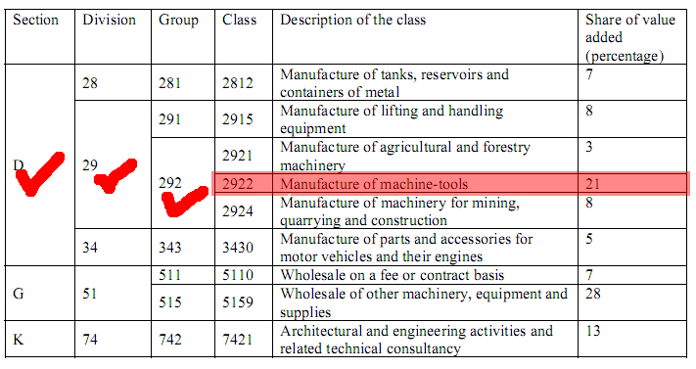
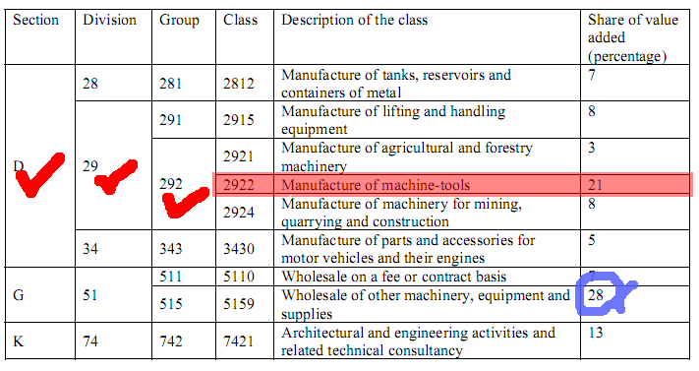
Top-down method
Identify the section which has the highest share of the value added.
Within this section identify the division which has the highest share of the value added within this section.
Within this division identify the group which has the highest share of the valued added within this division.
Within this group identify the class which has the highest share of value added within this group.
(Box 1)

Slide 27
Top-down method
For wholesale and retail trade, step 3 has to be refined
Why?
Additional levels exist that are not part of the ISIC structure itself, e.g.
Own-account vs. fee-based
Specialized vs. non-specialized
Similar distinctions do not exist for other activities, such as manufacturing.
The principal activity is then determined as follows
Step 1: Identify the section
Step 2: Identify the division
Step 3a: Identify specialized or non-specialized trade
Step 3b: Identify the group
Step 4: Identify the class

Slide 28
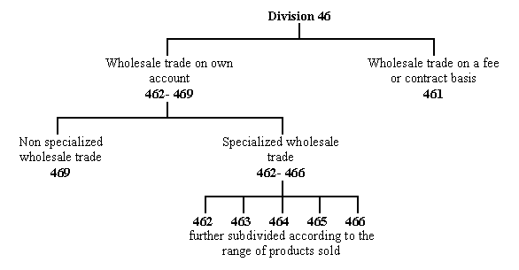
Top-down method Wholesale

Slide 29
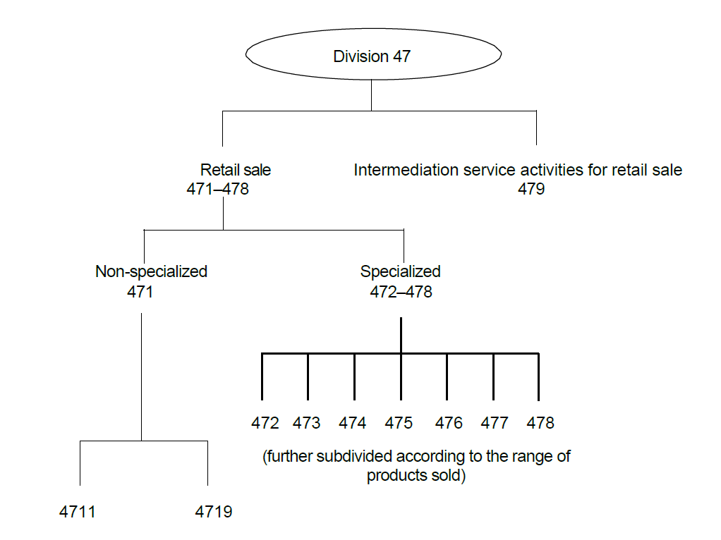
Top-down method Retail sale

Slide 30
Top-down method
The rules may sound complicated, but:
Reflect more complex composition of trade activities in ISIC
Driven by the desire for more detail in this area
Provide necessary definitions for specialized vs. non-specialized trade activities

Slide 31
Top-down method
Criteria for specialized vs. non-specialized trade
Idea:
“Non-specialized” should involve a significant number of different product lines
“Noise items” should be ignored
Implementation:
It is considered to be “non-specialized” trade if products from five or more classes from ISIC groups 472-478 are involved (excluding those who make up less than 5% of value added), and if none of them make up more than 50% of value added.
Only trade activities are taken into account when computing percentages.

Slide 32
Vertical integration

Slide 33
Treatment of vertically integrated activities
Vertical integration of activities occurs where the different stages of production are carried out in succession by the same unit and where the output of one process serves as input to the next.
Examples of common vertical integration:
tree felling and subsequent sawmilling
production of wearing apparel in a textile mill

Slide 34
Treatment of vertically integrated activities
Vertical integration should be treated like any other form of multiple activities, i.e. the principal activity of the unit is the activity accounting for the largest share of value added, as determined by the top-down method.
If value added or substitutes cannot be determined for the individual steps in a vertically integrated process directly from accounts compiled by the unit itself, comparisons with similar units could be used. Alternatively, valuation of intermediate or final products could be based on market prices.

Slide 35
Treatment of vertically integrated activities
Impact of the changed rule should be minimal, since in many cases units will be broken up statistically if portions are substantial

Slide 36
Outsourcing

Slide 37
Outsourcing
Can take many forms:
Outsourcing of labour
Outsourcing of support functions
Outsourcing of parts of a production process
Outsourcing of the complete production process

Slide 38
Outsourcing - Terminology
Principal = unit that enters in a contractual relationship with another unit (here called contractor) to carry out some part of the whole production process. Sometimes, the terms "converter" or "contractor" had also been used.
Contractor = unit that carries out a specific production process based on a contractual relationship with a Principal. The term "subcontractor" had been used too. The activities performed by the contractor are denominated "on a fee or contract basis".
Outsourcing = contractual agreement according to which the principal requires the contractor to carry out a specific production process. Sometimes, the term "subcontracting" is used as well.

Slide 39
Outsourcing - Terminology
Other terminology is sometimes used (e.g. in recent OECD documents), where in this context:
“insourcing” and “outsourcing” refers to relationship between units involved
“offshoring” refers to transactions between economic territories
This terminology is not used here.

Slide 40
Outsourcing
The principal and the contractor may be located in the same economic territory or in different economic territories: the actual location does not affect the classification of either one of these units.

Slide 41
Outsourcing
Contractors, i.e. units carrying out an activity on a fee or contract basis, are usually classified with units producing the same goods or services for their own account

Slide 42
Outsourcing - manufacturing
In manufacturing, the principal provides the contractor the technical specifications of the manufacturing activity to be carried out on the input material.
The input material (raw or intermediate good) can either be provided (owned) by the principal or not.

Slide 43
Outsourcing - manufacturing
A principal who outsources only part of the transformation process is to be classified into manufacturing.
The activity of a principal who completely outsources the transformation process should be classified into manufacturing only if he owns the raw material used as input to the production process (and therefore owns the final output).

Slide 44
Outsourcing - manufacturing
In all other cases, the activity of the principal should be classified in Section G "Wholesale and retail trade" (according to the type of operation and the specific good sold).
In this case the principal buys the good from the contractor and re-sells it without transformation

Slide 45
Outsourcing - manufacturing
Output of outsourced activities:
If principal owns the input materials:
Service
Principal
Contractor
Good

Slide 46
Outsourcing - manufacturing
Output of outsourced activities:
If principal does not own the input materials:
Good
Principal
Contractor
Re-sale of good
= trade activity

Slide 47
Outsourcing – manufacturing
Some remarks:
A unit classified in Manufacturing can have two types of outputs:
a manufactured good
a manufacturing service
Both are identified in the product classification
Manufacturing is defined as a (mechanical or chemical) transformation process
This implies that the “manufacturer” has to have ownership of the good before and after the transformation process

Slide 48
Outsourcing – manufacturing
Some remarks:
Proposals for classification (in this case) are often driven by a reference to “risk”
To take the risk of manufacturing, you need to have a liability in this process
Owning the concept is not sufficient
Owning the concept does not imply ownership of the produced good
Sale of goods
Wholesale/retail sale is defined as “buying and reselling without transformation”
Simply selling the goods that you produce does not make you a wholesaler/retailer

Slide 49
Outsourcing – services
For services, the concept of a “service retailer” does not exist
If the whole process (service provision) is outsourced, both the principal and the contractor are classified to the same ISIC class
If only a portion of the process is outsourced, the principal remains classified as if it were carrying out the complete process
If a separate class exists for the outsourced portion, the contractor is classified to that portion, otherwise to the same class as the principal

Slide 50
Outsourcing – support functions
This applies to the outsourcing of functions like accounting, computer services etc.
In this case, the principal is classified as if it were carrying out the complete core process. (In other words, support functions do not influence the classification of a unit.)
The contractor is classified to the specific support function it is carrying out.

Slide 51
Outsourcing – employment
Increasingly, companies emerge that provide only the labour force to their clients.
In turn, producers (e.g. manufacturers) may have little or no employment
In this case the principal is classified as if it were operating with own employees.
The contractor is classified to ISIC 7820 or 7830, depending on the type of contract.
Important: Define the line between off-site employees and independent providers

Slide 52
Outsourcing
Contractor
Principal
Wholesale trade
Classify in ISIC 4610
Manufacturing
Services
Classify as if carrying out the complete process itself
Other
Classify as if contracted activity was carried out for own account
Partially oursourced
Remains classified in manufacturing (ISIC Section C)
Completely outsourced
Owns input
Remains classified in manufacturing (ISIC Section C)
Does not own input
Classified as wholesale/retail trade (ISIC Section G)
Employment
Classify in ISIC 7820 or 7830
Also: outsourcing of labour or support functions does not influence the classification of the principal.

Slide 53
Factoryless Goods Producer
Definition of FGP from the ongoing SNA revision:
A factoryless goods producer (FGP) is a principal that controls the production of a good by undertaking the entrepreneurial steps and providing the technical specifications required to produce the good, but that fully outsources the material transformation process required to produce the output
A principal in section C (Manufacturing) should not only own the final output, but also satisfy one of the following conditions: a) it owns the input materials to the production process, or b) it owns the intellectual property products (IPP).
In general, FGPs will continue to be classified in the same class where they would be classified if they carried out the manufacturing process themselves in Section C (Manufacturing).
Notes:
The guidance on the classification of Factoryless Good Producers (FGPs) in ISIC Rev. 4 was reviewed in light of the ongoing discussion on the definition of FGPs within the update process of the 2008 SNA and the Balance of Payments and International Investment Position Manual (BPM6).
As a result of this review, it was agreed that the criteria for identifying FGPs should include ownership of the intellectual property products (IPP) in addition to the ownership of the input materials.
The 2025 SNA define A factoryless goods producer (FGP) is a principal that controls the production of a good by undertaking the entrepreneurial steps and providing the technical specifications required to produce the good, but that fully outsources the material transformation process required to produce the output
During the ISIC revision process, it was discussed the control criteria for defining FGPs should cover some aspects of the control of the transformation process, including quality control and oversight of the production process. However, the discussion on FGP has since evolved during the SNA update process. As a result, the discussion on the control of the transformation process will be placed in the future research agenda.
The distinction between affiliates and non-affiliates is not a relevant criterion in the definition and classification of FGPs.
Overall, there was the recognition of the importance of separately identifying FGPs in the classification. However, based on current practices and feedback, it was agreed that it is not feasible at this stage to separately classify FGPs in ISIC and, by extension, in NACE.
Therefore, FGPs will continue to be classified in the same class where they would be classified if they carried out the manufacturing process themselves in Section C. In addition, Statistical Business Registers are encouraged to identification FGPs, so that this issue can be reconsidered in the next revision of the economic activity classifications.
A principal who completely outsources the transformation process but does not own the input materials is in fact buying the completed good from the contractor with the intention to re-sell it. Such an activity is classified in section G (Wholesale and retail trade), specifically according to the type of sale and the specific type of good sold.

Slide 54
Other issues

Slide 55
Change of principal economic activity
The principal activity may be assumed to be positively correlated with the continuity of the production factors. This criterion, however, is probably not relevant for multi-activity enterprise groups, where relatively small changes to one part of the group may cause a major change to the economic activity code of the group as a whole. In addition, a gradual shift in activities may (after respecting an appropriate stability rule) eventually cause a change in economic activity code, resulting in a reclassification of the enterprise group. In such cases, there is continuity and the change of activity may be disregarded.
To use the principal economic activity in determining continuity requires following the mix of economic activities of the group members in terms of value added, if available, or, if not, turnover. Employment may also be used, in particular in cases where no reliable turnover is available for each enterprise, only consolidated turnover for a VAT group. It has also been found that employment is also generally more stable over time than turnover.
For multi-activity groups, use of principal economic activity in determining continuity is very sensitive to the definition of the principal activity (especially at four-digit level) and also to whether some pre-defined threshold (such as 50 per cent) is used. Thus, principal activity as a single criterion is not a good approach. For all-resident groups in particular, however, a sudden change of principal economic activity when combined with some other changes, for example of group head or employment, is a strong indication of discontinuity. At global level, principal economic activity as a criterion is more difficult to apply.
Notes:
Change of principal economic activity
The principal activity may be assumed to be positively correlated with the continuity of the production factors. This criterion, however, is probably not relevant for multi-activity enterprise groups, where relatively small changes to one part of the group may cause a major change to the economic activity code of the group as a whole. In addition, a gradual shift in activities may (after respecting an appropriate stability rule) eventually cause a change in economic activity code, resulting in a reclassification of the enterprise group. In such cases, there is continuity and the change of activity may be disregarded.
To use the principal economic activity in determining continuity requires following the mix of economic activities of the group members in terms of value added, if available, or, if not, turnover. Employment may also be used, in particular in cases where no reliable turnover is available for each enterprise, only consolidated turnover for a VAT group. It has also been found that employment is also generally more stable over time than turnover.
For multi-activity groups, use of principal economic activity in determining continuity is very sensitive to the definition of the principal activity (especially at four-digit level) and also to whether some pre-defined threshold (such as 50 per cent) is used. Thus, principal activity as a single criterion is not a good approach. For all-resident groups in particular, however, a sudden change of principal economic activity when combined with some other changes, for example of group head or employment, is a strong indication of discontinuity. At global level, principal economic activity as a criterion is more difficult to apply.

Slide 56
Miscalculation of principal economic activity
Misclassification of principal activity of units in a frozen frame leads to undercoverage or overcoverage in the subsets of the frame corresponding to specific industries. Special efforts should be made to correct for this kind of error as it leads to increase in variance (due to overcoverage) and bias (due to undercoverage) in the following way. After a frozen frame is produced, a survey frame derived, and a survey sample is drawn, the resulting observation units complete a questionnaire. This may have the following outcomes:
It may turn out that a respondent reports that the registered activity code of the observation unit is not correct. In this case this frame error should be corrected in the survey dataset, because otherwise the observation will be attributed to the wrong industry. This does not cause bias but increases the variance of estimates.
Alternatively, it may be that units were not included in the survey frame because of being misclassified to out-of-scope industries. This introduces negative bias in the estimates.
Notes:
Misclassification of principal activity of units in a frozen frame leads to undercoverage or overcoverage in the subsets of the frame corresponding to specific industries. Special efforts should be made to correct for this kind of error as it leads to increase in variance (due to overcoverage) and bias (due to undercoverage) in the following way. After a frozen frame is produced, a survey frame derived, and a survey sample is drawn, the resulting observation units complete a questionnaire. This may have the following outcomes:
It may turn out that a respondent reports that the registered activity code of the observation unit is not correct. In this case this frame error should be corrected in the survey dataset, because otherwise the observation will be attributed to the wrong industry. This does not cause bias but increases the variance of estimates.
Alternatively, it may be that units were not included in the survey frame because of being misclassified to out-of-scope industries. This introduces negative bias in the estimates.

Slide 57
Revision of International Standard Industrial Classification of All Economic Activities (ISIC)

Slide 58
ISIC Revision History
Complete structure of ISIC Rev. 5 was endorsed by UNSC at its 54th session in 2023
UNSC at its 52nd session in 2021 endorsed a revision of ISIC, and approved ToR of task team on ISIC (TT-ISIC) for its revision
Original ISIC was adopted in 1948
Revision 3.1
Revision 2
1948
1958
1968
1990
2002
2008
…
2021
2022
2023
2024
v
High-level structure of ISIC Rev. 5 was endorsed by UNSC at its 53rd session in 2022
ISIC, Rev. 5 introductory text, explanatory notes, and implementation plan were submitted to UNSC for endorsement at its 55th session in 2024
Revision 1
Revision 3
Revision 4

Slide 59
Objectives of the ISIC revision
Relevance
Reflect new industries, new production pattern, new needs for economic analysis
Comparability
Improve linkages to major regional classifications
Continuity
Maintain close links to the previous version of ISIC
Main task: balancing these three objectives

Slide 60
Increased detail of ISIC during each revision process
 | ISIC Rev.3 | ISIC Rev.4 | ISIC Rev.5
Sections | 17 | 21 | 22
Divisions | 60 | 88 | 87
Groups | 159 | 238 | 258
Classes | 292 | 419 | 463

Slide 61
Main changes in ISIC – intermediation services
Identification of intermediation service activities
Definition of non-financial intermediation service
No distinction in the ISIC classification criteria between “digital” and other means (face-to-face, telephone, mail, email, etc.)
A number of groups and classes were created exclusively for intermediation services
…
4790 Intermediation service activities for retail sale
…
5540 Intermediation service activities for accommodation
…
6120 Telecommunication reselling activities and intermediation service activities for telecommunication
…
Notes:
Intermediation activities have increased enormously due to the technological advances through digital platforms. Due to the growing importance of these activities, its classification has recently been the subject of several discussions and some decisions were made and introduced in the framework of the new ISIC Rev 5
Firstly, a definition of intermediation service activities was agreed in order to clearly specify the types of activities.
Intermediation services activities have been defined as follows:
‘Intermediation services activities are activities that facilitate transactions between buyers and sellers for the ordering and/or delivering of goods and services for a fee or commission, without supplying the services or taking ownership of the goods that are intermediated. These activities can be carried out on digital platforms or through non-digital channels. Revenue for the intermediation activities can include other sources of income, such as revenues from sale of advertising space.’
Note that this definition excludes financial and insurance intermediation service activities, which are classified in section L “Financial and insurance activities”
Based on that, separate groups or classes have been created in the divisions where these goods and services are produced and where there is a significant component in the delivery of the underlying good or service of the respective divisions.
Intermediation services (except financial intermediation and intermediation service activities for telecommunications activities) which cannot be classified in the dedicated classes or belong to several divisions, are integrated into a dedicated class ISIC Rev. 5 and NACE Rev. 2 82.40.

Slide 62
Main changes in ISIC – FGP
Definition of FGP from the ongoing SNA revision:
A factoryless goods producer (FGP) is a principal that controls the production of a good by undertaking the entrepreneurial steps and providing the technical specifications required to produce the good, but that fully outsources the material transformation process required to produce the output
A principal in section C (Manufacturing) should not only own the final output, but also satisfy one of the following conditions: a) it owns the input materials to the production process, or b) it owns the intellectual property products (IPP).
In general, FGPs will continue to be classified in the same class where they would be classified if they carried out the manufacturing process themselves in Section C (Manufacturing).
Notes:
The guidance on the classification of Factoryless Good Producers (FGPs) in ISIC Rev. 4 was reviewed in light of the ongoing discussion on the definition of FGPs within the update process of the 2008 SNA and the Balance of Payments and International Investment Position Manual (BPM6).
As a result of this review, it was agreed that the criteria for identifying FGPs should include ownership of the intellectual property products (IPP) in addition to the ownership of the input materials.
The 2025 SNA define A factoryless goods producer (FGP) is a principal that controls the production of a good by undertaking the entrepreneurial steps and providing the technical specifications required to produce the good, but that fully outsources the material transformation process required to produce the output
During the ISIC revision process, it was discussed the control criteria for defining FGPs should cover some aspects of the control of the transformation process, including quality control and oversight of the production process. However, the discussion on FGP has since evolved during the SNA update process. As a result, the discussion on the control of the transformation process will be placed in the future research agenda.
The distinction between affiliates and non-affiliates is not a relevant criterion in the definition and classification of FGPs.
Overall, there was the recognition of the importance of separately identifying FGPs in the classification. However, based on current practices and feedback, it was agreed that it is not feasible at this stage to separately classify FGPs in ISIC and, by extension, in NACE.
Therefore, FGPs will continue to be classified in the same class where they would be classified if they carried out the manufacturing process themselves in Section C. In addition, Statistical Business Registers are encouraged to identification FGPs, so that this issue can be reconsidered in the next revision of the economic activity classifications.
A principal who completely outsources the transformation process but does not own the input materials is in fact buying the completed good from the contractor with the intention to re-sell it. Such an activity is classified in section G (Wholesale and retail trade), specifically according to the type of sale and the specific type of good sold.

Slide 63
Main changes in ISIC – section G (Wholesale and retail trade)
Elimination of distinction between online and in-store sales channels in section G
New treatment of wholesale and retail trade and repair of motor vehicles and motorcycles
ISIC, Rev. 4 division 45 (Wholesale and retail trade and repair of motor vehicles and motorcycles) was removed, and its activities were moved to other divisions.
The activities of maintenance and repair of motor vehicles and motorcycles
moved away from ISIC section G to section T (Other service activities)
placed in Division 95 (Repair and maintenance of computers, personal and household goods, and motor vehicles and motorcycles), together with the repair of computers and personal and household goods.
Activities on the wholesale and retail trade of motor vehicles and motorcycles were moved to the respective divisions on wholesale and retail trade.

Slide 64
Main changes in ISIC – new activities in ICT and finance
A split of ISIC, Rev. 4 Section J (Information and communication) into two
ISIC Rev.5 Section J - Publishing, content production and distribution
ISIC Rev.5 Section K - Telecommunications, computer programming, consultancy, computing infrastructure, and other information service activities.
The distinction at the group level between wired, wireless, and satellite telecommunications activities has been removed.
A new group, ISIC Rev. 5 group 631 “Computing infrastructure, data processing, hosting and related activities” containing a single class “Computing infrastructure, data processing, hosting and related activities” has been created to include activities such as cloud infrastructure , platform provision and cloud computing
A new group, ISIC Rev. 5 group 639, “Web search portal activities and other information service activities”.
Cybersecurity activities will be integrated in activities of software development, programming, consultancy activities and incident/information management
Notes:
ISIC Rev. 4 Section J has been split into two new sections: Section J “Publishing, broadcasting, and content production and distribution activities” and Section K “Telecommunication, computer programming, consulting, computing infrastructure and other information service activities”.
The first section (for which code J will be re-used), “Publishing, broadcasting, and content production and distribution activities”, includes the existing divisions 58, 59 and 60, as well as news agencies and post-production recording conversion services to streaming formats, formerly in division 63; the second section new section (for which code K will be re-used) “Telecommunication, computer programming, consulting, computing infrastructure, and other information service activities”, includes existing divisions 61, 62 and part of 63.
Creation of a new group 603 “News agency and other content distribution activities” composed of classes 6031 “News agency activities” (moved from ISIC Rev.4 Class 6391) and 6039 “Other content distribution activities” (new class).
Removal of the distinction at the group level between wired, wireless, and satellite telecommunications activities. Groups 611, 612 and 613 have been merged into one only group 611 “Wired, wireless and satellite telecommunication activities” containing a single class 6110 “Wired, wireless and satellite telecommunication activities”.
Class 6201 “Computer programming activities” has been transformed in Class 6211 “Development of video games, video game software, and video game software tools” and class 6219 “Other computer programming activities”.
Classes 6202 “Computer consultancy activities and computer facilities management activities” have been transformed into one new group 622 “Computer consultancy and computer facilities management activities” containing a single class 6220 “Computer consultancy and computer facilities management activities”.
Class 6209 “Other information technology and computer service activities” has been transformed in a new group 629 “Other information technology and computer service activities” containing a single class 6290 “Other information technology and computer service activities”.
Group 631 “Data processing, hosting and related activities; web portals” has been split into Group 591 “Motion picture, video and television programme activities”, Group 631 “Computing infrastructure, data processing, hosting and related activities” and Group 639 “Web search portals activities and other information service activities.
The new group 631 “Computing infrastructure, data processing, hosting and related activities” contains a single class 6310 “Computing infrastructure, data processing, hosting and related activities” to include activities such as cloud infrastructure and platform provision (IaaS, PaaS) and cloud computing (except software publishing and computer systems design) whether or not in combination with infrastructure provision, distributed ledger (blockchain) technology data processing activities and technical infrastructure provisioning services related to streaming.
The new group 69 “Web search portal activities and other information service activities” contains a single classes: 63.90 “Web search portal activities and other information service activities”. These class has been created to cover activities of web sites that use a search engine to generate and maintain extensive databases of Internet addresses and content in an easily searchable format (known as Web search portals).
Cybersecurity activities will be integrated in activities of software development, programming, consultancy activities and incident/information management under the new classes 6219 “Other computer programming activities”, 6220 “Computer consultancy and computer facilities management activities” and 6290 “Other information technology and computer service activities”. Cybersecurity software publishing will be added to group 582 “Software publishing”.

Slide 65
Main changes in ISIC – new activities in finance
More breakdowns for financial activities and updated explanatory notes to reflect new technology
Compared to section K in ISIC, Rev. 4, the new section L (Financial and Insurance activities) includes some new classes for financial services
…
6422 Activities of financing conduits
6431 Activities of money market funds
6491 Financial leasing activities
…
Notes:
Group 642 “Activities of holding companies” has been split into class 6421 “Activities of holding companies” and 6422 “Activities of financing conduits”.
Group 643 “Trusts, funds and similar financial entities” has been split into class 6431 “Activities of money market”, class 6432 “Activities of non-money market investments funds” and class 6433 “Activities of trust, estate and agency accounts”.

Slide 66
Main changes in ISIC – education, arts, culture
Updated the structure of section P on education to better align with International Standard of Classification of Education (ISCED).
For example, ISIC Rev. 4 Group 851 - "Pre-primary and primary education" was split into two new groups: "Pre-primary education" and "Primary education".
More breakdowns for activities related to Section S on arts and cultural activities.
The structure of ISIC Rev. 4 division 90 - "Creative, arts and entertainment activities" and division 91 - "Libraries, archives, museums, and other cultural activities" were reorganized to distinguish arts creation activities, performing arts, museums, collections, historical sites, and monuments activities, 913 ‑ Conservation, restoration and other support activities for cultural heritage, etc.

Slide 67
Main changes in ISIC –environment, and others
Environmental Issues
Division 39 (remediation and other waste management service activities): inclusion of carbon remediation, capture and storage activities
New classes 3511 and 3512 on electric power generation activities from non-renewable sources vs. renewable sources
New class 8413 - Regulation of the activities of providing environmental services
Class 8130 (Landscape service activities) - Improved explanatory notes to reflect selected activities on managing and conserving ecosystem and biodiversity
Separate Nature reserve activities (9412) from Botanical and zoological garden activities (9411)
Other changes at the class level
Further breakdown of 2610: new class for the manufacture of solar cells and panels, and photovoltaic inverters vs. for other electronic components
Further breakdown of 3100: news class for the manufacture of wooden furniture vs. for other furniture

Slide 68
ISIC Rev. 5 Explanatory Notes
Comprehensive review of specific activities. A few examples among the many changes are given below:
Quails are explicitly included in 0146 (Raising of poultry).
Manufacture of intercontinental ballistic missiles (ICBM) is removed from 3030 (Manufacture of air and spacecraft and related machinery) and implicitly included in 2520 (Manufacture of weapons and ammunition)
Distinction between 5510 (Hotels and similar accommodation activities) and 5520 ( Other short term accommodation activities) in the relevant explanatory notes
Alignment with SNA guidance notes
Treatment of crypto assets with and without liabilities in 6310, 6499, 6612, 6619 and 8299
No change in ISIC, Rev. 5 on Islamic finance

Slide 69
ISIC, Rev. 5 Introduction
Drafted based on the ISIC Rev.4 introduction
Increased alignment with 2008 SNA (e.g., para 39 on the characteristics of activities)
Updated description on the treatment of repair and maintenance activities (pp. 138-139)
Updated definition and treatment of FGPs, based on feedback from the ongoing SNA revision (pp. 140-150)
New discussion on intermediation services (pp. 157-159)
New discussion on financial activities (e.g. SPEs, in pp. 160-164)
List of changes from ISIC, Rev. 4 to Rev. 5 (Part Four – Changes in ISIC, Rev. 5)

Slide 70
ISIC, Rev. 5 Implementation Plan
Targets for implementation to support wider high-level engagement and identify actions at the global level to support implementation in countries
Provides a general direction for the steps to be taken in setting up an implementation programme at the national and regional level
The components of the work for the implementation plan include the development of national industry classifications adapted from ISIC revision 5 and the application of those national adapted classifications in statistical programmes.

Slide 71
Decision items for the UNSC 55th session
ISIC, Rev. 5 introductory text, explanatory notes, and implementation plan are submitted as separate background documents for endorsement, and were subsequent endorsed.
Introduction: https://unstats.un.org/UNSDWebsite/statcom/session_55/documents/BG-4e-ISIC5-Introuction-E.pdf
Explanatory notes: https://unstats.un.org/UNSDWebsite/statcom/session_55/documents/BG-4e-ISIC5_Exp_Notes-E.pdf
Implementation plan: https://unstats.un.org/UNSDWebsite/statcom/session_55/documents/BG-4e-ISIC5_Implementation_plan-E.pdf

Slide 72
The way forward with ISIC, Rev. 5
Planned work on correspondences:
ISIC, Rev. 4 — ISIC, Rev. 5
ISIC, Rev. 5 — NACE, Rev. 2.1
ISIC, Rev. 5 — CPC Ver. 3.0
More planned work on ISIC
Develop other supplementary materials, such as alphabetical index, a case law center, alternative structure, implementation guidelines, etc.
Establish a Standing Task Team on ISIC and CPC, make ISIC revision process more predictable and transparent in the future, and keep ISIC responsive to new user needs and emerging issues.

Slide 73
Recoding the business register to ISIC Rev.5

Slide 74
Overview
This presentation will look at options applicable in the recoding of the business register to a new classification
Valid not only for ISIC Rev.5

Slide 75
Planning of the recoding process
Estimation of work oad
Number of units to be recoded
System setup
Preparing of environment separate from production environment; dual coding options
Identification of possible sources
Setting of timeline

Slide 76
Planning of recoding process
Communication of changes
To internal users
To external users

Slide 77
Requirements
For the recoding exercise it is assumed that:
A business register exists, coded to the previous classification
A detailed correspondence table exists between the old and the new classification

Slide 78
Goal
The primary goal of recoding the business register is to update the codes of the units in the register to the new classification
Verifying the current coding of the units is not a primary objective, although wrong codes may be detected (and corrected along the way)

Slide 79
General approach
The “recoding” suggests that exisitng information will be used to arrive at the new classification code, rather than a straight “coding” of each unit in the register
Since the old code is known, the existing correspondence table should be used to find out where this unit is coded in the new classification

Slide 80
General approach
Applying the correspondence table to the code of a given unit results in a list of possible codes for that unit in the new classification
If only one code appears as an option (the 1-1 or m-1 cases), the unit is simply recoded to this new code
The real work starts if more than one code is possible (the 1-n or m-n cases)

Slide 81
Recoding units in m-n cases
All units in the business register need to be recoded
Due to resource constraints, one will often limit the amount of m-n cases
As not all units are statistically significant, a determination of which units should be recoded and which units should be “approximated” can be made

Slide 82
Internal sources
Existing business activity descriptions
Incl. existing information from past profiling activities
Product data
“in-house” sources
E.g specialists for industry branches

Slide 83
External sources
Administrative sources
Tax authorities (wages, VAT, etc.)
Social security (activity and existence)
Commercial sources
Trade associations
Chambers of commerce
Others
Telephone directories, ‘Yellow Pages’
Early inclusion of external sources in the revision process improves usefulness of information

Slide 84
Profiling
Profiling is used for large and complex enterprises
Too important to rely on estimates or possibly incorrect information
Complex structure needs to be explored to correctly assign statistical units
Can be done by personal visit, telephone etc.
Existing administrative sources might work for simple structures
Example: In Canada for manufacturing less than 500 units are profiled, accounting for over 80 per cent of value added

Slide 85
Surveys
If internal and external sources or profiling do not provide enough information, surveys can be carried out
Options:
Special surveys just to determine the new code
Register surveys (regular or special)
Product surveys
Add-ons to existing surveys to allow a decision on the new classification code

Slide 86
Probabilistic methods
Useful only if a large number of not statistically insignificant units has to be recoded
Methods will assign a code on a probability basis
Individual units may be coded incorrectly
Aggregated information is correct
In later regular surveys, coding of these small units will be corrected

Slide 87
Probabilistic methods
General approach:
A sample of the population to be recoded is surveyed to establish the new classifications code
A conversion matrix is developed based on the result, showing probabilities of the units in old code A to be coded to new codes B1, B2 etc.
Invalid links are removed (e.g. due to change in activity)
Verification of matrix is necessary
The matrix is applied to the full population

Slide 88
Priority rules
If information is available from different sources for a given unit, priority rules should be established to deal with potential discrepancies

Slide 89
Recoding process
Setting timetables
Keeping supporting information in the register
Use of indexes
Use of computer-aided coding systems
Treatment of corrections

Slide 90
National experiences?

Slide 91
Thank you!

