Slide 1
Regional Course on Statistical Business Registers
Session 12: New developments in SBRs
● Global Initiative on Unique Identifiers for Businesses

Slide 2
Global Initiative on Unique Identifiers
Intro to Unique Identifiers
Webinar series/WDF
GLEIF
Global Initiative
Way forward

Slide 3
Global Initiative on Unique Identifiers
Introduction to Unique Identifiers
Create a unique ID for all units, regardless of type
Use a non-confidential ID to facilitate statistical processing
Do not try to use meaningful codes, for example identifying the location, to preserve confidentiality
Make sure codes are not re-used

Slide 4
Global Initiative on Unique Identifiers
Introduction to Unique Identifiers
Similarities with established approach to Civil Registration, Vital Statistics and Population Registers/UN Legal Identity Agenda
Also supported by United Nations Commission on International Trade Law (UNCITRAL)

Slide 5
Global Initiative on Unique Identifiers
UNSD/GLEIF Webinar Series
Webinar series held Oct 2023 – Jan 2024 https://unstats.un.org/unsd/business-stat/Webinar-Unique-BusinessID.cshtml
Videos of all 3 webinars available on the site
Include roundtable discussions with experts
Country presentations

Slide 6
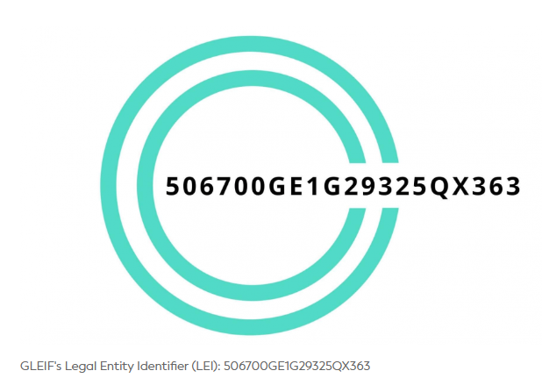
Global Initiative on Unique Identifiers
Global Legal Entity Identifier Foundation (GLEIF) https://www.gleif.org/
LEI is a global ISO standard
Over 2.4 million LEIs issued globally
Data is freely available
“Bulk issuing” of LEIs to all entities in a country
Nestle example https://search.gleif.org/#/record/KY37LUS27QQX7BB93L28
API demo as well: https://www.gleif.org/en/lei-data/gleif-api

Slide 7
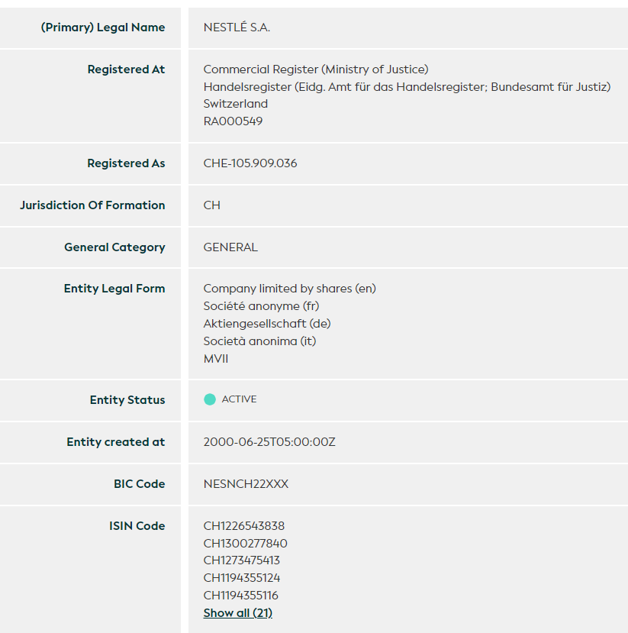
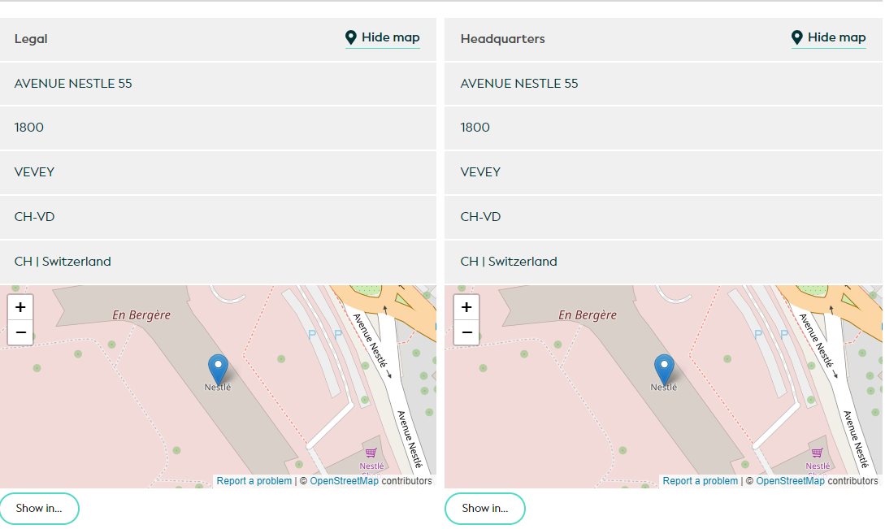
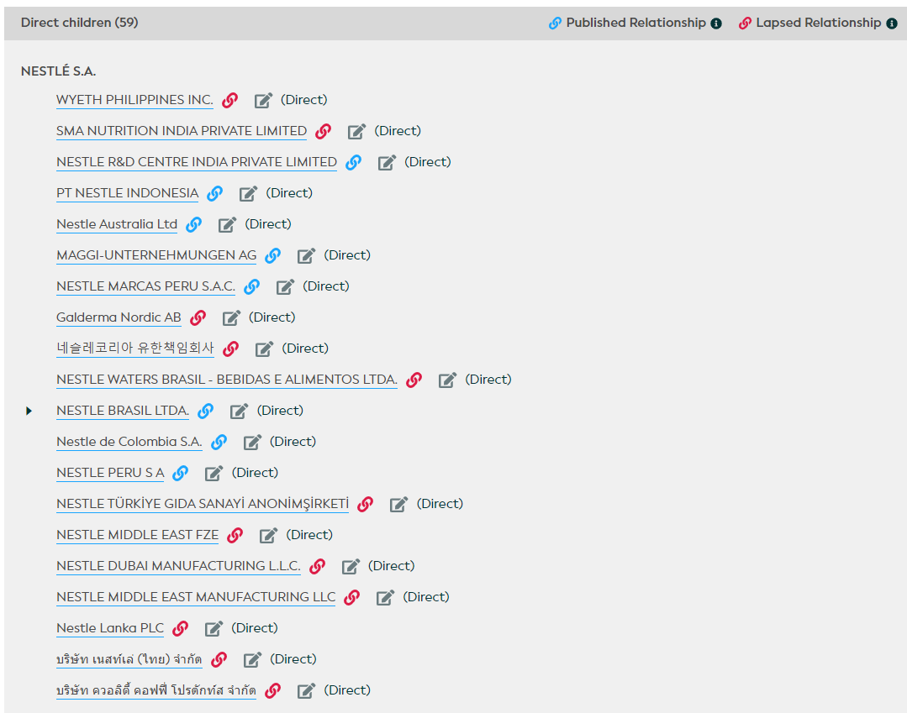
Global Initiative on Unique Identifiers

Slide 8
Global Initiative on Unique Identifiers
Global Initiative
The UN Statistical Commission, at its last session in March 2023:
Endorsed the Global Initiative on Unique Identifiers for Businesses which was put forward by the UN Committee of Experts on Business and Trade Statistics (UNCEBTS)
Encouraged countries and relevant organizations to coordinate their activities in this area in an effort to provide a solid infrastructure for statistical business registers

Slide 9
Global Initiative on Unique Identifiers
Main Objectives of Global Initiative
To strengthen the transparency on businesses in countries by improving their registration
To improve the availability of unique business identifiers in administrative data sources in countries
To promote access to and sharing of administrative data for statistical business registers
In addition, to better understand globalization and for profiling multinationals in their cross border legal ownership structures, it is important to link national unique identifiers with global identifiers so legal entities can be easily identified on a cross-border scale. This will facilitate the establishment and maintenance of global registers containing the legal structure of multinationals.

Slide 10
Global Initiative on Unique Identifiers
Potential Benefits of Global Unique Identifiers
Able to profile multinational groups, making the work of the large cases units (LCUs) easier
Reduce asymmetries between countries in international trade and balance of payments statistics
Development of granular statistics
Reducing response burden
Development of global registers
Potential Issues
Cost
Lack of awareness

Slide 11

Global Initiative on Unique Identifiers
Next Steps
Advisory Committee being established
Collaborative platform for countries and international organizations
Common approach and implementation strategy
Identify pilot projects for improving SBRs and mapping to global unique identifiers
Global Assessment will be held in 2024
Plan to develop repository on best practices/case studies
Seeking your input
World Data Forum 2024

Slide 12
Global Initiative on Unique Identifiers
Questions
Are you aware of global identifiers at all?
Are you aware of the Global Initiative?
Do you think using global identifiers would help your SBR/overall statistical production system?

Slide 13
Global Initiative on Unique Identifiers
Thank you!

