Slide 1
Regional Course on Statistical Business Registers
Session 15: Other developments in SBRs
● UN/OECD Multinational Enterprise Information Platform (MEIP)

Slide 2
Multinational Enterprise Information Platform
A joint initiative between OECD and UNSD
Brings together previous projects:
Global Groups Register (GGR) from UNSD
Analytical Database on Individual Multinationals and Affiliates (ADIMA) from the OECD (Organisation for Economic and Co-operation and Development)
MEIP
UNSD: https://unstats.un.org/unsd/business-stat/mne-platform/
OECD: https://www.oecd.org/sdd/its/mne-platform.htm

Slide 3
Multinational Enterprise Information Platform
Why have an MNE information platform?
SBRs naturally focus first on the largest enterprises
MNEs have been at the forefront of changes in the global economy
Understanding their structure and behavior fundamental to consistency in global statistics / can help resolve discrepancies in trade data
Facilitates analysis of globalization’s impact on global value chains (GVCs)
Provides transparency to the public

Slide 4
Multinational Enterprise Information Platform
Methodology
Developed from a number of timely, publicly available data sources
Platform combines traditional (i.e. annual reports) and alternative (i.e. webpage metdata) sources
Includes review of websites, social media profiles, apps
Advanced data techniques to match records (i.e. fuzzy matching)
Freely available to the public

Slide 5
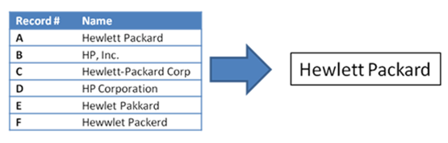
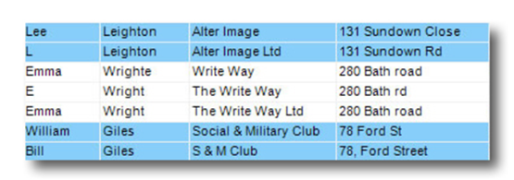
Multinational Enterprise Information Platform
Methodology
More on “fuzzy” or “approximate string matching”

Slide 6
Multinational Enterprise Information Platform
Sources
OpenCorporates
Combines information from various business registers
Example: https://opencorporates.com/companies/nl/28071597
Legal Entity Identifier
Example: https://search.gleif.org/#/record/LUZQVYP4VS22CLWDAR65
PermID
Example: https://permid.org/1-4298454609
CommonCrawl OpenStreetMap CorpWatch PeopleDataLabs Crunchbase GDELT Sectigo (crt.sh) Tranco WebDataCommons OpenOwnership WikiData

Slide 7
Multinational Enterprise Information Platform
Contents
Global register
Covering the structure of the 500 largest MNEs by providing information on the MNE’s head, their subsidiaries, their location and their ownership structure when available
Digital register
Covering the web presence of MNEs around the world by providing a list of connected websites and their relative importance determined by the number of visitors and the importance of links to their website (page rank)
Media monitor
Covering media articles relating to the largest 500 MNEs for 2022 and 2023. The aim of this data is to provide indications of significant events for each given company, such as mergers, acquisitions, restructuring, and investment

Slide 8
Multinational Enterprise Information Platform
Global Register
+120,000 subsidiaries from 500 MNEs
Name
Identifiers
Addresses
Alternative names
Hierarchy information where available
Metadata, country codes also included

Slide 9
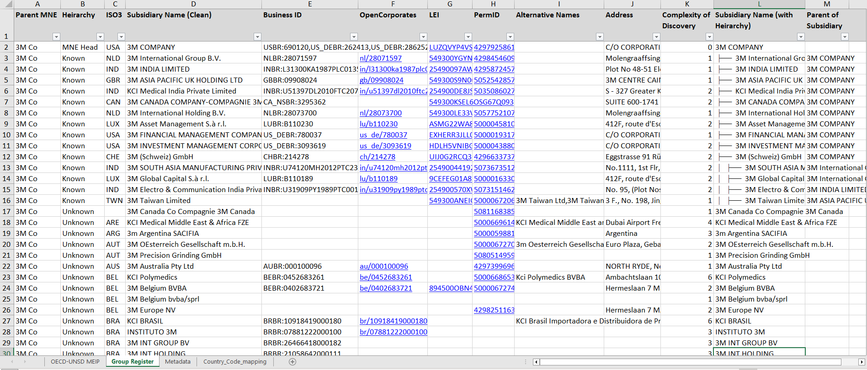
Multinational Enterprise Information Platform
Global Register

Slide 10
Multinational Enterprise Information Platform
Digital Register
~50,000 websites from 500 MNEs
Domain name
Location (top level domain, i.e. “.ar”, and country code)
Measures of importance
Page rank/number of visitors
“Harmonic centrality”

Slide 11
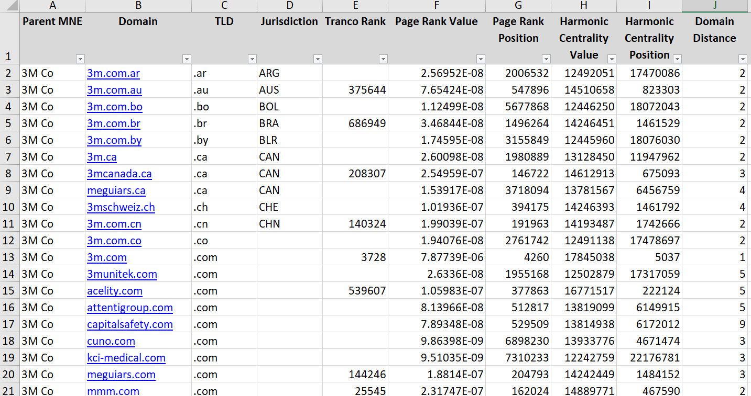
Multinational Enterprise Information Platform
Digital Register

Slide 12
Multinational Enterprise Information Platform
Media Monitor
+ 10 million media articles
New to this release
Track major events related to MNE
Future potential for ML to assist in interpreting/organizing

Slide 13
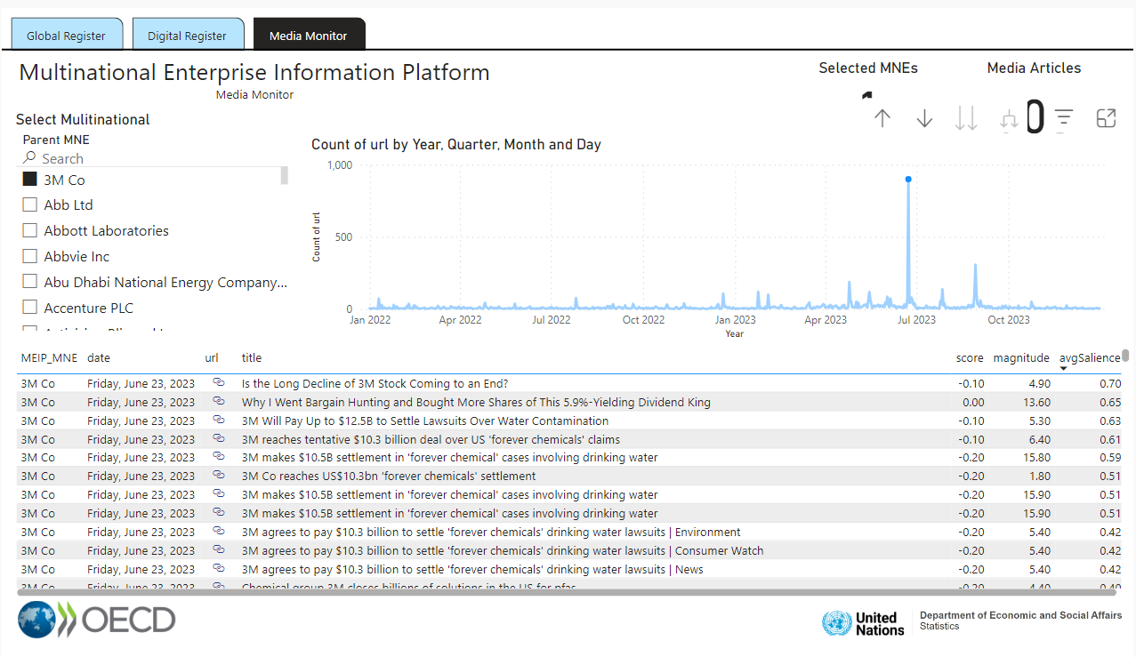
Multinational Enterprise Information Platform
Media Monitor

Slide 14
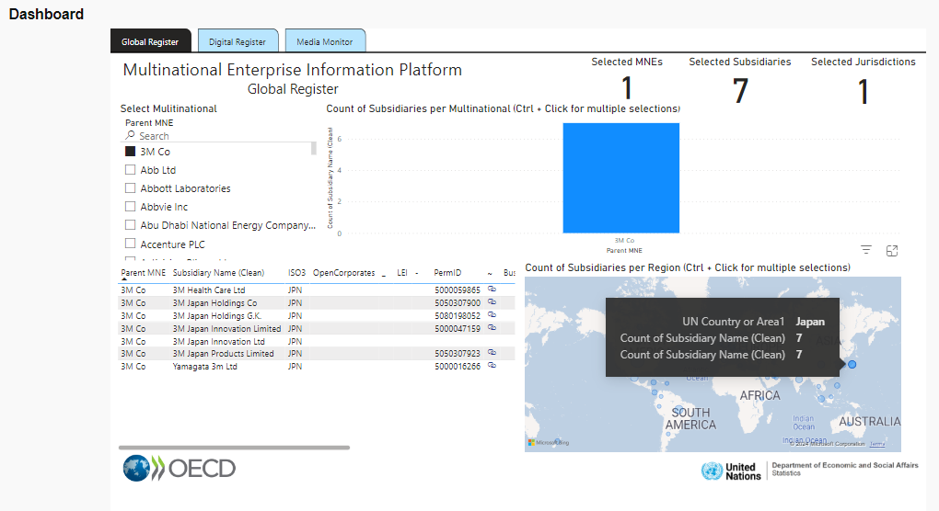
Multinational Enterprise Information Platform
Dashboard

Slide 15
Multinational Enterprise Information Platform
Next Steps
Reduce resource burden
Auto data extraction and processing from PDFs?
AI tools to automate queries, i.e. is x a subsidiary of y?
Widen scope
Additional variables - employment, investment, turnover
Include more MNEs
Improved timeliness
NLP to classify news events
Link MEIP with Global Initiative on Unique IDs
Provide framework for users to profile other companies of interest
Native cloud-based database on the UN Global Platform

Slide 16
Multinational Enterprise Information Platform
Questions/Discussion
Do you think the MEIP could be a useful resource in your work?
Would it be useful to have a platform to profile other companies not in the top 500 MNEs?
What else would you like to see from an MNE platform?

Slide 17
Multinational Enterprise Information Platform
Thank you!

