Slide 1
Regional Course on
Statistical Business Registers
Session 16 - Manual on Principal Indicators for Business and Trade Statistics Vol.1

Slide 2
Manual on Principal Indicators for Business and Trade Statistics Vol.1
The Manual represents a consolidation of the work of the Committee
It aims to provide guidance for the programmes of business and trade statistics to be agile and responsive to new and emerging user needs, integrating the strategic view on business statistics
The UNCEBTS prepared and submitted the draft first volume of the Manual on the principal indicators on business and trade statistics to the Statistical Commission in March 2022. At its 53rd session, the Statistical Commission took note of the draft first volume of the Manual and encouraged the preparation of volume 2 of the Manual to further elaborate on the international trade indicators.

Slide 3
Objectives of the manual
Presents a strategic view on business and trade statistics, including identifying policy needs and data gaps
Puts forth a list of principal indicators on business and trade statistics, designed to meet users’ needs in terms of better quality and increased data granularity and in support of the 2030 Agenda for Sustainable Development
The indicators are intended to be able to be compiled in an internationally comparable, flexible and sustainable approach
Identifies areas for further development

Slide 4
Target audience
NSOs and the statisticians that are responsible for the compilation and reporting of the principal indicators
Compilers from different statistical domains and institutions may also be involved in the collection and compilation of the data needed to produce the indicators
Data users outside the NSOs will also gain more information on the interpretation and use of the principal indicators presented as well as the data sources and methods of calculation

Slide 5
Outline of the manual
I. Introduction
Objective
Structure of this Manual
Process of preparing the Manual
Target audience
II. Strategic and Data Production Frameworks for Business and Trade Statistics
Strategic Framework
Data production Framework
  i. The adoption of an enterprise-centered approach ii. The role of the domestic and potentially globally interconnected SBR as the backbone in the new data infrastructure
  iii. Exchange of microdata
  Priority areas of the UNCEBTS
  III. Principal business and trade indicators
Delineation and selection of the principal business and trade indicators
Availability and organization of data and integrated information systems
Institutional coordination and governance
Presentation of the indicators
Specific considerations for the indicators
IV. Future agenda
Appendix: methodological sheets

Slide 6
Role of Statistical Business Registers (SBRs)
The SBR as the core of the new data production framework for economic statistics
SBRs play a pivotal role in the process of data integration with different and multiple data sources by generating new information with the desirable characteristics
Appropriate micro-data linking methodologies based upon unique identifiers could be applied to produce consistent information scalable from micro to aggregated figures
The SBR provides the sample frame for multiple different surveys but can also serve as a direct source to produce selected business statistics

Slide 7
Analytical and Policy Framework
This section aims to elaborate on the analytical and policy framework for business and trade statistics in general and within each priority areas (namely, business demography, globalization and digitalization, well-being and sustainability)
The 2030 Agenda for Sustainable Development provided the overarching policy framework, but specific policy priority for each priority area are elaborated as well
The analytical framework reflects the need to better understand the structure and performance of businesses in an increasingly complex environment
This section also aims to elaborate on the importance of the integration of business and trade statistics

Slide 8
Section III on Principal indicators for business and trade
This section contains a detailed description of the indicators
It provides a further elaboration of the main concepts for business and trade statistics, covering:
  the scope of business and trade statistics
  statistical units
  importance of adding granularity to existing statistics by exploring relevant breakdowns to address relevant policy questions
  Identifies main policy questions that core indicators in these areas should be able to measure
  Identification of integrated approaches that could address existing data gaps (e.g. Micro data linking, data sharing, profiling, etc.)
It includes references to related indicators and work undertaken by relevant international and regional organizations

Slide 9
Institutional coordination and governance
This section addresses issues of institutional coordination and governance for the compilation of the principal indicators:
  Several institutions in the country may be responsible for the compilation and reporting of the principal indicators
  There is the need to provide guidance on institutional coordination mechanisms and governance needed for the national reporting of the indicators
Also, coordination at the international level among international statistical organizations is planned to be addressed in this section

Slide 10
Indicators on Business Dynamics, Demography and Entrepreneurship
1. Number of active enterprises
2. Number of enterprise births
3. Employment created by enterprise births
4. Number of enterprise deaths
5. Loss of employment due to enterprise deaths
6. Number of X-year-old employer enterprises
7. Number of persons employed in X-year-old employer enterprises
8. Employment in the population of active enterprises
9. Employment share of enterprise births
10. Enterprise survival rate
11. Number of high-growth enterprises
12. Employment in high-growth enterprises
13. Number of young (up to 5-year old) high-growth enterprises (gazelles)
14. Employment in young (up to 5-year old) high-growth enterprises (gazelles)
15. Labour compensation paid by active enterprises
16. Gross Value Added produced by active enterprises

Slide 11
Indicators on Globalization and Digitalization
17. Total exports of businesses as a percentage of businesses’ gross value added
18. Number of trading businesses by number of partner countries
19. Export intensity of businesses
20. Value of trade by foreign affiliates
21. Employment abroad in foreign affiliates controlled by resident enterprises as share of enterprises’ total employment
22. Entry and exit rates for the digital economy sector
23. Average post-entry employment growth for the digital economy sector
24. Percentage of businesses with internet connection
25. Capital investment of businesses on ICT as a percentage of total business capital investment
26. Capital investment of businesses on ICT as a percentage of total gross value added
27. Percentage of businesses using cloud computing services
28. ICT-related patents (registered)
29. ICT-related trademarks (as a percentage of total trademarks)
30. Patents in AI technologies
31. Percentage of businesses engaged in sales via e-commerce
32. Value of e-commerce sales by businesses
33. Labour productivity growth in the ICT sector
34. Contribution of ICT sector to labor productivity growth
35. Gross value-added of ICT-related businesses as percentage of total gross value added
36. Employment of ICT specialists as a percentage of total employment
37. Percentage of businesses providing ICT-related training
38. Percentage of enterprises reporting hard-to-fill vacancies for ICT specialists

Slide 12
Indicators on Wellbeing and Sustainability
39. Proportion of women in managerial positions
40. Annual growth rate of real total gross value added per employed person
41. Average hourly earnings for employees in businesses by sex
42. Unemployment rate, by sex, age and persons with disabilities
43. Gross value added of businesses per employed person
44. Sector employment as a proportion of total employment
45. Water-use efficiency in businesses
46. Level of water stress attributable to businesses
47. Share of renewable energy consumption in businesses
48. Energy efficiency in businesses
49. Green investment by businesses
50. Greenhouse gas emissions generated by businesses per unit of value added
51. Research and development expenditure as a proportion of gross value added
52. Researchers (in full-time equivalent) per million inhabitants
53. Number of companies publishing sustainability reports
54. Job Openings (Vacancies) in businesses
55. Taxes and other payments of businesses to the Government
56. Total taxes paid by businesses as a proportion of total government tax revenues

Slide 13
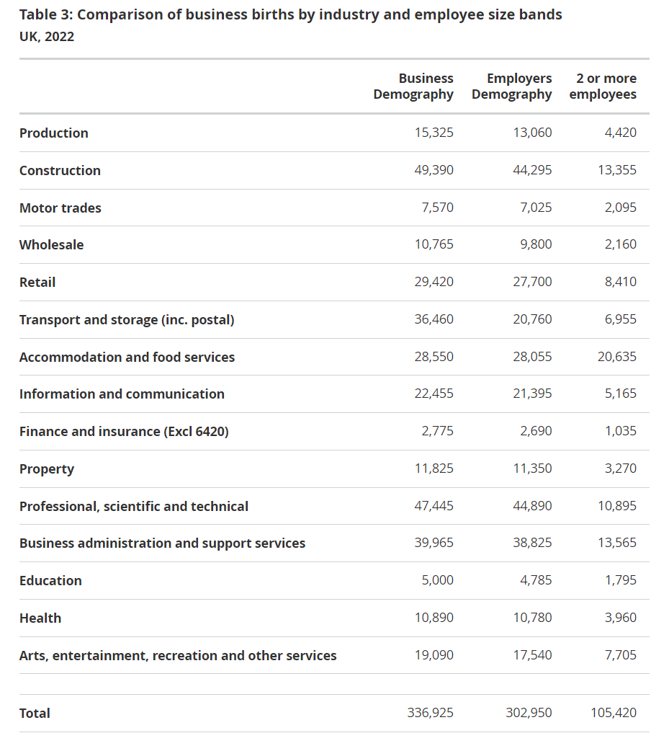
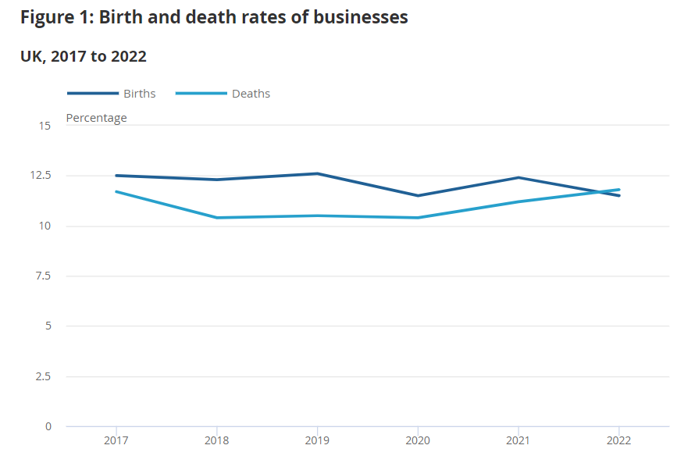
Example
Business demography statistics
Example of SBR-derived demographics from the UK

Slide 14
Template used for the methodological description of the indicators
Name of indicator | Unit of measure
Definition of the indicator | Statistical unit
Objective of the indicator | Reference period
Contribution and usefulness of the indicator | Frequency (periodicity) of data collection and dissemination
Classification | Dissemination format
Industrial Coverage | Timeliness
Breakdown | Source data type
Algorithm | Availability of methodological documents
Description of the calculation of the indicator

Slide 16
Discussion questions
Could you share which indicators are currently compiled by your office?
  Indicators on Business Dynamics, Demography and Entrepreneurship
  Indicators on Globalization and Digitalizations
  Indicators on Wellbeing and Sustainability
Statistical business registers will serve as the main sources for what type of indicators?

Slide 17
Indicators on Business Dynamics, Demography and Entrepreneurship
1. Number of active enterprises
2. Number of enterprise births
3. Employment created by enterprise births
4. Number of enterprise deaths
5. Loss of employment due to enterprise deaths
6. Number of X-year-old employer enterprises
7. Number of persons employed in X-year-old employer enterprises
8. Employment in the population of active enterprises
9. Employment share of enterprise births
10. Enterprise survival rate
11. Number of high-growth enterprises
12. Employment in high-growth enterprises
13. Number of young (up to 5-year old) high-growth enterprises (gazelles)
14. Employment in young (up to 5-year old) high-growth enterprises (gazelles)
15. Labour compensation paid by active enterprises
16. Gross Value Added produced by active enterprises

Slide 18
Thank you!

