Slide 1
Regional Course on Statistical Business Registers
Session 5: SBR Maturity Model

Slide 2
How it was developed
The Manual on the Maturity Model for Statistical Business Registers was prepared by the UN Committee of Experts on Business and Trade Statistics. In particular:
Task Team on Exhaustive Business registers
Developing guidance for the development of Statistical Business Registers (SBR) to become more inclusive and exhaustive in a rapidly changing economy and to be better tailored to statistical production.
Task Team on Capacity Building
Develop and examine the best ways to reduce the gap between countries in utilizing administrative registers in producing business statistics and integration. The ultimate goal is to leave no one behind.
2

Slide 3

Challenges
There is no standard situation, many difference between countries.
How to create a guidance tool for all?
How to make use of existing material and rich experiences across countries?
3

Slide 4
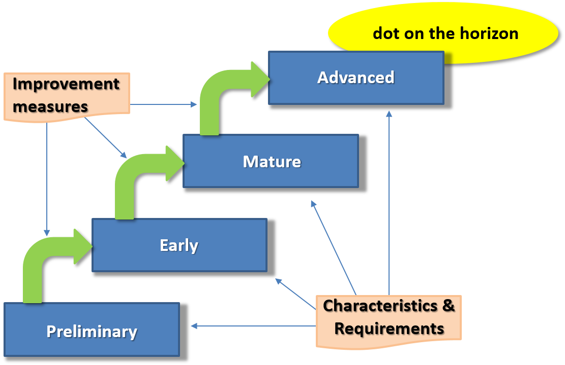
Conceptual visualization SBR MM
4

Slide 5
Statistical Business Register Maturity Model
Seven dimensions
Legal and institutional framework
Data sources for SBR
Maintenance and update of SBRs
Coverage of a SBR
Use of SBR
IT environment
Interoperability
Four maturity stages:
preliminary, early, mature, advanced
5

Slide 6
Tool
share knowledge and best practices
determine the current state of your SBR
determine possible next steps for development
find help and guidelines to actually be able to take those steps
6

Slide 7
Interactive Self-assessment questionnaire
An online tool to assess the status of implementation of the SBR
Seven modules, each corresponding to a specific dimension
Each module contains several questions and based on the answers, the stage of maturity for that dimension can be derived
The SBR Maturity model:
can be used to evaluate the maturity of the national SBR; and
can be used to develop a roadmap towards maturity
7

Slide 8
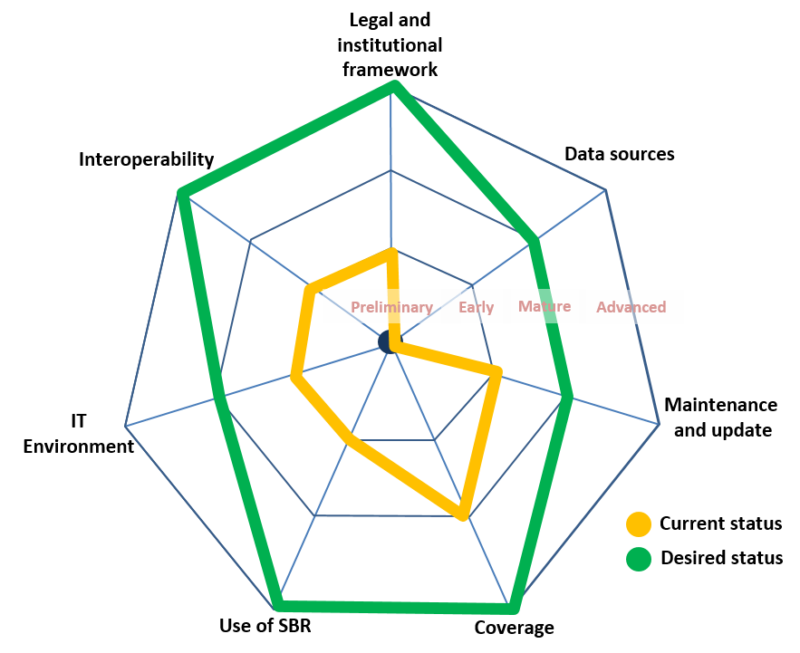
How does the SBR MM work?
8

Slide 9
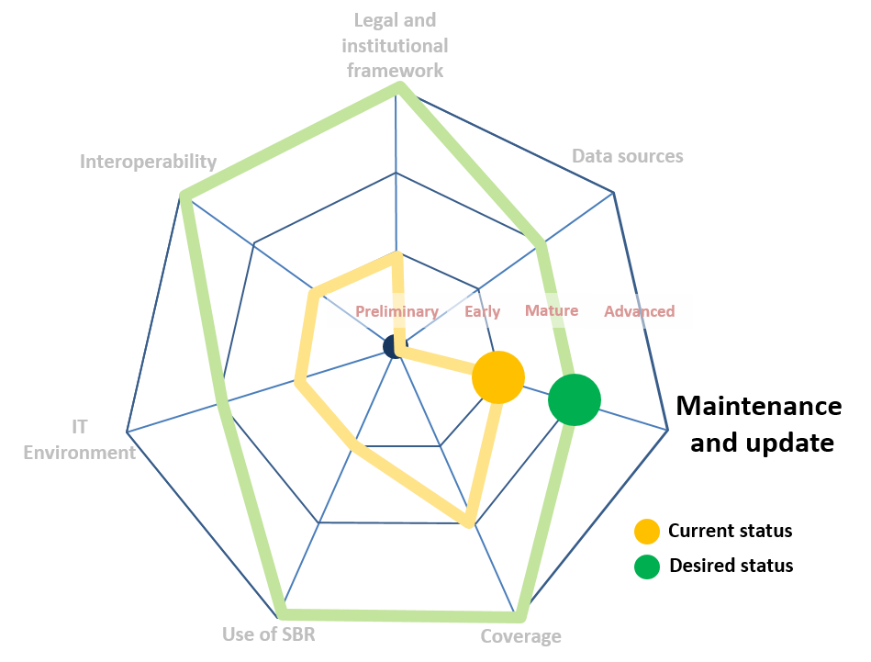
How does the SBR MM work?
9

Slide 10
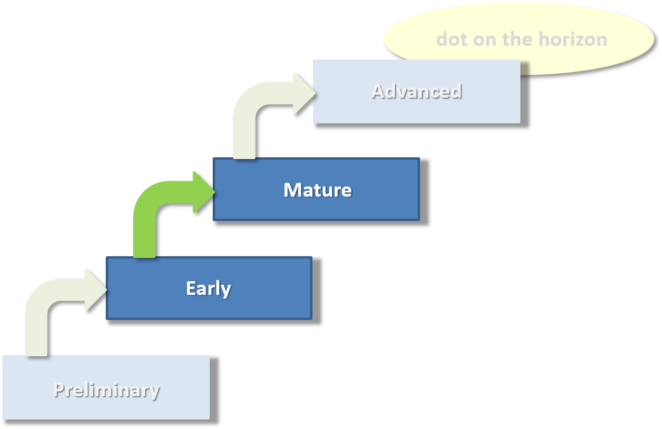
Maintenance and update
Reference to specific passages in handbooks and guidelines
Reference to documented best practices, like
Procedures and methods
Dialogue frameworks
Chain management
Partnerships
10

Slide 11
Additional tools: Maturity model toolkit
to help NSOs identify gaps in their SBRs’ level of maturity in each dimension and to provide resources and training material to NSOs to facilitate efforts to improve in these areas.
The maturity model toolkit consists of the following:
Interactive Self-assessment questionnaire
Link to existing manuals handbooks and training material
Regular global assessment on the implementation of SBR in countries
11

Slide 12
Link to existing manuals handbooks and training material
Stocktaking of existing manuals, training material, tools, best practices etc.
Mapping of list of materials to dimensions and stages of maturity
12

Slide 13
Global assessment
The maturity model and the self-assessment questionnaire will be the basis for the development of a regular global assessment on the implementation of SBR in countries.
The global assessment is intended to be conducted on a regular basis, integrated with the country progress reports of the Wiesbaden Group on SBR and the Expert Group on SBRs.
The main objectives of the global assessment are to:
monitor the implementation of SBRs in countries, and
identify priority areas to develop technical assistance programmes and further guidance and training materials
13

Slide 14
End of Session 5

