Slide 1
Regional Course on Statistical Business Registers
Session 6: SBR Maturity Model
Dimension 1: Legal and institutional framework
▪Dimensions 2 & 3: Data sources, maintenance and updates

Slide 2
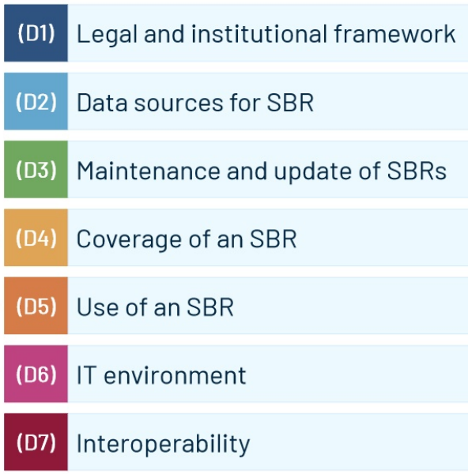
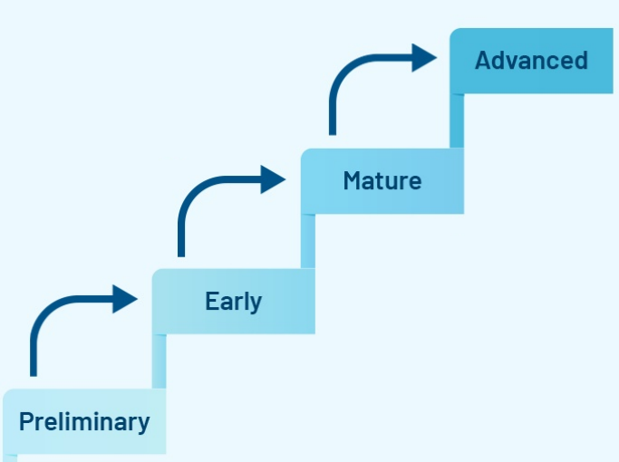
Maturity Model of Statistical Business Registers
Seven dimensions Four maturity stages

Slide 3
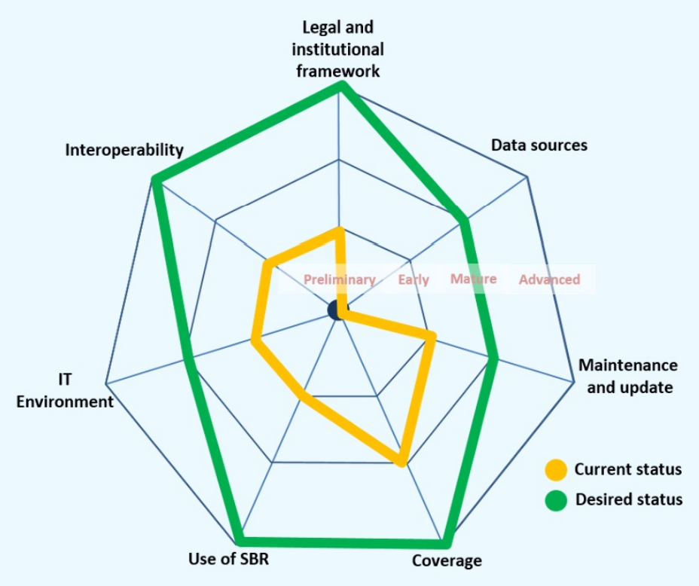
2) Toolkit on SBRs (under construction)
A questionnaire for self-assessment
A list of training materials
Knowledge and practice sharing
Regular global assessment

Slide 4
Dimension 1: Legal and Institutional Framework

Slide 5

Dimension 1: Legal and Institutional Framework
Legal Framework
Statistical law
Memorandum of Understanding or Service Level Agreement
Arrangements among the relevant institutions in the country for the maintenance and update of SBRs.
Institution Framework

Slide 6
(D1) Legal and institutional framework
This dimension refers to the legal and institutional framework relevant for establishing and maintaining a SBR.
early
mature
advanced
preliminary

Slide 7
(D1) Legal and institutional framework
A sound legal and institutional framework that regulates official statistics and, in particular, the rights and obligations related to data collection and acquisition, including access to administrative records and other relevant sources, provides an essential basis for the development and maintenance by the NSO of an effective and efficient of SBR.
The legal framework refers primarily to the Statistical Act or Statistical Law regulating official statistics in a country but also other legal instruments and provisions regulating privacy and data protection, access, sharing and archiving.
Some common elements are identified and elaborated in the Generic Law on Official Statistics (GLOS). https://unece.org/DAM/stats/publications/2016/ECECESSTAT20163_E.pdf

Slide 8
(D1) Legal and institutional framework
Aspect of Generic Law on Official Statistics (GLOS) relevant to SBR
Mandate for data collection (Article 15 of GLOS)
Access to administrative data (Article 17 of GLOS)
Legislative mandate for NSO on the establishment and maintenance of SBR (Article 19 of GLOS)
Data subject to statistical confidentiality (Article 20 of GLOS)
Access to individual data of the National Statistical System (Article 23 of GLOS).
Provision for data dissemination (Article 29 of GLOS).

Slide 9
(D1) Legal and institutional framework
Beyond the Statistics Act or Law, other provisions in administrative rules and regulatory frameworks can support the development and maintenance of SBRs. These include.
The establishment and use of a unique identifier for businesses in the country
Registration requirements for countries that have a business register, which is a data source for the SBR. Recommendations on business registers can be found in the Legislative Guide on Key Principles of a Business Registry, prepared by the United Nations Commission on International Trade Law (UNCITRAL).
Exemptions for the NSO from specific provisions in data privacy, protection, sharing and archiving acts to access and process microdata and to combine microdata from various sources for statistical purposes, including the development and maintenance of statistical registers.

Slide 10


Business registers vs Statistical Business Registers
Business Registers
Statistical Business Register
It contains legal entities
Typically, businesses have to register in order to carry out the economic activity
Typically maintained by the business registrar authority
It contains statistical units for the collection and compilation of economic statistics
Maintained by the National Statistical Office
Notes:
This slide provide a comparison between business registrar managed by the business egistration authority and the SBR managed by the NSO.
In essence, the business registrars is for legal purpose whereas the SBR is for statistical purpose

Slide 11
(D1) Legal and institutional framework
The availability of a national institution that is responsible for the registration of businesses is an important element for the SBR.
A business register, administrative business register, or business registry are different from the SBR as they represent the country’s mechanism for receiving, storing and making accessible to the public certain information about businesses, as required by domestic law.
Most countries have a business registry supported by the legislation that require businesses to register in order to participate in the formal economy.
When available, they represent an important source of information for SBRs.

Slide 12
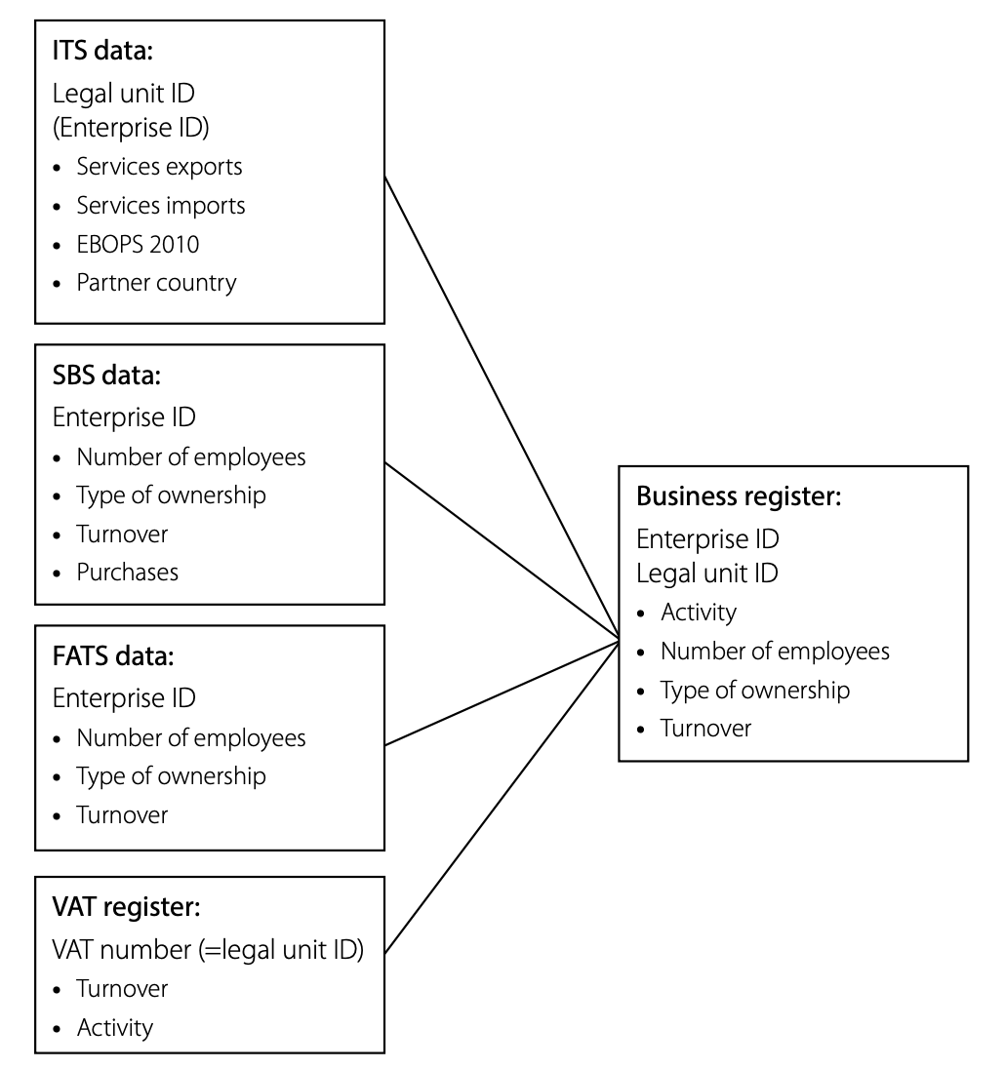
Use of unique legal identifiers
Information on the same company has to be linked when combining information from different sources
The availability of a unique legal identifier (among administrative data) is key for an efficient and effective micro data linking
Notes:
The SBR can be linked to other than administrative sources. This can be achieved by storing the identification numbers of units in other sources in the live register, or by integrating special modules in the SBR to be used for matching with other sources.
In this case the statistical units in the SBR can be linked to the units in these other sources, which means their data are available to assist in maintaining the units in the SBR and/or for use by surveys.
To improve interoperability, the SBR should support development of the conditions for exchange of coordinated statistical information among countries, including an international identification service.
One of the key is the unity identifier, for enterprises commonly used across sources. This is essential to conduct the linking and improve interoperability

Slide 13
(D1) Legal and institutional framework
A memorandum of understanding (MOU), a service level agreement (SLA), or similar arrangement can be used to formalize, in a less binding arrangement, the cooperation between institutions to access administrative data.
These MOUs generally cover data flows, metadata, communications, protection of the confidentiality, and often include a clause ensuring that the NSO will be informed in advance of any changes made to administrative process that will affect the resulting data.

Slide 14
(D1) Legal and institutional framework
The Guidelines on the Legislative Framework for Civil Registration, Vital Statistics and Identity Management (United Nations 2019) , notes that the legal framework can cover the following aspects:
business registration;
business registers;
unique identifiers, data protection and privacy;
compliance, enforcement, rights and remedies; and transitional provisions.

Slide 15
(D1) Legal and institutional framework
Institutional arrangements refer to the arrangements among the relevant institutions in the country for the maintenance and update of SBRs.
A clear understanding of the roles of the different institutions is important to establish an institutional arrangement. The NSO is typically the institution responsible for the SBR, and it is vital for the NSO to establish and maintain good relations with other institutions, especially the owners who are responsible for data sources.
Depending on the nature of the national statistical system; i.e., centralized vs decentralized, there may be special institutional arrangements that guarantee the sharing of relevant information. Institutional arrangements can also be put in place with relevant agencies within the country, such as the institution in charge of businesses registration.

Slide 16
Summary of stages of maturity for Dimension 1
No statistical law or institutional arrangement and no MoU are in place in support of the SBR
Preliminary
There is a provision in the statistical law and/or MoU that mandates the NSO to
collect data that are relevant for SBRs
Access to administrative data is not guaranteed by legislation or MOUs
Early
A statistical law allows the NSO to establish and maintain the SBR
A statistical law gives the NSO access to relevant administrative data for the SBR
Mature
A statistical law allows the NSO to release the public anonymized microdata, while complying with the principle of confidentiality
Advanced

Slide 17


(D1) Legal and institutional framework
Preliminary stage:
No statistical law or institutional arrangement and no MoU are in place in support of the SBR
Early stage:
There is a legal framework or MoU that the NSO to collect data that are relevant for SBRs
Example: Economic census
-a large network of enumerators to collect information
- data entry staff and managers to guide this process
→ the legislation needs to be supported by appropriate funding.

Slide 18

(D1) Legal and institutional framework
Early stage:
An administrative business register may or may not be available.
* Access to administrative data is not guaranteed by legislation or MOUs
Mature stage:
A statistical law allows the NSO to establish and maintain the SBR
A statistical law gives the NSO access to relevant administrative data for the SBR
Registration or inclusion of businesses
- regular access to and use of all necessary census, administrative business register or other administrative data.
- legal agreements and MoUs with several source owners
Notes:
Other characteristics for the mature stage
- The use of administrative data in statistical production is mandatory where this is available.
- Using a survey as an instrument to collect data with respondents is only permitted where information to produce reliable indicators is not available in administrative sources.
The legal framework covers aspects of business registration (enforcements of registration of new business (business births) and the cessation of businesses (business deaths); unique identifiers of business in registers; data protection and privacy; compliance, enforcement, rights and remedies; and transitional provisions.

Slide 19
Question - (D1) Legal and institutional framework
Can you think of other characteristics at the mature stage?

Slide 20
Question - (D1) Legal and institutional framework
Can you think of other characteristics at the mature stage?
The use of administrative data in statistical production is mandatory where this is available.
Using a survey as an instrument to collect data with respondents is only permitted where information to produce reliable indicators is not available in administrative sources.
The legal framework covers aspects of business registration (enforcements of registration of new business (business births) and the cessation of businesses (business deaths); unique identifiers of business in registers; data protection and privacy; compliance, enforcement, rights and remedies; and transitional provisions.

Slide 21

(D1) Legal and institutional framework
Mature stage:
Access to microdata services of the NSO are granted for public organizations for statistical purposes only.
The access is not allowed for commercial users outside of NSO.
Advanced stage:
A statistical law allows the NSO to release the public anonymized microdata, while complying with the principle of confidentiality
There is a legislation on data protection, privacy and confidentiality that allows:
- NSO to disseminate selected information in the SBRs; - NSO to share statistical information/micro data with outsiders (commercial users).
Businesses are granted:
- access to their information stored in the SBR
- allowed to update relevant information about their own organization.
Notes:
Other characteristics of advanced stage
In an international context, regulations are in place to ensure the exchange, use and integration of national data, to create an international SBR.
Web scraping can be used for statistical production when it is not in conflict with other legislation.

Slide 22
Question - (D1) Legal and institutional framework
Can you think of other characteristics at the advanced stage?

Slide 23
Question - (D1) Legal and institutional framework
Can you think of other characteristics at the advanced stage
In an international context, regulations are in place to ensure the exchange, use and integration of national data, to create an international SBR.
Web scraping can be used for statistical production when it is not in conflict with other legislation.

Slide 24


(D1) Legal and institutional framework
early
mature
advanced
preliminary
No
Yes
No
Does the legislation on data protection and privacy allow the NSO to disseminate selected information in the SBRs?
Does it ensure regular access to and use of all necessary census, administrative business register or other administrative data?
No
No
Does it enable NSOs to collect data that are relevant to SBR?
Do you have legal framework or MoU in support of SBRs?
Yes
Yes
Yes

Slide 25
Legal and institutional framework
The legal conditions in Mexico
There are two levels in the legal framework: a general and a specific, and both contribute to updating the SBR
Law of the National System of Statistical and Geographic Information
- Directory of Economic Units for the country
- Administrative Records
Technical Standard for the Incorporation and Update of Information in the Statistical Business Register of Mexico

Slide 26
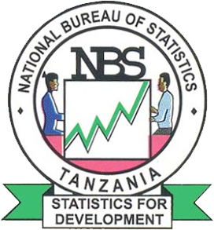
Country example: Tanzania
LEGAL INSTITUTIONAL
FRAME WORK
Framework relevant for establishing and maintaining the SBR
There is Statistics Act, which allow to Conduct Census and Surveys.
MoU signed with MDAs to access Administrative data Sources, i.e. Tanzania Revenue Authority, Ministry of Education, Ministry of Health and Ministry of Trade and industry etc
Signed MoUs on processes
Advanced Stage
Mature Stage
Early Stage
Preliminary stage
Standard Statistics law allows the dissemination of SBR
MoU entailing NBS to collect some SBR variables from MDAs
Provision mandating NBS to Collect data in Statistical Law or MoU
No Statistical Act, Even Memorandum of Understanding (MoU)

Slide 27
Discussions
5. Give a brief description on the legal framework on official statistics in your country, with a focus on the aspects that are relevant in the production of business statistics.
Is there a provision in the statistical law or a MOU(Memorandum of understanding) that mandates or allows the NSO(National Statistical Organization) to collect data that are relevant for SBR?
Is there any provision on how your office should collect data on businesses?
Is there any provision that grants NSO access to administrative data sources (e.g. records of businesses from the tax office)? If not, is there any institutional arrangement on data sharing in general among the NSO and other government agencies at various levels (national, regional or local governments)?
Is there any mandate on the use of unique IDs for businesses in your country? If not, is there any institutional arrangements that helps the sharing of micro-data on businesses?
Is there any provision on how data on businesses should be compiled and disseminated? If not, can you show some published reports or datasets on business statistics?

Slide 28
Dimension 2: Data sources for the SBR

Slide 29
(D2) Data sources for the SBR
This dimension refers to the the characteristics of the SBR in terms of the data sources used for establishing and maintaining the SBR
early
mature
advanced
preliminary

Slide 30
(D2) Data sources for the SBR
Data sources may be grouped into three categories:
Administrative sources, such as business registration/license register, tax register, company/trade associations and chambers of commerce registers, social security registers, etc.
Statistical sources: economic census and agricultural census, feedback from economic surveys, profiling and SBR improvement/maintenance surveys.
Other sources: for example data from private data suppliers, telephone directories and the Internet, big data

Slide 31

Dimension 2: Data sources for the SBR
Data Sources
Administrative sources (licenses register, tax register, social security register, labor and employment registers)
Statistical sources (Economic Census, Enterprise/establishment surveys, SBR improvement surveys
Other sources (commercial data providers, utilities, internet companies)

Slide 32
Data sources for SBRs
Admin data
Business registers
Tax registers
Social security registers
Industry association registers
….
Statistical Business Register
Statistical sources
Economic censuses
improvement surveys
….
Other sources
Commercial data available from private companies
….
Notes:
Different data sources may be used in combination to construct and maintain an SBR with good coverage and content
Data sources may be grouped into three categories:
Administrative sources, such as business registration/license register, tax register, company/trade associations and chambers of commerce registers, social security registers, etc.
Statistical sources: economic census and agricultural census, feedback from economic surveys, profiling and SBR improvement/maintenance surveys.
Other sources, for example data from private data suppliers, telephone directories and the Internet.

Slide 33
(D2) Data sources for the SBR
The data sources depend greatly on the country’s situation and the availability of relevant information from other institutions.
Therefore, the choice of the best data source depends very much on the specific context of a country.
However, in line with the UN Guidelines on Statistical Business Registers (para 6.4 UN 2020), the recommendation is for SBRs to be created and maintained primarily using administrative sources.
They enable good coverage and stability. This approach is in line with Principle 5 of the United Nations Fundamental Principles of Official Statistics, which states “Data for statistical purposes may be drawn from all types of sources, be they statistical surveys or administrative records.
Statistical agencies are to choose the source with regard to quality, timeliness, costs and the burden on respondents

Slide 34
Limitation on the use of economic censuses as a main source for the maintenance an SBR
Economic censuses are very expensive even if the scope is restricted to businesses with identifiable premises. They are generally conducted at best every five or ten years. Thus, NSOs should consider a suite of annual surveys based on a register-based list to be much more cost-effective.
SBRs need to be updated between economic censuses. The small businesses located during area enumeration are volatile in the sense that they may go rapidly in and out of production, or ownership, or change their activities or addresses. Thus, to be truly effective as a source of survey frames in the years between censuses, the SBR must be constantly updated, which itself can be costly.
In addition to its high cost, the enumeration approach has the disadvantage of not being able to identify and document non-recognizable places of business, or enterprises without a fixed location, for example web-based businesses or individual entrepreneurs such as electricians and plumbers providing services at locations other than their homes.

Slide 35
Further observations
It should be recognized that there are countries where the NSO does not have access to administrative data, comprehensive administrative data do not exist, or the quality of the administrative data is not sufficient for the update of the SBRs.
In these countries, the traditional economic censuses or other kinds of business surveys, as well as household surveys, are therefore an indispensable source for the SBRs.
Economic censuses, mostly based on the establishment unit, deliver relevant and core information for the SBR on each establishment, such as address, economic activity, legal unit, number of employees. Even in countries that are able to use administrative data for their SBRs, data from censuses may be used as a complementary source for checking or updating the SBR.
The preferred data sources depend on the specific situation in any given country, including the availability of administrative data and the scope and complexity of the national statistical system itself.
However, efforts should be undertaken by countries in exploring potential administrative sources for use in the SBR, understanding their coverage and concepts, and assessing their quality. The improvement of the quality and timeliness of the SBR goes hand-in-hand with the improvement of administrative data. In addition, the NSO should aim to actively partner with administrative data providers and influence datasets for use in the SBR.

Slide 36
Summary of stages of maturity for Dimension 2
Limited and irregular information available for the update of the SBR
Preliminary
Economic census and maintenance surveys are the main data sources for the establishment and maintenance of the SBR
Early
Maintenance of the SBR is primarily based on administrative sources, combined with surveys
Mature
The SBR is based on one or more data sources that allows frequent and comprehensive updates of the SBR
Advanced

Slide 37
(D2) Data sources for the SBR
Preliminary stage:
No SBR / Economic Census
(i.e. no up-to-date comprehensive data sets on establishments/enterprise/ business units for statistical purposes/uses)
* Scoping exercises may be underway.
Early stage:
The construction of the SBR depends mainly on the economic census together with maintenance surveys. * There may be a periodic economic census used to update the SBR

Slide 38
(D2) Data sources for the SBR
Early stage:
No profiling or substantial data confrontation with other sources is undertaken. * In general, the maintenance procedures run on a reference period with a significant lag (This hampers the survey data collection)
An assessment of the availability and quality of administrative data for SBRs is being undertaken.
Mature stage:
The SBR is updated on a sub-annual basis using mainly administrative sources, such as business registrations, taxation data, etc.
* Data collection is more efficient because the maintenance procedures applied are close to the actual reference period.
Notes:
Other characteristics for mature stage
- Operational rules enable the integration and transformation of administrative data into statistical units.
- There is a nationally consistent unique identifier used to maintain and identify economic units from a whole of government perspective.
- More attention is given to national and possibly international profiling.

Slide 39
Question - (D2) Data sources for the SBR
Can you think of other characteristics at the mature stage?

Slide 40
Question - (D2) Data sources for the SBR
Can you think of other characteristics at the mature stage?
Operational rules enable the integration and transformation of administrative data into statistical units.
There is a nationally consistent unique identifier used to maintain and identify economic units from a whole of government perspective.
More attention is given to national and possibly international profiling.

Slide 41
(D2) Data sources for the SBR
Mature stage:
The SBRs is updated on a continuous and frequent basis and reflects almost in real time the ‘events’ that are recorded in the administrative data.
Advanced stage:
There are multiple sources used to update the SBR on a sub annual basis.
Commercial data sources are also used in the maintenance strategy of the SBR.
Businesses are granted:
- access to their information stored in the SBR
- rights to update relevant information about their own organization.
Notes:
Other characteristics for the advanced stage
- Where there is enabling regional legislation, data from other countries can be used to update the SBR.
- Web scraping and data mining techniques are also used to improve or to verify the content of the SBR.
- International coordination is optimized resulting in cooperation and data sharing between countries.

Slide 42
Question - (D2) Data sources for the SBR
Can you think of other characteristics at the advanced stage?

Slide 43
Question - (D2) Data sources for the SBR
Can you think of other characteristics at the advanced stage?
Where there is enabling regional legislation, data from other countries can be used to update the SBR.
Web scraping and data mining techniques are also used to improve or to verify the content of the SBR.
International coordination is optimized resulting in cooperation and data sharing between countries.

Slide 44

(D2) Data sources for the SBR
early
mature
advanced
preliminary
No
Yes
Yes
No
No
Does the data set (SBR) depend mainly on the economic census together with maintenance surveys?
Does it The SBR is updated on a sub-annual basis using mainly administrative sources?
Are there multiple sources used to update the SBR on a sub annual basis ?
Do you have up-to-date comprehensive data sets on business units for statistical purposes?
Yes
No
Yes

Slide 45

Example: Data sources for the SBR in SBR
Relevance of field operations for updating the SBR
Business surveys
(monthly update)
Economic Censuses
(five-year update)
Administrative records provided by several government agencies
(annual update)
National Price Indices
(monthly update)
SBR of Mexico
administrative records that are verified visiting each one of the businesses
The SBR is always updated through field operations

Slide 46
Example: Data sources for SBR in Tanzania
Preliminary stage
Data sources for SBR
Various Data sources NBS used to build and maintaining the SBR.
Currently, main data source is Administrative sources from Revenue Authority.
Complemented by Feedback from surveys, Economic Census and Surveys and Physical Investigations
Data Confidentiality
Data are limited of irregular
Early Stage
Economic Census and Survey used to establish SBR
Mature Stage
SBR maintenance based on Administrative data sources, Mainly Tanzania Revenue Authority (TRA) i.e. income Tax unit
Advanced Stage
Uses More than one administrative data sources in maintenance and update SBR i.e Surveys and Census

Slide 47
Discussions
Discuss the feasibility of using the following data sources to update the SBR in your country:
Economic census (frequency of the census, estimated numbers of units, coverage of the units, and if there is any update on the variables in the years between censuses)
Surveys (how will the results of the surveys be used to improve the quality of SBR)
Administrative data and tax registers (where to find newly established enterprises/legal units, and the participants are welcome to share their experience on data sharing on businesses between NSOs and other government agencies in general)
[Optional] Internet and big data (does your office have any experience in using big data or other non-traditional data sources?)

Slide 48
Dimension 3: Maintenance and update for the SBR

Slide 49
(D3) Maintenance and update of the SBR
This dimension includes the maintenance and update procedures for the SBR, and in particular the operational requirements of maintaining effective and reliable systems.
early
mature
advanced
preliminary

Slide 50
Dimension 3: Maintenance and update of the SBR
Maintenance/Update
Maintenance groups
Changes in characteristics of statistical units
SBR maintenance procedures
Consideration in dealing errors

Slide 51
Dimension 3: Maintenance and update of the SBR
In general, the key objective of maintenance is to update the coverage and content of the SBR, taking into account continuity and stability rules, according to a well-defined calendar, and in as timely a fashion as the information sources allow. This is so the SBR is able to provide economic surveys with sampling frames that are accurate and as up to date as possible
The operational requirements of a maintenance program include the modification of records and preservation of stored records. Modernizing and maintaining the operational requirements is a prerequisite of contemporary functions of NSOs, essential to improving services to the public

Slide 52
Dimension 3: Maintenance and update of the SBR
Part of the maintenance of the SBR includes the digitalization and automatization of procedures. However, these aspects are elaborated under the IT dimension of the Maturity Model. In this dimension, the focus is on the following aspects:
the sources of information described in Dimension 2 (e.g., administrative sources, economic censuses, feedback from surveys and SBR improvement surveys) and rules for dealing with conflicting information;
continuity and stability rules determining whether a statistical unit is deemed to have continued despite significant changes (for example, of ownership, size, economic activity and/or location), or to have died and been replaced by another unit, as are stability rules (sometimes called resistance rules) that restrict the speed with which changes of characteristics are applied in order to inhibit unwanted oscillations in values;
consistency in maintenance rules, procedures, methodologies, standards, definitions and concepts, and over time;
quality evaluation of the SBR
preservation of stored records (e.g., procedures for storing and preserving records);
validation procedures;
the frequency of updates

Slide 53
Summary of stages of maturity for Dimension 3
The SBR is not maintained or updated, or is updated irregularly
Preliminary
The maintenance and update procedures for the SBR are being developed
Early
Maintenance and update procedures and methods of making changes to records are clearly defined and executed
Mature
Maintenance and update of the SBR are conducted on a continuous basis
Advanced

Slide 54
(D3) Maintenance and update of the SBR
Preliminary stage:
Effectively no maintenance activities undertaken as there is no SBR / Economic Census available.
* Scoping exercises may be underway.
Early stage:
Methods of making changes to the records, the ways of maintaining the integrity of the records, and keeping a log of all such changes are being developed.

Slide 55
(D3) Maintenance and update of the SBR
Early stage:
Procedures for storing and preserving records is not in place.
*Internal review mechanisms for system functions may or may not be elaborated.
Validation procedures are not regularly done (ad-hoc and highly manual).
* This is due to a lack of resources or a lack of suitable data sets for confrontation. (e.g. lack of unique identifier, databases or legal authority to collect information)
Mature stage:
Procedures for storing and preserving records and internal review mechanisms for system functions are well established and functioning.
Validation procedures are done on a regular basis by confronting the multiple sources used to update the SBR.
Notes:
Other characteristics at early stage
- The economic census frame may be updated using surveys (not a dedicated one).
*In general, the maintenance procedures run on a reference period with a significant lag (This hampers the survey data collection)
- The SBR team is relatively small compared to the population of the country and national statistical office.
- The SBR is not updated on a regular basis.
Other characteristics at mature stage
- Methods of making changes to the records, the ways of maintaining the integrity of the records, and keeping a log of all such changes are well developed and documented.
- There may also be a periodic census used to update the SBR as well.
- The primary data sources are used to update the SBR on a regular basis at sub annual frequency.

Slide 56
Question - (D3) Maintenance and update of the SBR
Can you think of other characteristics at the early and mature stage?

Slide 57
Question - (D3) Maintenance and update of the SBR
Can you think of other characteristics at the mature stage?
Early stage
The economic census frame may be updated using surveys (not a dedicated one).In general, the maintenance procedures run on a reference period with a significant lag (This hampers the survey data collection)
The SBR team is relatively small compared to the population of the country and national statistical office.
The SBR is not updated on a regular basis.

Slide 58
Question - (D3) Maintenance and update of the SBR
Can you think of other characteristics at the mature stage?
Mature stage
Methods of making changes to the records, the ways of maintaining the integrity of the records, and keeping a log of all such changes are well developed and documented.
There may also be a periodic census used to update the SBR as well.
The primary data sources are used to update the SBR on a regular basis at sub annual frequency.

Slide 59
(D3) Maintenance and update of the SBR
Mature stage:
Maintenance procedures are in place to integrate and transform administrative data into statistical units through profiling.
* Profiling team engages with the largest and most statistically significant organizations for a nation’s economy.
Advanced stage:
Profiling
- covers a substantial proportion of a country economic activity in terms of industry value add;
- ensures that where there are significant contributors to economic activity;
- uses timely administrative data to identify units for investigation.
There is a nationally consistent unique identifier used to maintain and identify economic units from a whole of government perspective.
Notes:
Other characteristics at the advanced stage
-The SBR is updated on a sub-annual basis in line with the updates from the data sources.
- The government databases include all key data requirements for the SBR.
- The SBR combines / integrates data from many sources so that it reflects the real world.
- Such a system may have one data item derived from one administrative source but many other key data items derived from others; with the NSO determining the rules depending on reliability and timeliness.
- The data items are all derived based on the economic unit’s model.
- Detailed unit record level reports are created which explain all key changes and are made available to all internal stakeholders.

Slide 60
Question - (D3) Maintenance and update of the SBR
Can you think of other characteristics at the advanced stage?

Slide 61
Question - (D3) Maintenance and update of the SBR
Can you think of other characteristics at the advanced stage?
The SBR is updated on a sub-annual basis in line with the updates from the data sources.
The government databases include all key data requirements for the SBR.
The SBR combines / integrates data from many sources so that it reflects the real world.
Such a system may have one data item derived from one administrative source but many other key data items derived from others; with the NSO determining the rules depending on reliability and timeliness.
The data items are all derived based on the economic unit’s model.
Detailed unit record level reports are created which explain all key changes and are made available to all internal stakeholders.

Slide 62
(D3) Maintenance and update of the SBR
early
mature
advanced
Yes
No
preliminary
No
Are the methods of making changes to the records, the ways of maintaining the integrity of the records, and keeping a log of all such changes developed?
Validation procedures are done on a regular basis by confronting the multiple sources used to update the SBR (on an at least an annual basis)?
No
Profiling covers a substantial proportion of a countries economic activity in terms of industry value add.
No
Is maintenance activities effectively undertaken?
Yes
Yes
Yes

Slide 63

Country example: Maintenance and update of the SBR in Mexico
Scope of the work done
Starting of the SBR
Continuous updating based on Business Surveys, Administrative Records and Price Indices
Full update
Economic Censuses
Continuous updating based on Business Surveys, Administrative Records and Price Indices
Full update
Economic Censuses
Continuous updating based on Business Surveys, Administrative Records and Price Indices
Full update
Economic Censuses
2009
2010
2011
2012
2013
2014
2015
2016
2017
2018
2019
2020
2021
2022
2023
2024
SBR is updated mainly in the subset of the Business Priority Group
SBR is updated mainly in the subset of the Business Priority Group
SBR is updated mainliy in the subset of the Business Priority Group

Slide 64
Country example: Tanzania
MAINTENANCE AND UPDATE OF SBR
Maintenance and update procedures for the SBR Constant update of the SBR in terms of both coverage and content
Dynamics of administrative units i.e. units can die, change location, change activity etc.
Updating procedures incorporate rules identifying the types of legal and administrative signals that result in the birth, death, or continuation of an establishment or enterprise
Advanced Stage
Mature Stage
Early Stage
Preliminary stage
Procedures adjusted continuously, Government unique identifier driven and profiling of Enterprises
Procedures, Methods and documentations.
No regular validation
Updating procedures and methods are being developed
SBR not maintained or updated, or is updated irregularly without formal procedures

Slide 65
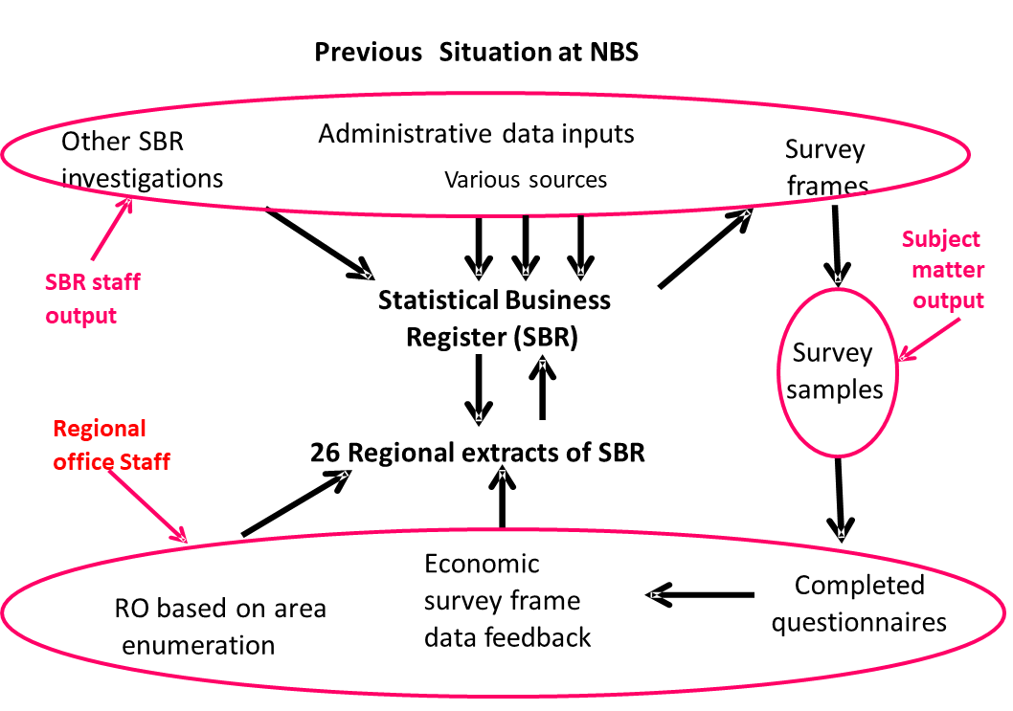
Dimension 3…
cont.
Regional Offices (RO) update SBR through area investigations confined to improvement of content and not coverage.

Slide 66
Dimension 3…cont.
Proposed Situation at NBS
Administrative data inputs
NGUVU KAZI KWA JINSI
Specify
Primary
Selected
Survey
investigations
source
sources
frames
26 Regional Statistics Offices use administrative data sources to improve the content of the units in SBR,
Business Register
Survey
samples
26 Regional extracts
of SBR
RO investigations
Economic
Completed
to improve content
survey frame
questionnaires
not coverage
data feedback

Slide 67
Discussions
Discuss the challenges of establishing an SBR in your country with regard to the following aspects:
Current and new data sources of the SBR
Maintenance and update of an SBR

Slide 68
Quiz (1)
‘My country has a legal framework to use economic census but not administrative data; SBR is based mainly on economic census; update of the records is taking place systematically.’
Q. Which of the following should be highly likely to be the assessment of their SBR?
D1. Preliminary, D2. Early, D3. Early
D1. Preliminary, D2. Preliminary, D3. Preliminary
D1. Early, D2. Early, D3. Early
D1. Early, D2. Preliminary, D3. Preliminary

Slide 69
Quiz (1)
‘My country has a legal framework to use economic census but not administrative data; SBR is based mainly on economic census; update of the records is taking place systematically.’
Q. Which of the following should be highly likely to be the assessment of their SBR?
D1. Preliminary, D2. Early, D3. Early
D1. Preliminary, D2. Preliminary, D3. Preliminary
D1. Early, D2. Early, D3. Early
D1. Early, D2. Preliminary, D3. Preliminary

