Slide 1
Regional Course on
Statistical Business Registers
Session 8: SBR Maturity Model (continued)
● Dimension 6: IT environment
● Dimension 7: Interoperability

Slide 2
Overview
Sessions 6 & 7 covered the first 5 dimensions of the
SBR Maturity Model
↓
This session will cover the final two dimensions, on the
IT environment and interoperability

Slide 3
Dimension 6: IT Environment

Slide 4
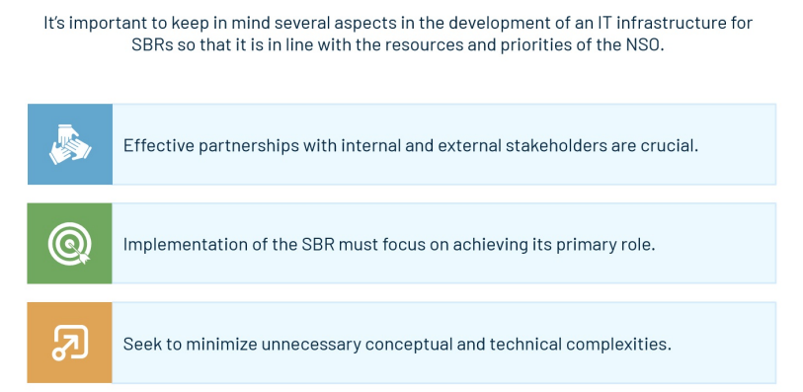
Dimension 6: IT Environment

Slide 5
Dimension 6: IT Environment
Goal
Develop a system that fits within the NSO’s infrastructure and is compatible with other systems, i.e. administrative data acquisition systems and business survey collection systems
Project management
Significant undertaking: should be managed as a project, using project management methodology, if available
Effort should be appropriate to size, complexity and risk
Other common PM methodologies like PRINCE2 (PRojects IN Controlled Environments) and PMI/PMBOK (Project Management Body of Knowledge)

Slide 6
Dimension 6: IT Environment
Software development methodology
  Agile implementation:
Demonstrating value to shareholders quickly
Managing change and risk continuously
Frequent evaluation and realignment of scope, cost, schedule, quality
  2 phases of IT development:
Acquiring initial db infrastructure
Then programming and process development
Follow organizational IT standards
If one is not already implemented, should adopt an appropriate one

Slide 7
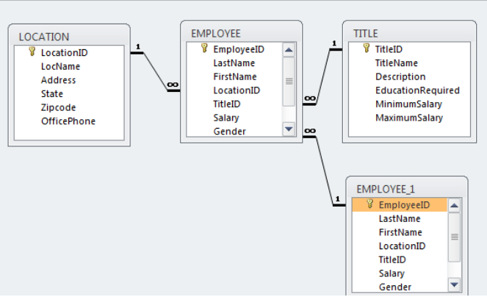
Dimension 6: IT Environment
Database management systems
Security
Scalability
Concurrent users
Flexible and standardized query language
Relational database
management systems
(RDBMS)
Additionally:
Referential and data integrity
Efficient storage and performance
Modularity

Slide 8
Dimension 6: IT Environment
Database options
Low cost: Microsoft Access (no concurrent users, limited capacity)
Others: Oracle, Microsoft SQL Server, MySQL, MariaDB and PostgreSQL
Technologies should be:
Accessible, staff able to be trained
Long shelf life
Able to integrate external systems, administrative data especially, through APIs
Use clear definitions and concepts

Slide 9
Dimension 6: IT Environment
Other elements
Should be a place (within or external to db) for storing and accessing data on: frames, snapshots, reporting burden, etc.
In primary role of providing survey frames, db should include data on collection process: units sampled, how and where data about units will be collected and results of collection efforts -> inputs into “respondent burden module” for use across agency/statistical office, including efforts to mitigate that burden

Slide 10
Dimension 6: IT Environment
Other elements
Unique Identifiers
Essential, will discuss more in the session on the Global Initiative on Unique IDs
Data retention policy
Don’t just change the information in the system
Instead add information about the change, including the time when change occurred (or was implemented), and maintain the old value
Can help in reconstructing the register and maintaining the historical register
Documentation
User manual/wiki/technical documentation

Slide 11
Dimension 6: IT Environment
ADB and Statistics Norway-developed systems
Adaptable, NSOs maintain ownership of the system and code
Statistics Norway: STATBUS Statbus.org + github.com/statisticsnorway/SBR
Runs on Microsoft’s IIS (Internet Information Server) and is written in ASP.NET
Choice of underlying database – Microsoft SQL Server, PostgreSQL, MySQL
Data can be uploaded in CSV or XML format
  Includes data quality checks, system user management
  Different languages, different classification systems
Define, construct, maintain statistical units
Classify units by sector/activity
Produce survey frames and register-based statistics
Upload from different sources
Multiple ID fields including computer generated; up to 3 languages

Slide 12
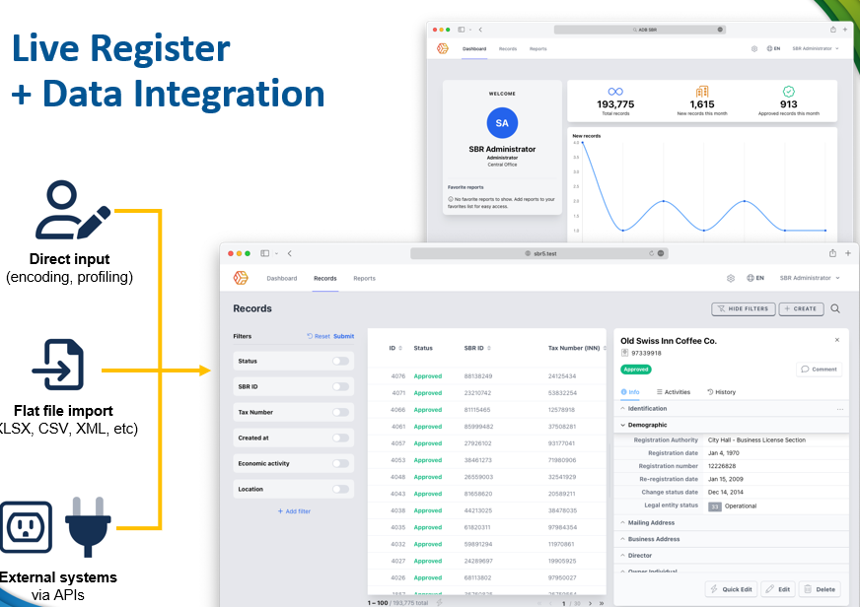
Dimension 6: IT Environment
ADB and Statistics Norway-developed systems
ADB SBR System
Many of the same features as STATBUS:
Web-based application
User accounts
Create frames/snapshots, historical data
API integration
These systems are not “plug-and-play”!
Require collaboration with these organizations
Internal planning and management and maintenance are still needed

Slide 13
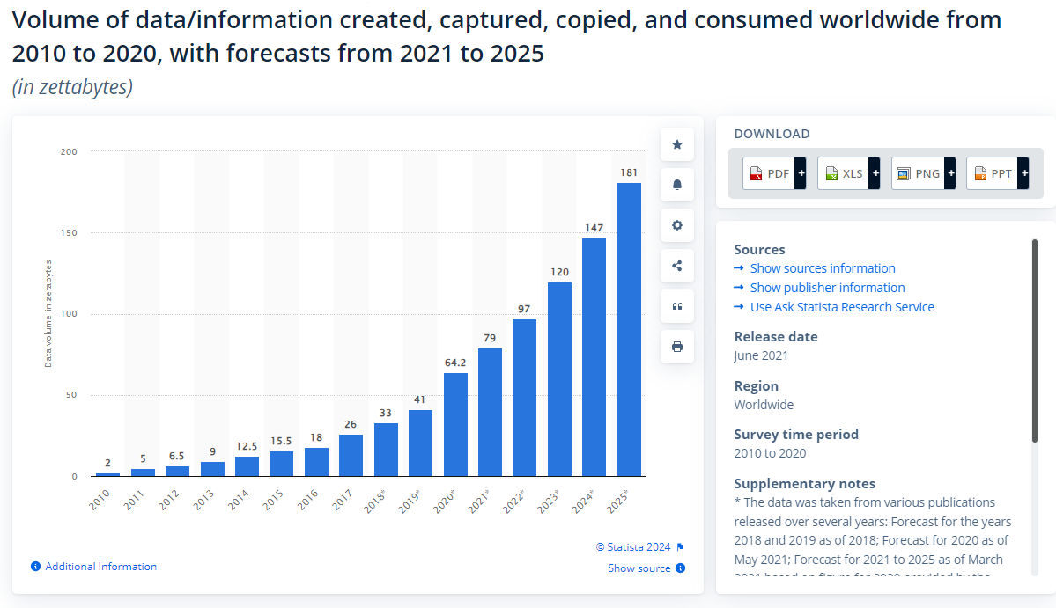
Dimension 6: IT Environment
Big Data, Artificial intelligence (AI) and Machine Learning (ML)

Slide 14
Dimension 6: IT Environment
Big Data, Artificial intelligence (AI) and Machine Learning (ML)
Many web scraping tools available online
Companies providing data -> now also providing web scraping services
Can be used to help identify web stores/online retail
AI can help write code for scraping, etc.
Language recognition is a major component

Slide 15
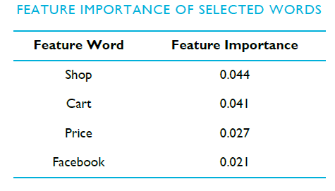
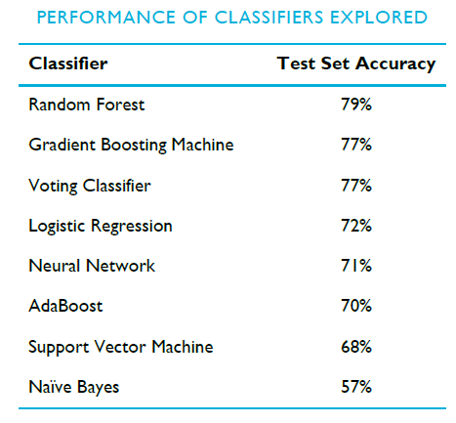
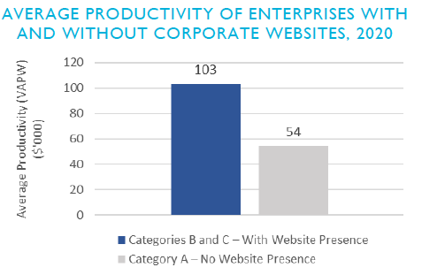
Dimension 6: IT Environment
Big Data, Artificial intelligence (AI) and Machine Learning (ML)
Singapore example
https://www.singstat.gov.sg/-/media/files/publications/economy/ssn222-pg1-4.ashx

Slide 16
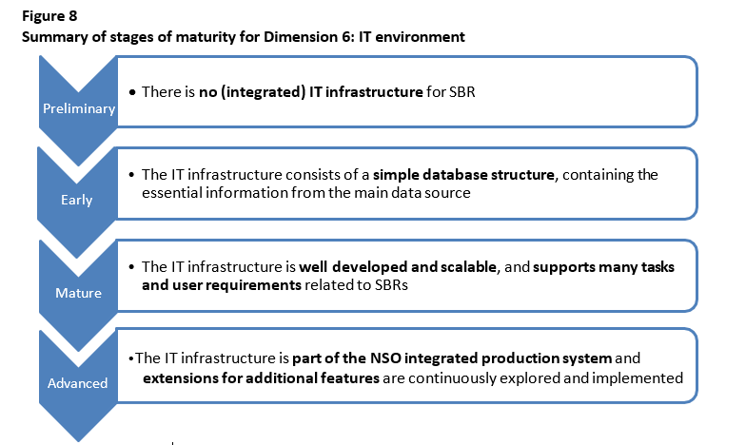
Dimension 6: IT Environment

Slide 17
Dimension 6: IT Environment
Preliminary →
  No integrated insfrastructure
  Records kept manually, i.e. Excel
  Basic maintenance strategy
Early →
  Simple db structure with essential data
  May have other applications, but not integrated
Mature →
  Managed like a project, maintained, dedicated staff
  Modular, scalable, supports historical register, unique IDs
Advanced
  Part of integrated system, continuously improved
  New technologies: big data, web scraping, portals for businesses to enter info

Slide 18
Dimension 6: IT Environment
Questions:
Does your SBR use a relational database?
Have you had positive/negative experience with specific types of software?
Have you had any experience with ADB/STATBUS products?

Slide 19
Dimension 7: Interoperability
Interoperability
The ability of computer systems or software to exchange and make use of information in a coordinated manner
In SBRs
The ability of an SBR to communicate and exchange standardized data with other registers, be they domestic, regional, or global
Data can be easily re-used and processed in different applications, allowing different information systems to work together

Slide 20
Dimension 7: Interoperability
Interoperability
Related to IT infrastructure but important enough to be separately assessed
Increases efficiency
Requires
A unique ID
Standardized language/classification/characteristics

Slide 21
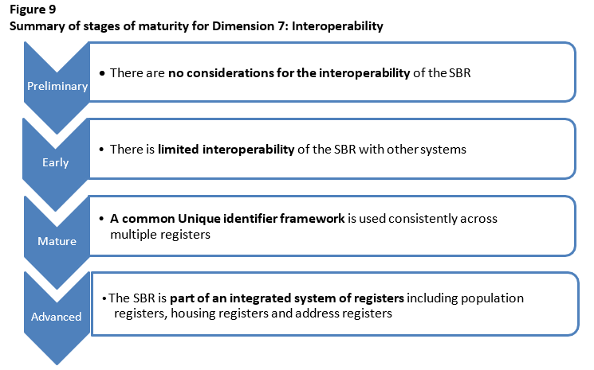
Dimension 7: Interoperability

Slide 22
Dimension 7: Interoperability
Preliminary →
  Matching done manually
  No considerations for interoperability
Early →
  Some automated routines
  Some interoperability with administrative sources
Mature →
  Common unique ID to link administrative & statistical registers
  Compatability with international standards
Advanced
  Microdata linking implemented
  Interoperable with international sources using global identifiers
  Integration with population, housing, other registers

Slide 23

Dimension 7: Interoperability
Available at this link

Slide 24
Dimension 7: Interoperability
Questions:
1. Does your SBR meet the minimum requirements, namely:
Use of a unique identifier +
A standardized language/classification/characteristics?
2. Which, if any, other registers can be linked with your SBR? Could this be done in a more efficient way?
3. Has your office implemented micro data linking?

Slide 25
Dimension 7: Interoperability
Thank you!

