Slide 1



Session 1:
Inequality
Rana Hasan and Art Martinez
Economic Research and Regional Cooperation Department
Asian Development Bank

Slide 2
Management Seminar of SIAP – The Future of Economic Statistics
Outline of Presentation
Why tracking inequality matters
Do we have access to high quality data?
Concluding thoughts

Slide 3
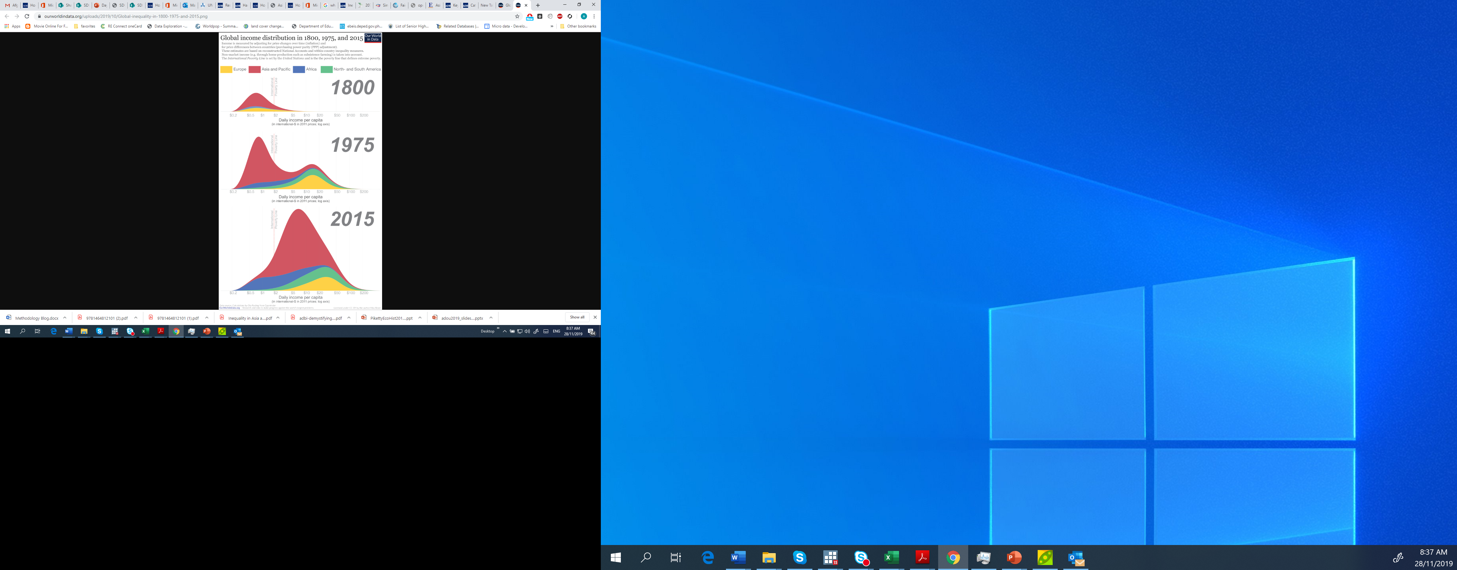
Management Seminar of SIAP – The Future of Economic Statistics
The news on inequality is both positive and negative: reduction in income disparities among countries but increasing gap between rich and poor within countries.
Global income distribution in 1800, 1975, and 2015
Source: Roser, M. 2019. Global Economic Inequality.

Slide 4

Management Seminar of SIAP – The Future of Economic Statistics
Inequality of total household income / consumption
Annualized change in inequality of expenditure or income,
Asian economies with rising inequality, 1990s and 2000s
Source: Kabur, R., Rhee, C. and J. Zhuang. 2014. Inequality in Asia and the Pacific Trends, Drivers and Policy Implications.

Slide 5
Management Seminar of SIAP – The Future of Economic Statistics
Why is tracking inequality important?
It informs us about the nature of the growth process.
Rising inequality tells us that the growth process is uneven. Is this “good”? Is it “bad”?
  “Development must be inegalitarian because it does not start in every part of an economy at the same time.” Nobel laureate Arthur Lewis
  Rising inequality may reflect phenomena that can undermine the development process—e.g., inequality of opportunities and regulatory capture

Slide 6
Management Seminar of SIAP – The Future of Economic Statistics
Policy issues:
Many economies have undertaken market-oriented reforms (e.g., reductions of tariff rates and non-tariff barriers and industrial deregulation).
What is the growth experience? What is happening to worker incomes and duration of employment?
Are new technologies benefiting some workers over others?
What is happening to spatial inequality? Are some states/provinces growing faster? Are urban areas doing better than rural areas? Are big cities doing better than secondary cities?
What should be the stance of labor regulations and minimum wage laws?
Data issues:
Are household and enterprise surveys regularly conducted? Do they cover key units of interest (e.g., informal enterprises)?
Are the results published quickly?
Are the micro-data available to researchers?

Slide 7
Management Seminar of SIAP – The Future of Economic Statistics
What type of inequality do we want to track?
Many types of inequality:
  Income versus nonincome
  Income versus wealth
Do we have high quality data collection systems that can guide us in designing policies and interventions to facilitate such reduction?
Do we have data available?
Are they of high quality? timely? granular?
Do we have access to data?

Slide 8
Inequality of total household income / consumption
Data issues:
Are household surveys representative?
Probability of Response Against Per Capita Income by State, United States
Source: Figure 3.2. Asian Development Bank. 2007. Key Indicators for Asia and the Pacific 2007 Special Chapter: Inequality in Asia.

Slide 9
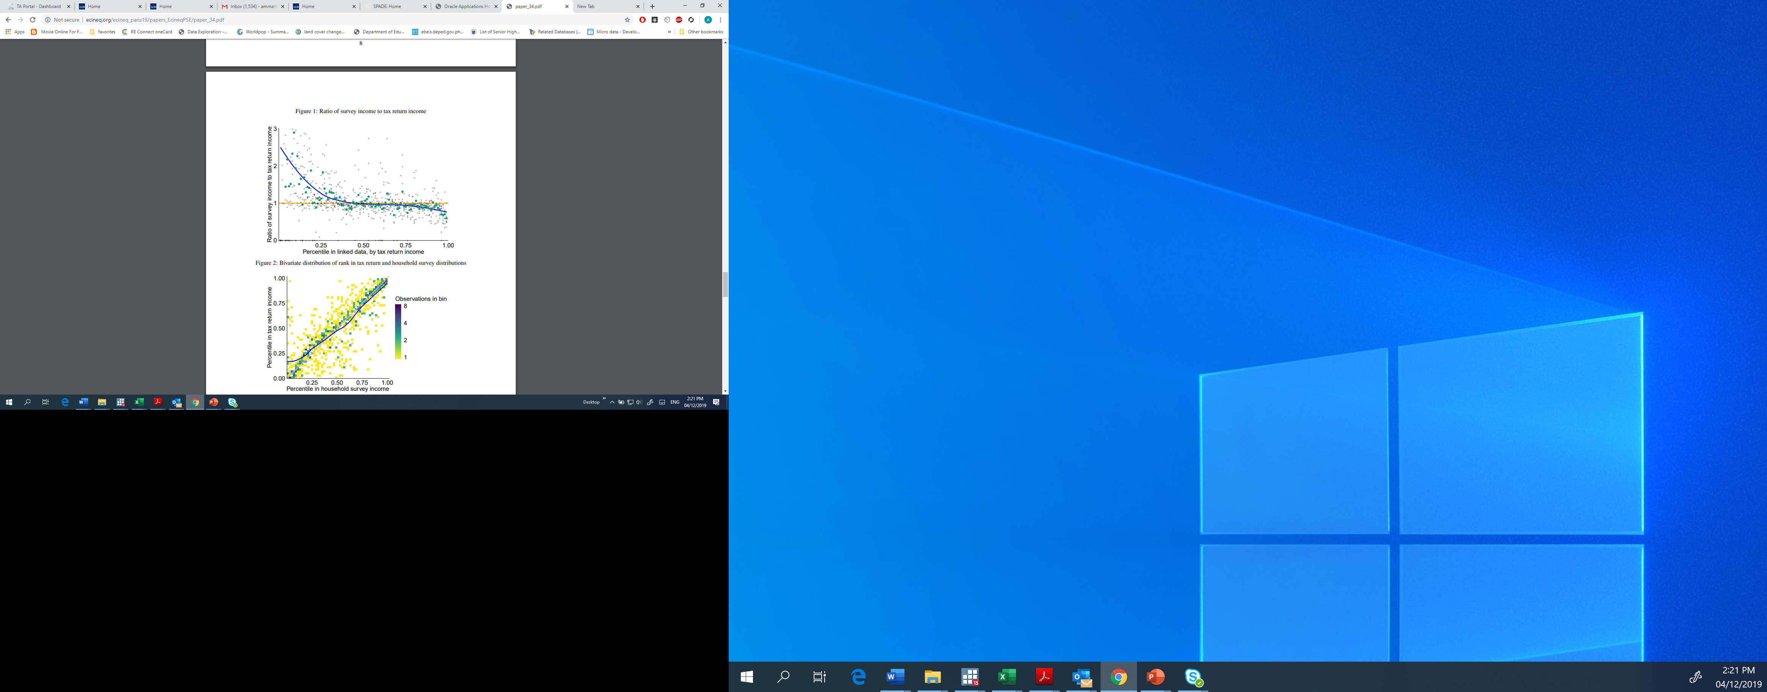
(con’t) Inequality of total household income / consumption
Data issues:
Are income data reported in household surveys accurate?
Ratio of survey income to tax return income
Source: Figure 1 (Data from Uruguay). Higgins, Lustig, and Vigorito (2018). The Rich Underreport their Income: Assessing Bias in Inequality Estimates and Correction Methods using Linked Survey and Tax Data

Slide 10
(con’t) Inequality of wages and job earnings
Data issues:
How reliable are wage and earnings data reported in labor force surveys?
Top 10 Annual Salaries from Labor Force Surveys versus Average Salaries from Corporate Sources (in US$)
Source: Table 3.7. Asian Development Bank. 2007. Key Indicators for Asia and the Pacific 2007 Special Chapter: Inequality in Asia.

Slide 11
Management Seminar of SIAP – The Future of Economic Statistics
Inequality of income before and after taxes and transfers
Asia’s Income Inequality in the Global Context, 2015
Region | Pre-tax and pre-transfer Gini (mean) | Post-tax and post-transfer Gini (mean) | % Difference
Developing Asia | 40.0 | 37.4 | -6.3
Japan, Australia, and New Zealand | 45.7 | 32.6 | -28.6
Latin America, and Caribbean | 47.1 | 43.4 | -7.7
Sub-Saharan Africa | 45.9 | 45.0 | -1.8
European Union | 46.8 | 29.9 | -36.0
North America | 48.6 | 34.5 | -29.1
OECD | 47.4 | 31.1 | -34.1
OECD=Organisation for Economic Co-operation and Development
Note: Mean refers to the simple average of Gini coefficients of the countries in the region.
Source: Solt, F. 2019. Measuring Income Inequality Across Countries and Over Time: The Standard World Income
Inequality Database, version 8.
Data issues:
Do we have high quality tax data from administrative registers?
What type of data harmonization do we need to do to facilitate ‘comparability’ and ‘aggregation’ for purpose of compiling official statistics?
How can developing countries improve their administrative data collection systems?
Can we access these admin data without compromising data privacy?

Slide 12
Management Seminar of SIAP – The Future of Economic Statistics
Comparison of LFS Data Collection Instruments of Select Countries
Type of Information | India |  |  | Indonesia | Philippines | US
 | 2005 NSS | 2011 NSS | 2017 PLFS | 2017 LFS | 2017 LFS
employment status
industry | Y | Y | Y | Y | Y | Y
occupation | Y | Y | Y | Y | Y | Y
wages and earnings | Y (wage and salary earnings for wage workers) | Y (wage and salary earnings for wage workers) | Y (wage earnings and gross earning from self employment activitiy) | Y (income for own-account workers and casual workers; salary and allowance for employees) | Y (basic pay for or private households; working for private establishment; working for gov't/gov't corporation; and working with pay in own family operated farm or business) | Y
social protection
employer's contribution to social pension | Y (for wage workers from select industries) | Y (for wage workers from select industries) | Y (for wage workers from select industries) | Y (for employees) | N | N
paid leave | Y (for wage workers from select industries) | Y (for wage workers from select industries) | Y (for wage workers from select industries) | Y (for employees) | N | N
employment contract | Y (for wage workers from select industries) | Y (for wage workers from select industries) | Y (for wage workers from select industries) | Y (for employees and casual workers) | N | N
others | Y (method of payment) | Y (method of payment) |  | Y (insurance for employees and casual workers; transporation and food wages, and over time pay for employees)
enterprise characteristics
firm size | Y (for select industries) | Y (for select industries) | Y (for select industries) | Y (for employer assisted by permanent workers) | N | N
registration | N | N | N | N | N | N
bookkeeping practice | N | N | N | Y (for own-account worker and employers) | N | N
others | Y (location of workplace and enterprise type for select industries) | Y (location of workplace and enterprise type for select industries for select industries) | Y (location of workplace and enterprise type for select industries) | Y (type of institution and location of workplace)
occupational mobility
whether changed job in the past X period | Y (particulars of last employment, including reasons for break in employment) | Y (duration of present spell of unemployment) | N | Y (whether person quit job within the last one year) | N | Y
previous industry | Y | N | N | Y | N | N
previous occupation | Y | N | N | Y | N | Y
previous wages and earnings | N | N | N | N | N | N

Slide 13



Management Seminar of SIAP – The Future of Economic Statistics
Other Considerations
How can data producers make data easily accessible to those who need it?

Slide 14

Management Seminar of SIAP – The Future of Economic Statistics
Other Considerations
How can we share granular / microlevel data to facilitate a richer analysis of socioeconomic inequality without compromising data privacy?

Slide 15
Management Seminar of SIAP – The Future of Economic Statistics
Key questions
Do we need additional data / new statistics or should we focus more on enhancing the quality of existing data?
How can we capitalize on innovative data sources and modern data collection methods to gain more nuanced insights on inequality?
Can we combine geocoded survey data with increasingly available geospatial data sets to facilitate richer analysis, while still following standard protocols on data anonymity
What can we do to sensitize policymakers to the need to invest in and use better data for policy-relevant analysis?

Slide 16
Thank you.
Email:
Rana Hasan
rhasan@adb.org

