Slide 1
Module 16: Price Index
Session I

Slide 2
Contents – Session I
Introduction – purpose and use of Price Index
What is an Index number
Aggregate index

Slide 3
Introduction – Purpose and Use
  What is Price Index?
  Main uses
  Common price indices
Notes:
3

Slide 4
Price
Price Index – an Introduction
The price of a product – whether goods or services – is simply defined as the value of one unit of that good or service.
Prices are observable in monetary transactions.
Prices are generally determined on a market.
Wages are also considered as ‘price’ of the factor service ‘labour’.
The price of each good or service is made up of several cost factors.

Slide 5
Price Index
Price Index – an Introduction
Of all the index numbers, price indices are the most important and are commonly used in various economic and business contexts.
Price index compares the prices of a group of commodities at a certain time or place with prices of the base period or place, respectively.

Slide 6
What are Price Indices?
Price Index – an Introduction
A price index compares the prices of a set of products at different points in time, or at different locations.
It therefore measures price changes or price differentials rather than price levels.
Price indices capture changes in prices of a set of goods & services actually paid or received, at different stages of distribution, such as:
  price paid by the customer (CPI) or
  price received by the producer (output PPI).
6
6
Notes:
National Accounts - Basic Concepts
Aug. 2011
PDOS-
6
6

Slide 7
Main Purpose
Price Index – an Introduction
As the price level goes up, the value of money goes down.
The main purpose of compiling a price index is to measure the change in purchasing power of the economy’s currency with respect to
  the specified group of goods and services purchased or sold
  by a specified type of purchasers or sellers.
7
7
Notes:
National Accounts - Basic Concepts
Aug. 2011
PDOS-
7
7

Slide 8
Use of Price Indices
Price Index – an Introduction
Main uses:
Measurement of inflation – changes in general level of prices over time.
Calculation of real values – National Accounts Statistics at constant prices.
Calculation of indexed values – adjustment of wages & salaries.
Contract escalation.
Determination of foreign exchange rates and for International studies.
8
8
Notes:
National Accounts - Basic Concepts
Aug. 2011
PDOS-
8
8

Slide 9
Prices change in stage of economic process
Price Index – an Introduction
Often case:
P
P
Final consumption
Raw materials
Intermediate outputs
Final Products
Wholesale
Retail
P
P
P

Slide 10
Different Price Indices
Price Index – an Introduction
There are different kinds of price indexes. For each different stage of processing price indices are compiled.
These differ with respect to
items they take into account.
buyers or sellers involved in the transactions.
periodicity, i.e. whether the prices are observed weekly or monthly or yearly.
10
10
Notes:
National Accounts - Basic Concepts
Aug. 2011
PDOS-
10
10

Slide 11
Common Price Indices
Price Index – an Introduction
  Principal Price indices
  Consumer Price (CPI)
  Producer Price Indices (PPI): input PPI and output PPI
      Services Producer Price Indices like BSPI & CSPI and CGPI
  Import and Export Price Indices (XMPI)
  Purchasing Power Parity (PPP)
  GDP implicit price index or GDP deflator
Others
  Labour Cost Index – wage rate index
  Energy Price Statistics
  Construction Cost Index
  House rent index – often part of CPI
11
11
Notes:
National Accounts - Basic Concepts
Aug. 2011
PDOS-
11
11

Slide 12
Price Index in this module
Price Index – an Introduction
Of the various price indices mentioned in the previous slide, this module focusses on mainly on CPI.
The PPI and XMPI are also discussed briefly, especially in the context of weighting, product classification and interpretation.
We will start with a discussion on Index numbers in general, before turning to Price indices.

Slide 13
What is an Index Number
  Simple price index
  Types of simple price index
Notes:
13

Slide 14
Definition: Index numbers
Index number
Definition: Index numbers are statistical devices designed to measure relative changes in the level of a phenomenon (variable or a group of variables) with respect to
time, or
geographical location or
other characteristics such as income, profession, etc.
Index numbers measure magnitude of change.
We will discuss index numbers for changes with respect to time.

Slide 15
Index numbers - Examples
Index number
The variable may be
  price of a particular commodity or a group of commodities
  volume of trade, imports and exports, agricultural or industrial production, etc.
  Human and livestock population
  national income of a country or
  cost of living of persons belonging to particular income group/profession, etc.

Slide 16
Types of Indices
Index number
Types of indices
Simple index number
Simple aggregate index
Weighted aggregate index.
We begin by considering the simplest form of index numbers, “simple indices”.
In the context of price index, the simple indices are called ‘price relatives’.

Slide 17
Simple Index
Notes:
17

Slide 18
Definition: Simple Index
Simple Index
Formally, a simple index number or an elementary index – I_{t} – of a variable Y is defined as

Slide 19
Index number: Examples
Simple Index
Example 1: The average exchange rate of Tanzanian shillings (TShs) to US dollars (US$) for each year is converted into index numbers with the year 2000 as a base year as follows:
Year | TShs per US$ | Index 2000=100
2000 | 800.7 | 100.0
2001 | 876.4 | 109.5
2002 | 966.6 | 120.7
2003 | 1038.6 | 129.7
2004 | 1089.3 | 136.0
2005 | 1128.8 | ?
Find out the value of the index for 2005.

Slide 20
Rule of three
Simple Index
The “rule of three” is a very useful procedure when deriving index numbers from a series of statistics.
Year | TShs per US$ |  | Index (2000=100)
2000 | A → | 800.7 | B → | 100.0
2001 |  | 876.4 |  | 109.5
2002 |  | 966.6 |  | 120.7
2003 |  | 1038.6 |  | 129.7
2004 |  | 1089.3 |  | 136.0
2005 | C → | 1128.8 | D → | ?
The value in the cell D is worked out as follows:
D = B*C/A = 100*1128.8/800.7 = 141.0

Slide 21
Index number: Examples
Simple Index
Example 2: The population of Zambia each year may be converted into index numbers with the year 2000 as a base year as follows:
Year | Population | Index 2000=100
2000 | 9,885,591 | 100.0
2001 | 10,089,492 | 102.1
2002 | 10,409,441 | 105.3
2003 | 10,744,380 | 108.7
2004 | 11,089,691 | 112.2
2005 | 11,441,461 | 115.7
2006 | 11,798,678 | 119.4
2007 | 12,160,516 | ?

Slide 22
Index number: Examples
Simple Index
Example 3: The average price (in a local currency) of tea leaves (of a particular kind) for each year is given in the following table. These when converted to index numbers with the year 2000 as a base year are the ‘elementary indices’ or ‘price relatives’:
Year | Price of tea leaves per Kg. | Elementary Index (2000=100)
2010 | 1500 | 100.0
2011 | 1550 | 103.3
2012 | 1620 | 108.0
2013 | 1710 | 114.0
2014 | 1850 | 123.3
2015 | 2000 | ?

Slide 23
A few questions
Simple Index
Exercise 1
Fill in the missing index numbers in the boxes with a ? mark answer the following:
By what percentage has the 2007 population of Zambia has grown since the year 2000?
By how much (in percentage) TShs to US$ exchange rate has increased during 2000 to 2004?
What is the price relative of tea leaves in 2015 with respect to 1010?

Slide 24
Aggregate Index
Notes:
24

Slide 25
Why index numbers?
Aggregate Index numbers
Indices of the elementary kind, discussed above, have little value in themselves.
But they can be used to compile more complex “composite” indices, involving many different goods and services.
In economic statistics, the term “index numbers” is usually reserved for these more complex “composite” indices.

Slide 26
Need for Composite Index numbers
Aggregate Index numbers
When there is only one product, the elementary index (discussed above) serves well as a measure of change in price of the product or volume of its production.
Further, when there is a whole variety of products, with prices and volume of production / consumption changing at different rates, one can measure the change in money value of production / consumption by a single indicator, as shown in the next slide.

Slide 27
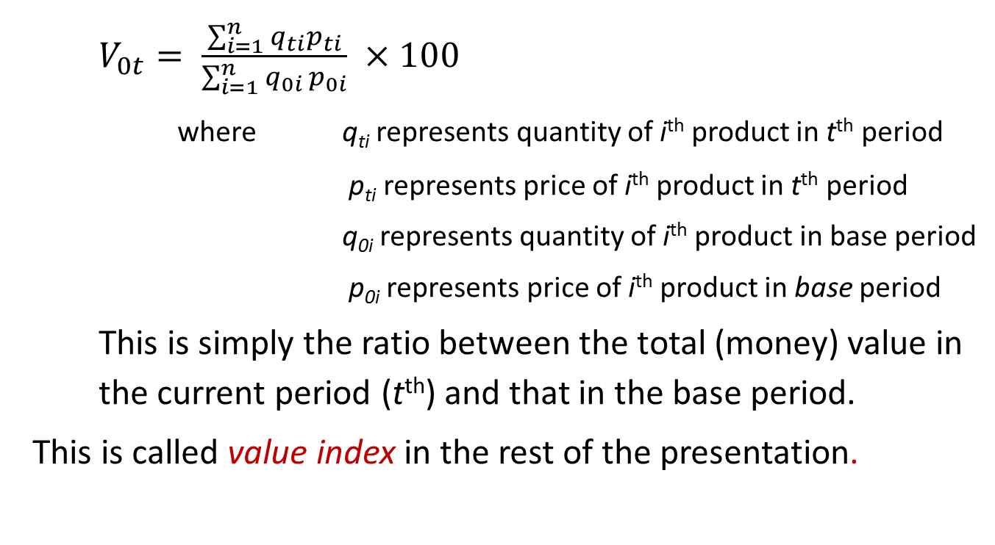
Measuring change in value
Aggregate Index numbers
$V_{0t}= \frac{\sum_{i=1}^{n}{q_{ti}p_{ti}}}{\sum_{i=1}^{n}{q_{0i }p_{0i}}} ×100$
where q_{ti} represents quantity of i^{th} product in t^{th} period
p_{ti} represents price of i^{th} product in t^{th} period
q_{0i} represents quantity of i^{th} product in base period
p_{0i} represents price of i^{th} product in base period
This is simply the ratio between the total (money) value in the current period (t^{th}) and that in the base period.
This is called value index in the rest of the presentation.

Slide 28
Decomposing V_{0t}
Aggregate Index numbers
Changes in prices
Change in value: V_{0t}
Changes in quantities
But how to separate out the change in value between changes in price and changes in quantity?
Constructing composite Index numbers becomes essential for measuring separately the change in prices or that in volume.
This leads to what is known as the Index Number Problem

Slide 29
Index Number Problem (1)
Aggregate Index numbers
How to combine the relative changes in the prices and quantities of various products into a single measure of the relative change of the overall
  price level and
  quantity level.

Slide 30
Index Number Problem (2)
Aggregate Index numbers
Or, conversely, how a value ratio pertaining to two periods of time can be decomposed into
  a component that measures the overall change in prices between the two periods— the price index and
  a component that measures the overall change in quantities between the two periods— the quantity (volume) index.
There is no unique way to achieve this.

Slide 31
Types of composite indices
Composite Index numbers
There are only two types of composite indices, (because “value” indices are always simple relatives or ratios of value):
  Price indices
  Quantity (or volume) indices
Quantity and volume are synonyms here. In economic statistics, changes in quality are considered as changes in quantity and included with them.
Usually the index is assigned a value of 100 in some selected base period.
The values of the index for other periods indicate the average percentage change (in prices or quantities) from the base period.

Slide 32
Price and Quantity Index
Composite Index numbers
A price index reflects the average of the proportionate changes (%) in the prices of the specified set of goods and services between two periods of time.
A quantity index reflects the average of the proportionate changes (%) in the quantities of the specified set of goods and services between two periods of time.
For the rest of this module, we will focus on Price Index only.

Slide 33
End of Session I

