Slide 1
Module 16: Price Index
Session II

Slide 2
Contents – Session II
Composite Price Index
  Unweighted composite index
  Weighted composite index
Important terms
  Base period (year): price reference period,
              weight reference period and
              index reference period
  Elementary aggregates
  (Expenditure) weights
  Consumption basket
  Price relatives and relative prices
  Price updating

Slide 3
Composite Price Index
Notes:
3

Slide 4
Why Price Indices? – An Illustration
Composite Index numbers
Assume that
you have a habit of taking tea in the morning and
price of tea leaves (your preferred variety) is 1.2 times in the current month (in 2012) as compared to its average price in 2010.
As compared to the average of 2010, how much does your morning cup of tea cost you in the current month,
if you drink black tea, i.e. without cream and sugar?
if you drink tea with cream and sugar?
Notes:
National Accounts - Basic Concepts
Aug. 2011
PDOS-
4
4

Slide 5
Why Price Indices? (2)
Composite Index numbers
Yes, the answer to part A of the question is 1.2 times.
Can you answer part B with the given information?
To answer part B, we need more information. What are they?
We need to know
the quantities of tea, cream and sugar you use for your cup of morning tea,
ratios of average prices of cream and sugar with respect to average price of tea leaves in 2010 and
ratios of prices of cream and sugar in the current month as compared to corresponding average prices in 2010.
Notes:
National Accounts - Basic Concepts
Aug. 2011
PDOS-
5
5

Slide 6
Why Price Indices? (3)
Composite Index numbers
From (i) and (ii) we can work out the average cost of your morning tea in 2010.
In addition, using (iii) we can work out the cost in the current month.
The ratio of (b) to (a) will be the answer to part B.
Notes:
National Accounts - Basic Concepts
Aug. 2011
PDOS-
6
6

Slide 7
Example 5 (fixed quantities)
Composite Index numbers
quantity (gms.) / price / cost | products |  |  | total
 | tea leaves | sugar | cream
quantity (gms.) for one cup | 1.0 | 2.5 | 0.5
average price (per gm.) in 2010 | 15 | 4 | 10
price (per gm.) in current month | 20 | 6 | 20
cost in 2010 | ? | ? | ? | ?
cost in current month | ? | ? | ? | ?
15 | 10 | 5 | 30
20 | 15 | 10 | 45
Calculate the costs in your workbook.
Notes:
National Accounts - Basic Concepts
Aug. 2011
PDOS-
7
7

Slide 8
Example 5 – Solution (Contd.)
Composite Index numbers
Thus the answer to part B will be
45/30 = 1.5
That is,
as compared to the average of 2010, the cup of morning tea cost you 1.5 times in the current month
OR
if it was 100 in 2010, in the current month it is 150.
We say, the price index (base year: 2010) for the ingredients of your morning tea is 150 in the current month.
Notes:
National Accounts - Basic Concepts
Aug. 2011
PDOS-
8
8

Slide 9
Example 6 (changing quantities)
Composite Index numbers
quantity (gms.) / price / cost | products |  |  | total
 | tea leaves | sugar | cream
quantity (gms.) per cup in 2010 | 0.9 | 3.0 | 0.6
quantity (gms.) per cup in 2011 | 1.0 | 2.5 | 0.5
quantity (gms.) per cup in current month | 1.2 | 2.0 | 0.4
average price per gm. in 2010 | 15 | 4 | 10
price (per gm.) in current month | 20 | 6 | 20
cost in 2010 | ? | ? | ? | ?
cost in current month | ? | ? | ? | ?
Calculate the costs in your workbook.
13.5 | 12 | 6 | 31.5
24 | 12 | 8 | 44
Notes:
National Accounts - Basic Concepts
Aug. 2011
PDOS-
9
9

Slide 10
Example 6 – Solution (Contd.)
Composite Index numbers
Thus, the cup of tea in the current month is costlier than 2010 by
44 / 31.5 = 1.40 times.
That is, as compared to the average of 2010, the morning cup of tea cost you 1.4 times in the current month
But this rise in cost is not just for price rise. The change in the quantities required per cup is also responsible.
Notes:
National Accounts - Basic Concepts
Aug. 2011
PDOS-
10
10

Slide 11
Example 6 – Solution (Contd.)
Composite Index numbers
Thus, to get a measure of change in prices, we must keep the quantities constant.
The question is which time period’s quantities should we consider for that purpose?
quantities of 2010
OR
quantities of 2011
OR
quantities of the current period?
Notes:
National Accounts - Basic Concepts
Aug. 2011
PDOS-
11
11

Slide 12
Example 7 – Solution with 2011 quantities
Composite Index numbers
quantity (gms.) / price / cost | products |  |  | total
 | tea leaves | sugar | cream
quantity (gms.) per cup in 2010 | 0.9 | 3.0 | 0.6
quantity (gms.) per cup in 2011 | 1.0 | 2.5 | 0.5
quantity (gms.) per cup in current month | 1.2 | 2.0 | 0.4
average price per gm. in 2010 | 15 | 4 | 10
price (per gm.) in current month | 20 | 6 | 20
cost in 2010 for 2011 quantities | ? | ? | ? | ?
cost in current month for 2011 quantities | ? | ? | ? | ?
15 | 10 | 5 | 30
20 | 15 | 10 | 45
Calculate the costs in your workbook.
Notes:
National Accounts - Basic Concepts
Aug. 2011
PDOS-
12
12

Slide 13
A Price Index
Composite Index numbers
In Example 7, using fixed (2011) quantities, the ratio of costs in the current period (2012) and 2010 gives us a measure of price change – 1.5 times.
This gives the general expression of the most commonly used measure of price index.
Algebraically,
where q_{ib} represents quantity of i^{th} product in b^{th} period
p_{it} represents price of i^{th} product in t^{th} period
p_{i0} represents price of i^{th} product in base period
Notes:
National Accounts - Basic Concepts
Aug. 2011
PDOS-
13
13

Slide 14
Lowe Price Index
Composite Index numbers
The Lowe price index is a type of index in which the quantities are fixed and predetermined.
Many of the indices produced by statistical agencies turn out to be Lowe indices.
We will discuss this further in the next session.
Notes:
National Accounts - Basic Concepts
Aug. 2011
PDOS-
14
14

Slide 15
Some important terms
Notes:
15

Slide 16
Price Index for a cup of tea
Composite Index numbers – Some important terms
This is an example of computing price index for a simple mix of products needed for a cup of tea of one person.
The ratio of costs of the current period and that of 2010 gives us
is the price index for the current month (t), with
  2010 as the reference period (0) and
  quantities of the 2011 (b).
  In the context of price index, such reference period is called the base period – denoted by suffix ‘0’ in the formula.
Notes:
National Accounts - Basic Concepts
Aug. 2011
PDOS-
16
16

Slide 17

Price Index – an alternative expression
Composite Index numbers – Some important terms
Note that can also be written as
$I_{0t}= \sum_{i}^{ }{\frac{p_{it}}{p_{i0}} w_{i}}$ where $w_{i}= \frac{p_{i0}q_{ib}}{\sum_{i}{p_{i0}q_{ib}}}$
  In the context of CPI, w_{i} ’s are called expenditure weights.
  In Example 5, weights are as follows:
weight / cost | products |  |  | total
 | tea leaves | sugar | cream
cost in 2010 for 2011 quantities | 15 | 10 | 5 | 30
Weight (w_{i}) | 0.5 | 0.33 | 0.17 | 1
Notes:
National Accounts - Basic Concepts
Aug. 2011
PDOS-
17
17

Slide 18
What is Consumer Price Index (CPI)?
Composite Index numbers – Some important terms
Conceptually, CPI is similar to the price index for a cup of tea, only that in practice,
  The price index is compiled for all the residents of an economy or a well-defined segment of it [not a single person as in the example];
  the set of products for consumption is very large – including all goods and services consumed by residents or a segment of them, and
  average of prices collected from a sample of sellers of the product is used for compilation of the index.
Notes:
National Accounts - Basic Concepts
Aug. 2011
PDOS-
18
18

Slide 19
Consumption Basket
Composite Index numbers – Some important terms
The very large set of products are used for compilation of CPI.
Each individual product has a share in the total value of consumption expenditure, which is the expenditure weight of the product.
Consumption Basket: the set of goods and services for which an index of price change is constructed, along with their expenditure weights.
In our example, the consumption basket is composed of tea leaves (your preferred variety), sugar and cream, along with their respective weights 0.5, 0.33 & 0.17.
Notes:
National Accounts - Basic Concepts
Aug. 2011
PDOS-
19
19

Slide 20
Base period
Composite Index numbers – Some important terms
The base period generally is understood to be the period with which other periods are compared.
The values of expenditure in the base year provide the basis of assigning weights for a price index.
However, the concept of the “base period” is not a precise one and may be used to mean rather different things.
Notes:
National Accounts - Basic Concepts
Aug. 2011
PDOS-
20
20

Slide 21
Base period – three types
Composite Index numbers – Some important terms
Three types of base periods may be distinguished:
the price reference period, that is, the period whose prices appear in the denominators of the price relatives used to calculate the index, or
the weight reference period, that is, the period, usually a year, whose values serve as weights for the index. However, when hybrid expenditure weights are used in which the quantities of one period are valued at the prices of some other period, there is no unique weight reference period, or
the index reference period, that is, the period for which the index is set equal to 100.
The three reference periods may coincide but frequently do not.
Notes:
National Accounts - Basic Concepts
Aug. 2011
PDOS-
21
21

Slide 22
Example 8 – with three different base periods
Composite Index numbers – Some important terms
weights / price | products |  |  | total
 | tea leaves | sugar | cream
weights in 2009 – w_{i09} | 0.9 | 3.0 | 0.6 | 1.0
average price per gm. in 2010 | 15 | 4 | 10
average price per gm. in 2011 | 17 | 5 | 15
price (per gm.) in current month | 20 | 6 | 20
(weights in 2009)*(price relatives in 2010) | 0.4412 | 0.2400 | 0.1333 | 0.8145
(weights in 2009)*(price relatives in current month) | 0.5882 | 0.3600 | 0.2667 | 1.2149
Index reference period – 2010; Weight reference period – 2009 and Price reference period - 2011
Calculate the values in your workbook.
Notes:
National Accounts - Basic Concepts
Aug. 2011
PDOS-
22
22

Slide 23
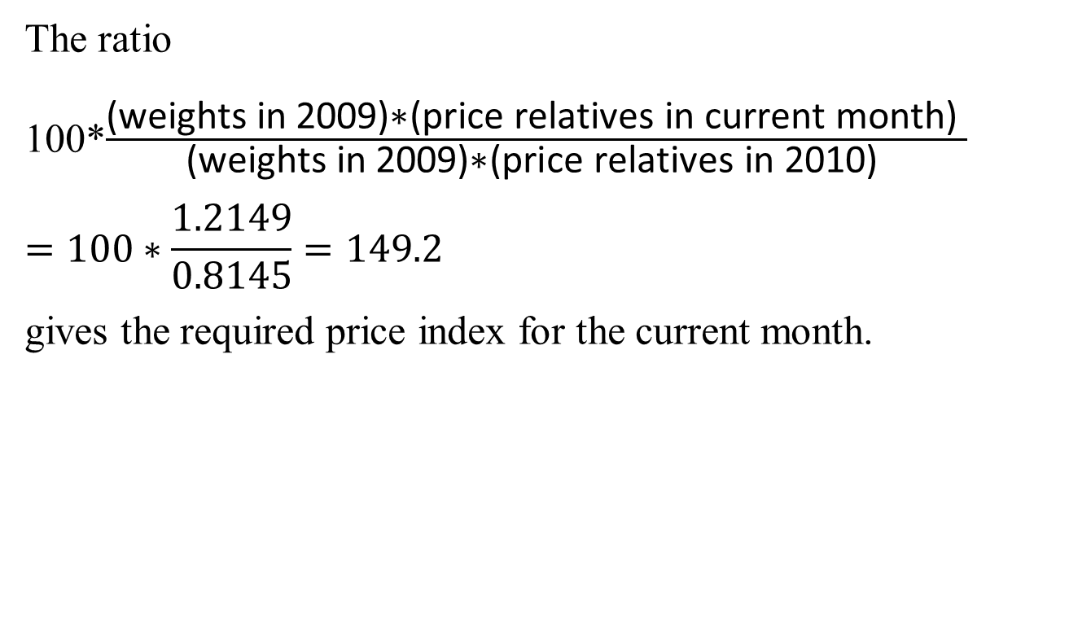
Example 8 (contd.)
Composite Index numbers – Some important terms
The ratio
100*$\frac{\text{(}\text{weights} \text{in}\text{ 2009)∗(}\text{price} \text{relatives} \text{in} \text{current} \text{month}\text{) }}{\text{(}\text{weights} \text{in}\text{ 2009)∗(}\text{price} \text{relatives} \text{in}\text{ 2010) }}$
$$=100∗\frac{1.2149}{0.8145}=149.2$$
gives the required price index for the current month.
Notes:
National Accounts - Basic Concepts
Aug. 2011
PDOS-
23
23

Slide 24
Some more important terms
Composite Index numbers – Some important terms
The ratios of prices of products (like tea, cream and sugar in 2010) is called relative prices.
For each individual product, the ratios of prices in the current period to those of the base year is called price relatives.
Combining the information on quantities and relative prices, we assign weights or expenditure weights to each product in the basket.
Notes:
National Accounts - Basic Concepts
Aug. 2011
PDOS-
24
24

Slide 25
Price Comparison
Composite Index numbers – Some important terms
: price of i^{th} commodity at t^{th} time point
Relative Price: of i^{th} commodity w.r.t. j^{th} commodity at t^{th} time point
Price relative: of i^{th} commodity between base period and the t^{th} time point
Notes:
25

Slide 26
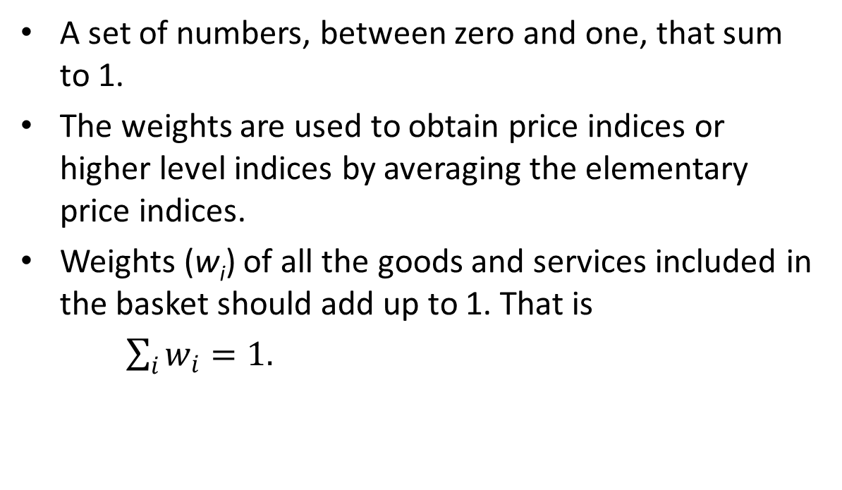
(Expenditure) Weights
Composite Index numbers – Some important terms
A set of numbers, between zero and one, that sum to 1.
The weights are used to obtain price indices or higher level indices by averaging the elementary price indices.
Weights (w_{i}) of all the goods and services included in the basket should add up to 1. That is
$\sum_{i}{w_{i}}=1.$
Notes:
26

Slide 27
Elementary aggregates
Composite Index numbers – Some important terms
The lowest level of aggregation for which value data are available and used in the calculation of a price index are called elementary aggregates.
In our example of ‘a cup of tea’, each of the three items – tea leaves, sugar and cream – are elementary aggregates.
Each elementary aggregate is assigned separate weights.
Notes:
27

Slide 28
Elementary Price Index
Composite Index numbers – Some important terms
An elementary price index is a price index for an elementary aggregate.
In practice, a number of price observations on different varieties and from different sellers are taken and the elementary price index is calculated from individual price observations without using weights.
More generally, the term is used to describe any price index that is calculated without weights.
Notes:
28

Slide 29
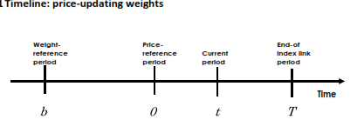
Price updating of weights
Composite Index numbers – Some important terms
Usually, the weight reference period precedes the price reference period.
Price-updating is done by multiplying the elementary
aggregate expenditure shares by the corresponding
elementary price indices b→0
Notes:
National Accounts - Basic Concepts
Aug. 2011
PDOS-
29
29

Slide 30
Example 9: Price updating of weights
Composite Index numbers – Some important terms
As we will later on see, CPI weights are obtained from results of a household consumption expenditure survey (HCES).
In the present example, the HCES is conducted with 2008 as the reference period, while the index reference period is 2010.
weight / cost | products |  |  | total
 | A | B | C
Weight (w_{i}⁰⁸) in 2008 | 0.5 | 0.3 | 0.2 | 1.0
Prices (p_{i}⁰⁸) in 2008 | 13 | 4 | 11
Prices (p_{i}¹⁰) in 2010 | 15 | 5 | 10
Price relatives 2008→2010 (pr) | 1.15 | 1.25 | 0.91
pr * w_{i}⁰⁸ | 0.58 | 0.38 | 0.18 | 1.13
Updated weights (w_{i}) for 2010 | 0.509 | 0.331 | 0.160 | 1.00
Calculate the values in your workbook.
Notes:
National Accounts - Basic Concepts
Aug. 2011
PDOS-
30
30

Slide 31
End of Session II

