Slide 1
Module 16: Price Index
Session III

Slide 2
Contents – Session III
Index number formula
  Simple index: Dutot, Carli and Jevon
  Weighted index: Lowe, Laspeyres, Paashe’s and Fischer’s

Slide 3
Price Index – Formula
Notes:
3

Slide 4
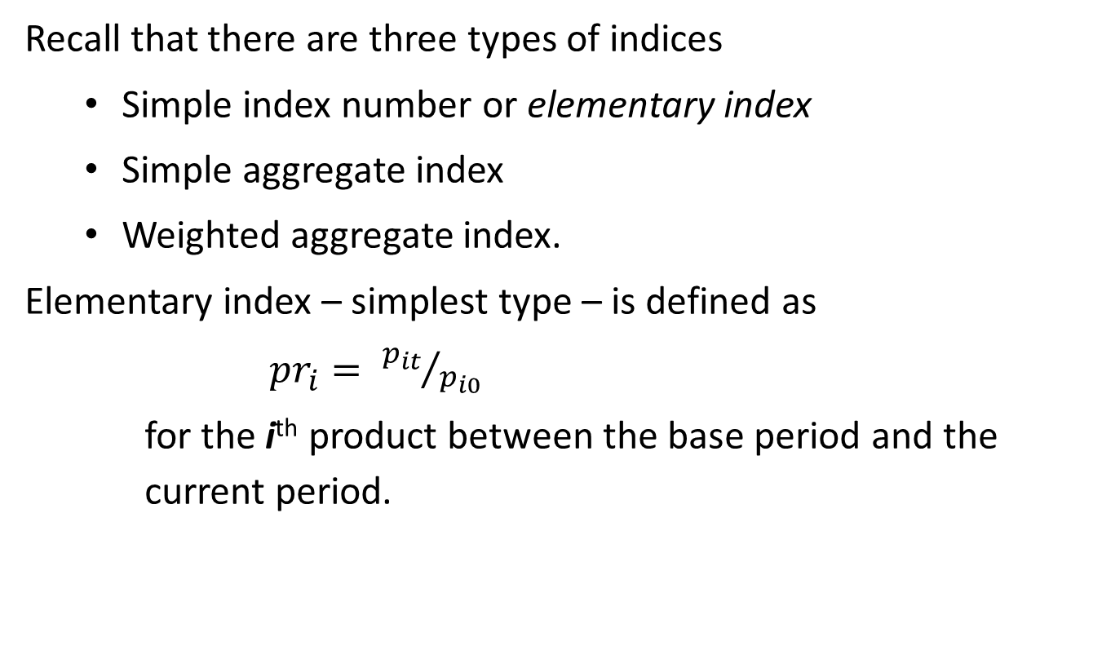
Index number formula
Price Index Formula
Recall that there are three types of indices
Simple index number or elementary index
Simple aggregate index
Weighted aggregate index.
Elementary index – simplest type – is defined as
${pr}_{i}= {p_{it}}/{p_{i0}}$
for the i^{th} product between the base period and the current period.
Notes:
National Accounts - Basic Concepts
Aug. 2011
PDOS-
4
4

Slide 5
Why we need an aggregation method?
Price Index Formula
A price relative is computed for a single commodity.
For an exactly-specified commodity, price relatives measure “pure” price change.
But for a consumption item, consisting of different varieties with varying price, we cannot compute its price relative.
For example,
  rice with different varieties – coarse, medium and fine. We can define a derived price of the item rice as total value/total quantity
  the value of ratio derived prices of two time periods will be affected by both the change in composition as well as change in prices.
  It is not a measure of “pure” price change.
Notes:
National Accounts - Basic Concepts
Aug. 2011
PDOS-
5
5

Slide 6
Aggregation methods – broad kinds
Price Index Formula
Depending upon whether the aggregation method uses weight for the commodities or commodity-groups involved, we have two broad kinds of aggregate index, viz.:
Simple aggregate index based on unweighted aggregation
Weighted aggregate index based on weighted aggregation.
Notes:
National Accounts - Basic Concepts
Aug. 2011
PDOS-
6
6

Slide 7
Simple aggregate index
Price Index Formula
A simple aggregate index is calculated from individual price observations without using weights.
Three most commonly used simple(unweighted) aggregate index formulas are:
Dutot
Carli and
Jevon
These are used for compiling elementary price indices from observed price data.

Slide 8
Simple aggregate index – Dutot
Price Index Formula
In this method, the aggregate price of various commodities in a given year is expressed as a percentage of the same in the base year. The formula is
P_{0t}=Σp_{t}/Σp₀ * 100
  where Σp_{t}= aggregate of prices for the current period.
  and Σp₀= aggregate of prices for the base period.
  [henceforth the subscript i for products is dropped from the formula. All the ∑ signs represent sum over all products.]

Slide 9
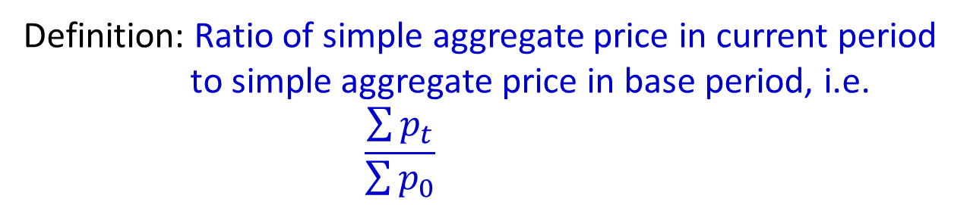
Example 10: Simple Aggregate Index (Dutot index)
Price Index Formula – simple aggregate
Definition: Ratio of simple aggregate price in current period to simple aggregate price in base period, i.e.
$$\frac{\sum{p_{t}}}{\sum{p_{0}}}$$
Calculate Dutot Index in your workbook

Slide 10
Limitations of Dutot Index
Price Index Formula – simple aggregate
This – Dutot Index – is simple but has the following limitations:
  The prices of various commodities may be quoted in different units,
    e.g., price of cereals may be quoted in Yen per quintal, liquids like milk, petrol, kerosene may be quoted in Yen per liter; cloth may be quoted in Yen per meter and so on.
  Thus, the index is influenced very much by the units in which commodities are quoted and accordingly some of the commodities may get more than their due importance.

Slide 11
Limitations of Dutot Index (contd.)
Price Index Formula – simple aggregate
  (ii) In this method the commodities get weighted according to the magnitudes of their prices
    Thus highly priced commodities exert greater influence on the value of the index.
  (iii) The relative importance in use of various commodities is not taken into consideration.

Slide 12
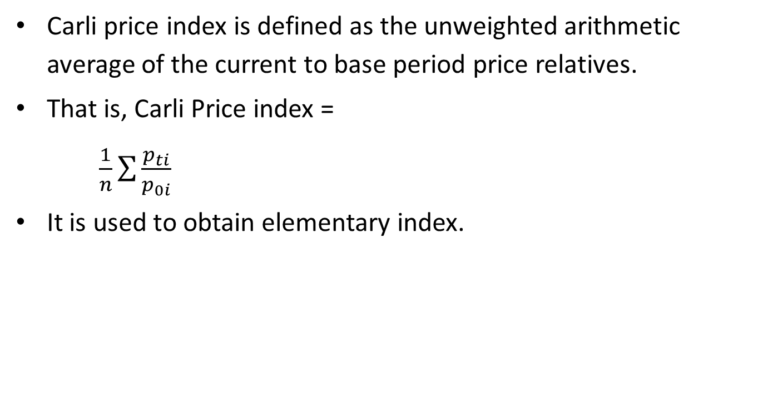
Simple Aggregate Index - Carli
Price Index Formula – simple aggregate
Carli price index is defined as the unweighted arithmetic average of the current to base period price relatives.
That is, Carli Price index =
$\frac{1}{n}\sum{\frac{p_{ti}}{p_{0i}}}$
It is used to obtain elementary index.

Slide 13
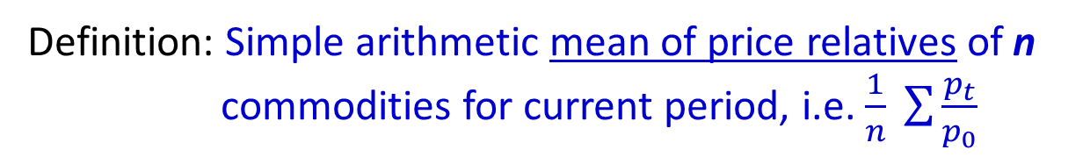
Example 11: Carli index – a simple aggregative formula
Price Index Formula – simple aggregate
Definition: Simple arithmetic mean of price relatives of n commodities for current period, i.e. $\frac{1}{n} \sum{\frac{p_{t}}{p_{0}}}$
Calculate Carli Index in your workbook

Slide 14
Carli Index - advantages and limitations
Price Index Formula – simple aggregate
Carli price index gives equal weights to all the items.
By economic approach, it has an upward bias.
When the items should be given equal weights and their prices vary randomly in a given period, Carli index is the best measure for common inflation rate.

Slide 15
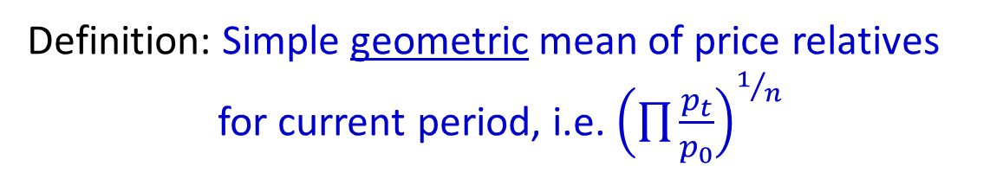
Example 12: Jevons index- another simple aggregative method
Price Index Formula – simple aggregate
Definition: Simple geometric mean of price relatives for current period, i.e. ${\left(\prod{\frac{p_{t}}{p_{0}}}\right)}^{1/n}$
Calculate Jevon Index in your workbook

Slide 16
Weighted Aggregative Method:
Price Index Formula –weighted aggregate
In this method, appropriate weights are assigned to various commodities to reflect their relative importance in the group.
Usually the value of quantities consumed, sold or marketed in the base year or in a given year are used as weights.
If v_{i} is the weight attached to a commodity then the weighted price index is given by
P_{0t}=(Σp_{it}v_{i}/Σp_{i0}v_{i}) * 100
This called the Lowe Index.

Slide 17
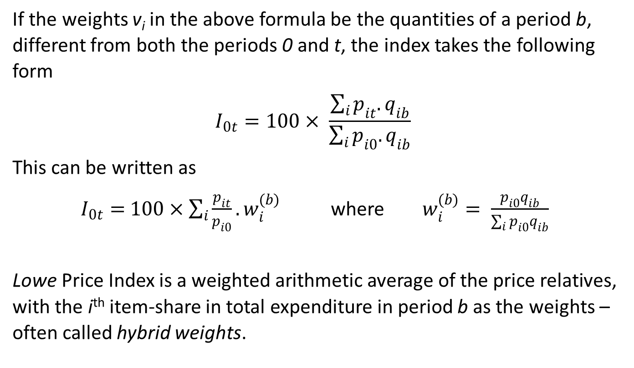
Lowe Index - defined
Price Index Formula –weighted aggregate
If the weights v_{i} in the above formula be the quantities of a period b, different from both the periods 0 and t, the index takes the following form
$$I_{0t}=100× \frac{\sum_{i}{p_{it}.q_{ib}}}{\sum_{i}{p_{i0}.q_{ib}}}$$
This can be written as
$I_{0t}=$ $100×\sum_{i}{\frac{p_{it}}{p_{i0}}.}w_{i}^{(b)}$where $w_{i}^{(b)}= \frac{p_{i0}q_{ib}}{\sum_{i}{p_{i0}q_{ib}}}$
Lowe Price Index is a weighted arithmetic average of the price relatives, with the i^{th} item-share in total expenditure in period b as the weights – often called hybrid weights.

Slide 18
Lowe Index
Price Index Formula –weighted aggregate
There are many ways in which these weights (v_{i}) – which are not necessarily reference quantities – might be specified.
For a Lowe price index, these weights are fixed and predetermined, but need not pertain to either quantity or expenditure of the time period for which prices are being compared.
By use of different types of weights, a number of formulae emerge for the construction of price index numbers.

Slide 19
Types of Weights – an example
Price Index Formula –weighted aggregate
Quantity weight in base period
Value/ expenditure weight in base period
Quantity weight in current period
Value/ expenditure weight in current period

Slide 20
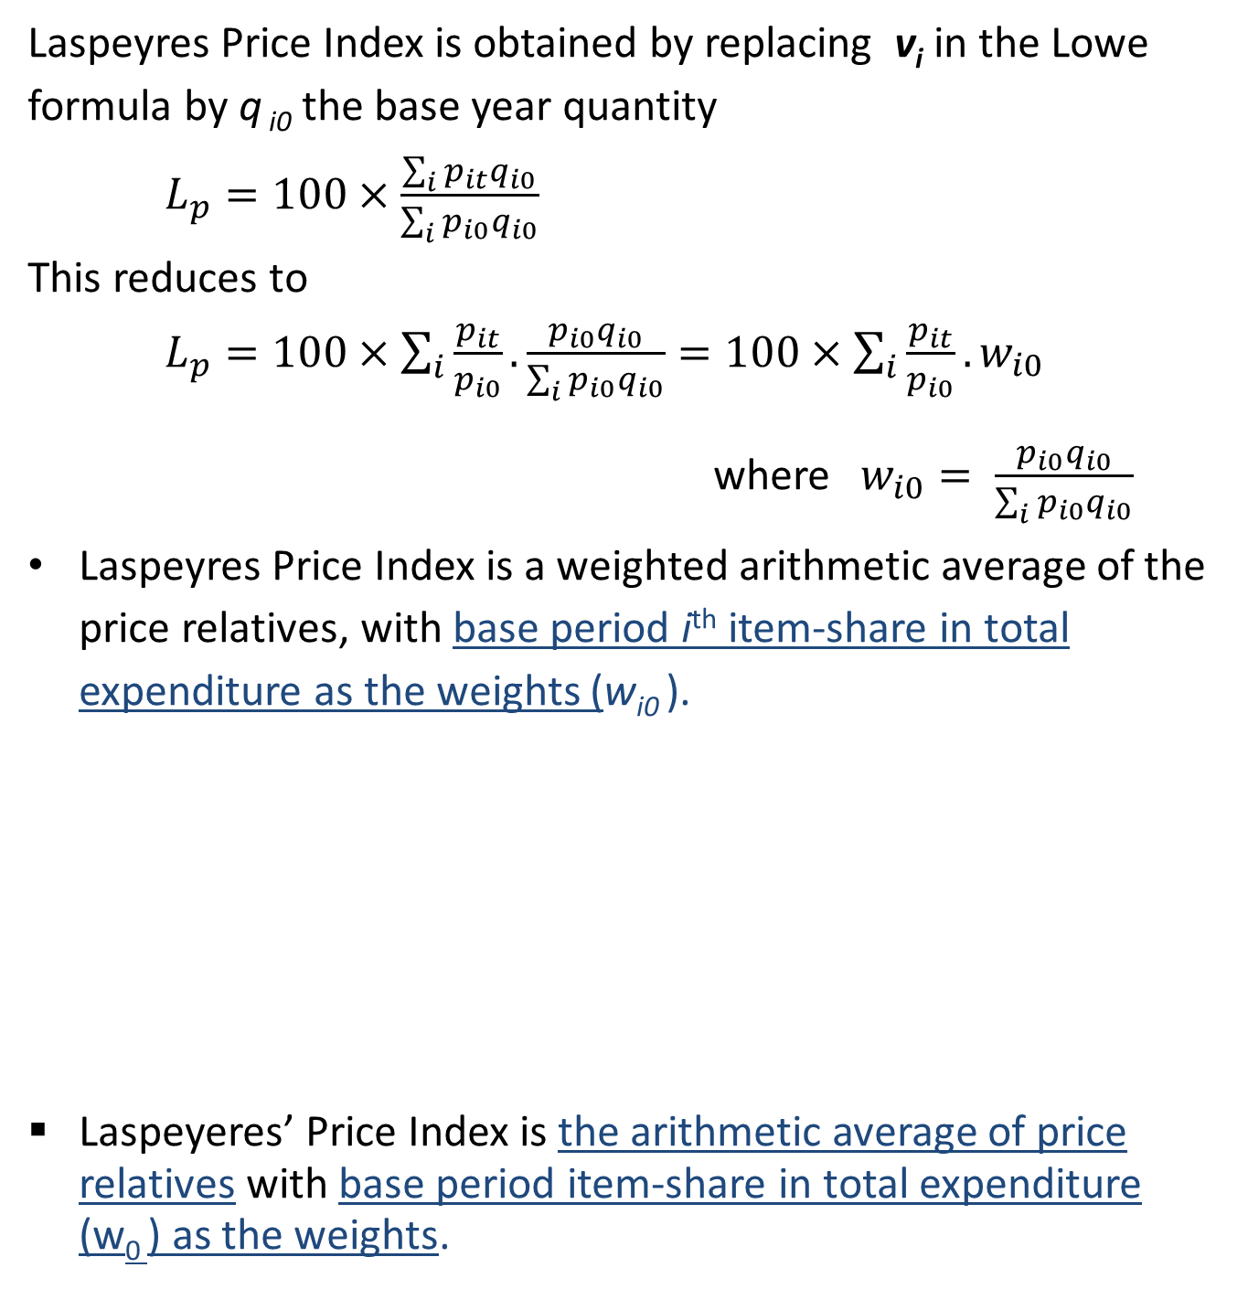
Laspeyres Price Index
Price Index Formula –weighted aggregate
Laspeyres Price Index is obtained by replacing v_{i} in the Lowe formula by q _{i0} the base year quantity
$L_{p}=100×\frac{\sum_{i}{p_{it}q_{i0}}}{\sum_{i}{p_{i0}q_{i0}}}$
This reduces to
$L_{p}=100×\sum_{i}{\frac{p_{it}}{p_{i0}}}. \frac{p_{i0}q_{i0}}{\sum_{i}{p_{i0}q_{i0}}}=100×\sum_{i}{\frac{p_{it}}{p_{i0}}.w_{i0}}$
where $w_{i0}= \frac{p_{i0}q_{i0}}{\sum_{i}{p_{i0}q_{i0}}}$
Laspeyres Price Index is a weighted arithmetic average of the price relatives, with base period i^{th} item-share in total expenditure as the weights (w_{i0} ).
Laspeyeres’ Price Index is the arithmetic average of price relatives with base period item-share in total expenditure (w₀ ) as the weights.

Slide 21
Example 13: Laspeyres price index
Price Index Formula –weighted aggregate
Calculate these values in your workbook
Using quantity weight q₀ in base period,
L_{p} = 100*(weighted aggregate price in current period) / (weighted aggregate price in base period) = 109.9

Slide 22
Example 13: Laspeyres price index (contd.)
Price Index Formula –weighted aggregate
Calculate weights
Calculate these values in your workbook
weights price relatives
L_{p} = 100*(weighted arithmetic mean of price relatives)

Slide 23
Paasche’s Price Index
Price Index Formula –weighted aggregate
Paasche’s Price Index is obtained by replacing W in the above equation by q ₁ the current year quantity
Paasche’s Price Index is a harmonic (not arithmetic) average of price relatives with current period weights of expenditure.

Slide 24
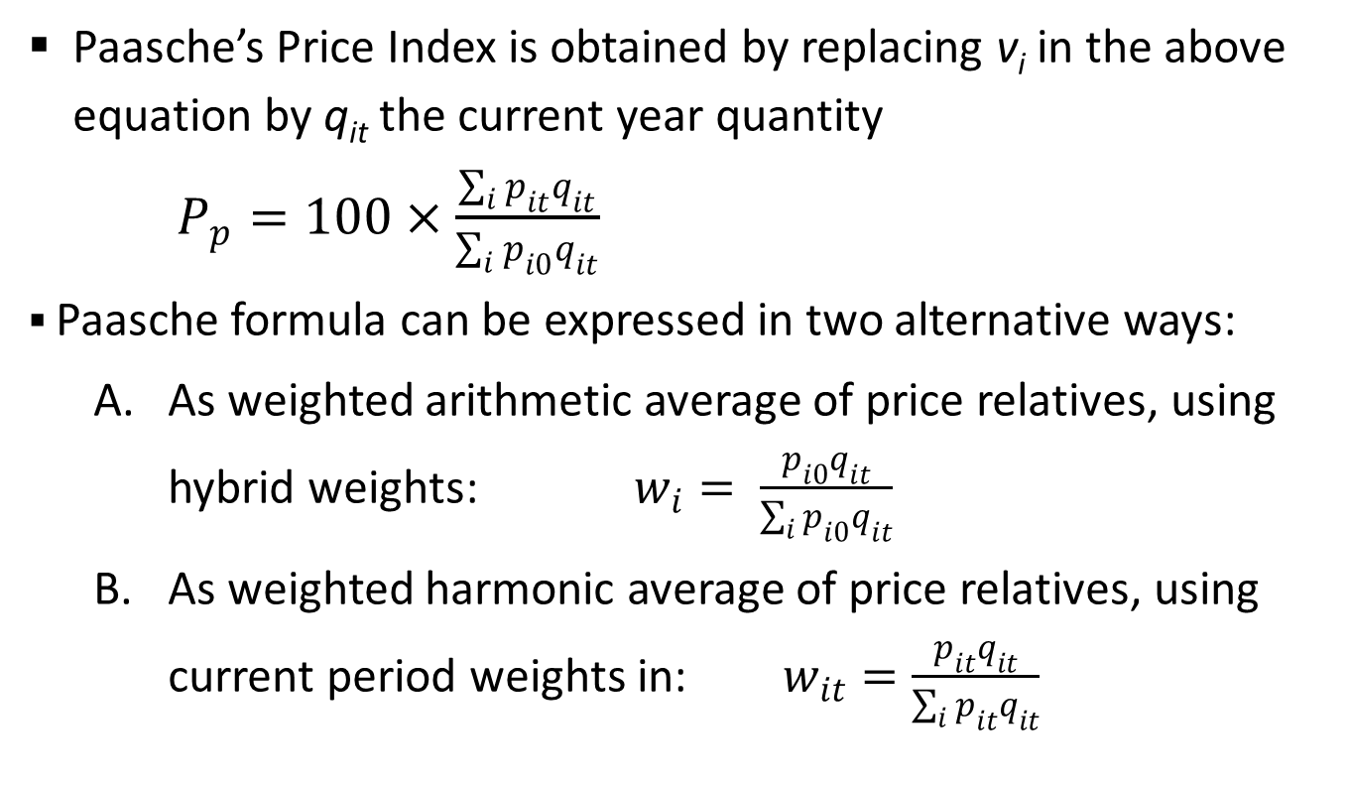
Paasche’s Price Index
Price Index Formula –weighted aggregate
Paasche’s Price Index is obtained by replacing v_{i} in the above equation by q_{it} the current year quantity
$P_{p}=100×\frac{\sum_{i}{p_{it}q_{it}}}{\sum_{i}{p_{i0}}q_{it}}$
Paasche formula can be expressed in two alternative ways:
  As weighted arithmetic average of price relatives, using hybrid weights: $w_{i}= \frac{p_{i0}q_{it}}{\sum_{i}{p_{i0}q_{it}}}$
  As weighted harmonic average of price relatives, using current period weights in: $w_{it}=\frac{p_{it}q_{it}}{\sum_{i}{p_{it}q_{it}}}$

Slide 25
Example 14 : Paasche’s Price Index
Price Index Formula –weighted aggregate
Calculate these values in your workbook
Using quantity weight q_{t} in the current period,
P_{p} = 100*(weighted aggregate price in current period) / (weighted aggregate price in base period) = 110.3

Slide 26
Example 14 : Paasche’s Price Index (contd.)
Price Index Formula –weighted aggregate
Calculate weights
Calculate these values in your workbook
weights price relatives
P_{p} = 100*(weighted harmonic mean of price relatives)

Slide 27
Laspeyeres vs. Paasche
Price Index Formula –weighted aggregate
Points to note about Laspeyeres’ and Paasche’s methods:
Laspeyres method is that it is generally expected to overestimate or to leave an upward bias.
Paasche’s method to underestimate, i.e., show a downward bias.
But the above arguments do not imply that Laspeyres index must necessarily be larger than the Paasche’s.

Slide 28
Fisher’s Index
Price Index Formula –weighted aggregate
Fisher Price Index is defined as the geometric mean of Laspeyres’ and Paasche’s indices.
Symbolically,
    ^{F}P₀₁=( ^{La}P₀₁ * ^{Pa}P₀₁)^{1/2} =(Σp₁q₀/Σp₀q₀ * Σp₁q₁/Σp₀q₁)^{1/2} *100
    For example, if
    LP= 100*1.099 = 109.9
    PP= 100*1.103 = 110.3
    then FP= 100* SQRT(1.099×1.103)=110.1

Slide 29
Fisher as Ideal index
Price Index Formula –weighted aggregate
Fisher’s Price Index number is known as ‘Ideal’ due to the following reasons:-
  (i) It is free from bias, since the upward bias of Laspeyres’ index number is balanced to a great extent by the downward bias of Paasche’s index number.
  (ii) It is based on the geometric mean, theoretically which is considered to be the best average for constructing index numbers.
  (iii) It conforms to certain tests of consistency.
  (iv) This formula takes into account the influence of the current as well as the base year.

Slide 30
End of Session III

