Slide 1
Price Index

Slide 2
Module 16: Price Index
Session IV

Slide 3
Contents – Session IV
Constructing Price Index - Part I
Issues involved
Price Index – Purpose, Scope and Coverage
Periodicity and Timeliness

Slide 4
Constructing Price Index
– Issues involved
Notes:
4

Slide 5
Construction of Price Index Numbers
Constructing Price Index
Price indices are useful indicators of measuring change in prices of a group of goods and services.
But its actual usefulness for analytical and predictive purposes depends on how well the choice of method and actual compilation are made.
The main compilation issues involved in designing a price index is indicated in the next slide.

Slide 6
Issues Involved
Constructing Price Index
Defining Purpose
Frequency – periodicity and timeliness
Choice of Base period
Assigning Weights
Selection of items
Choice of data collection method
Choice of method of calculation.
In this session, we will take up the first two issues. The rest will be discussed in the following sessions.

Slide 7
Price Index – Purpose, Scope and Coverage
Price Index – as a Measure of Inflation
Price index relating to standard of living
Purpose served by a price index
Scope and coverage of Price Index
Notes:
7

Slide 8
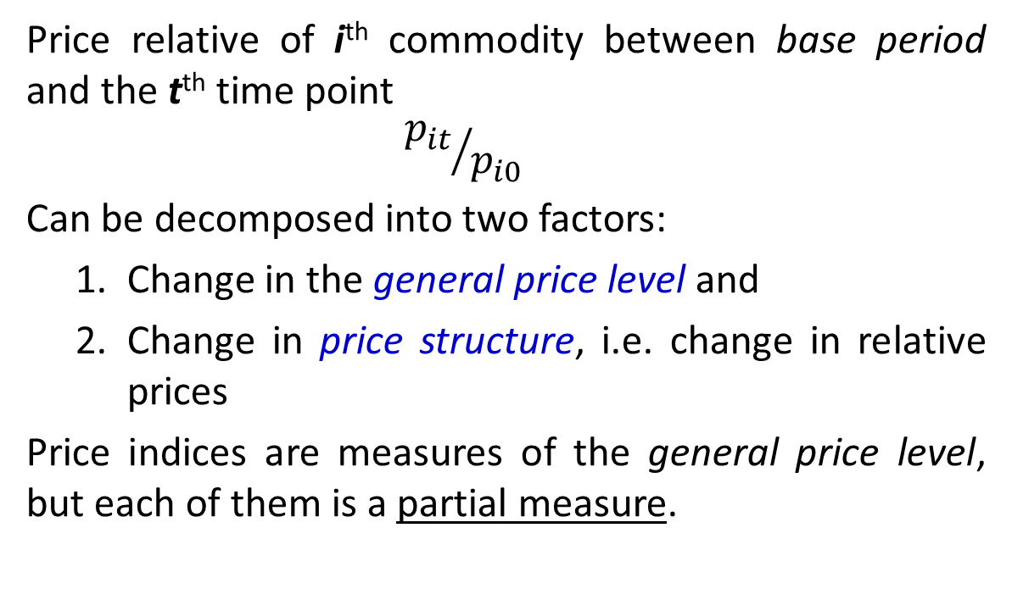
Decomposition of Price Change
Price Index – Scope & Coverage
Price relative of i^{th} commodity between base period and the t^{th} time point
$${p_{it}}/{p_{i0}}$$
Can be decomposed into two factors:
Change in the general price level and
Change in price structure, i.e. change in relative prices
Price indices are measures of the general price level, but each of them is a partial measure.
8
8
Notes:
National Accounts - Basic Concepts
Aug. 2011
PDOS-
8
8

Slide 9
Example 16: Decomposition of Price Change
– an example (with just 3 products)
Price Index – Scope & Coverage
product | p₀ | Relative price | product | p_{t} | Price relative | Relative price
Base period |  |  | Case 1 – current period
A | 10 | 1.0 | A | 12 | 1.2 | 1.0
B | 20 | 2.0 | B | 24 | 1.2 | 2.0
C | 15 | 1.5 | C | 18 | 1.2 | 1.5
p₀: price in base period p_{t}: price in base period Price relative = p_{t}/ p₀ Relative price : (price of the product) / price of A) |  |  | Case 2 – current period
 |  |  | A | 10 | 1.0 | 1.0
 |  |  | B | 16 | 0.8 | 1.6
 |  |  | C | 18 | 1.2 | 1.8
9
9
Notes:
National Accounts - Basic Concepts
Aug. 2011
PDOS-
9
9

Slide 10
Example 16: Decomposition of Price Change (Contd.)
Price Index – Scope & Coverage
product | p₀ | Relative price | product | p_{t} | Price relative | Relative price
Base period |  |  | Case 3 – current period
A | 10 | 1.0 | A | 13 | 1.3 | 1.0
B | 20 | 2.0 | B | 22 | 1.1 | 1.7
C | 15 | 1.5 | C | 18 | 1.2 | 1.4
For uniform weights of 1/3 of all the products:
Case 1: rise in general price level by 20%, with no change in price structure.
Case 2: no change in general price level, but change in price structure.
Case 3: rise in general price level by 20%, with change in price structure.
10
10
Notes:
National Accounts - Basic Concepts
Aug. 2011
PDOS-
10
10

Slide 11
General Price Level
Price Index – Scope & Coverage
In real life, we invariably find price change of the Case 3 kind.
Generally, an overall increase in the price level is accompanied by a change in the structure of relative prices, but it is only the overall [average] prices increase, not the relative price change, that constitutes inflation
General Price level: an economy-wide price index covering all money transactions occurring during the time period may be able to represent the general price level.
Increase in average prices of all goods and services in an economy should be distinguished from a change in the relative prices of individual goods and services.
11
11
Notes:
National Accounts - Basic Concepts
Aug. 2011
PDOS-
11
11

Slide 12
Coverage of PIs used as Measure of Inflation
Price Index – Scope & Coverage
The transactions relevant for a measure of general price level or inflation are
g&s ↔ M
The domains of price indices meant for measuring inflation are thus confined only to market transactions.
The non-market transactions, and own-use transactions are excluded since they do not involve money transactions.
12
12
Notes:
National Accounts - Basic Concepts
Aug. 2011
PDOS-
12
12

Slide 13
Coverage of Price Indices
– a Market Transactions Approach
Price Index – Scope & Coverage
MPI a part of it
Wage rate index
PPI- output
XPI
PPI - input
CPI
Construction cost index
13
13
Notes:
National Accounts - Basic Concepts
Aug. 2011
PDOS-
13
13

Slide 14
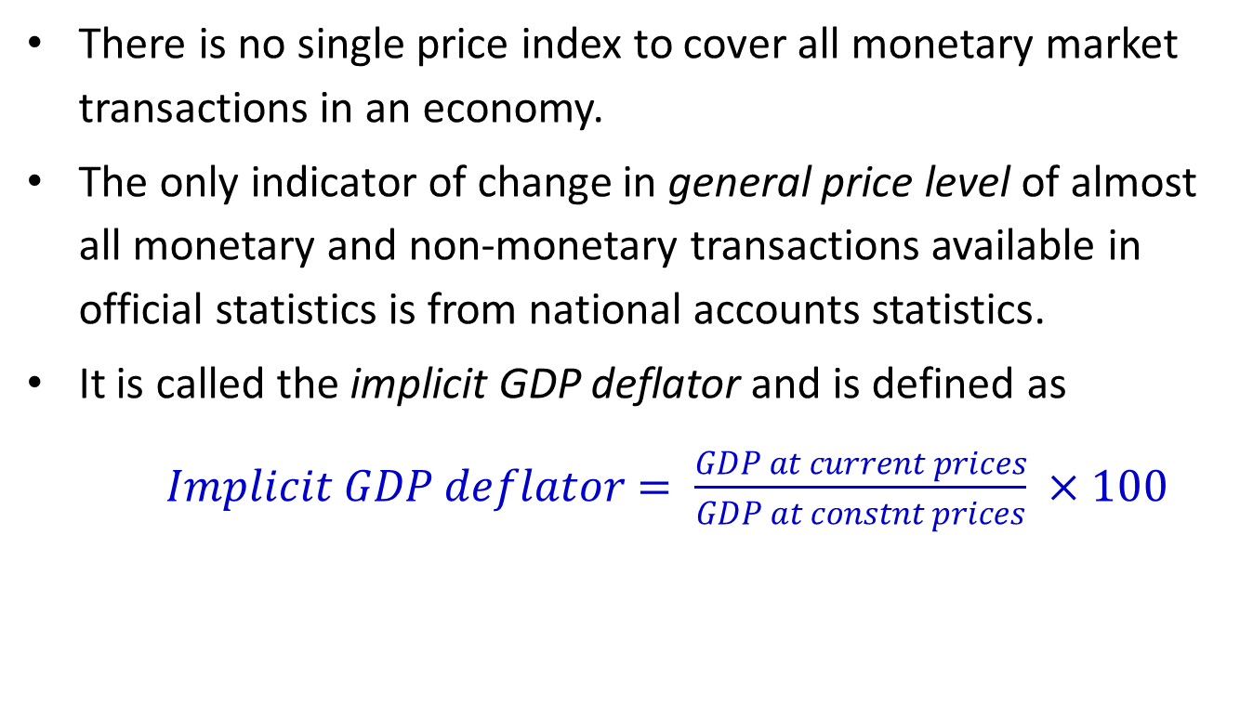
Implicit GDP Deflator
Price Index – Scope & Coverage
There is no single price index to cover all monetary market transactions in an economy.
The only indicator of change in general price level of almost all monetary and non-monetary transactions available in official statistics is from national accounts statistics.
It is called the implicit GDP deflator and is defined as
$Implicit GDP deflator= \frac{GDP at current prices}{GDP at constnt prices} ×100$
14
14
Notes:
National Accounts - Basic Concepts
Aug. 2011
PDOS-
14
14

Slide 15
Implicit GDP Deflator - Coverage
Price Index – Scope & Coverage
This is an index that measures the average price level of an economy’s output relative to the base year.
Percentage change in the GDP deflator, in a way, measures the rate of overall price increase for all goods and services produced in the economy.
But, it does not
  cover purchase and sale of existing assets and properties.
  serve the purposes that are served by the specific price indexes.

Slide 16
Price Index – as a Measure of Inflation
Price Index – Scope & Coverage
Inflation or the rise in the general level of prices over time can be measured using a number of different indices.
For assessing inflation faced by private households, the most suitable index is the consumer price index (CPI).
For assessing inflation from the point of view of producers or importers of goods, the producer price index (PPI) can be the most suitable measure of inflation for certain purposes.
As for building construction and housing, construction cost index may provide the most relevant picture of price trends in these industries.

Slide 17
Price index relating to standard of living
Price Index – Scope & Coverage
A Cost of Living Index (COLI) is defined as the measure of change in the minimum cost of maintaining a given level of welfare (also known as well-being, utility, standard of living).
A COLI designed to capture the change in minimum cost in response to environmental factors is called unconditional COLI), strictly speaking, is not a price index.
A COLI (conditional COLI) is based on the change in the minimum cost of maintaining a given level of welfare resulting from only the changes in consumer prices, holding the environmental factors constant.

Slide 18
COLI and Inflation
Price Index – Scope & Coverage
An unconditional COLI), strictly speaking, is not a price index.
A conditional COLI qualifies as a price index
A COLI reflects results of changing prices and changing expenditure patterns.
Inflation in its broadest sense is concerned only with changing prices.
A COLI is a more appropriate tool for negotiating income changes.
An inflation index is preferred for macro-economic policy analysis.

Slide 19
Definition of Purpose
Constructing Price Index – Purpose
The first and the foremost problem in the construction of index numbers relates to specify the purpose for which they are required.
  There is no all-purpose index number as every index number has its own particular uses and limitations.
  For example, a cost of living index will have different set of commodities, price quotations and weights compared with the general wholesale price index.
  Again the cost of living index for workers in an industrial town will have different requirements compared with one for agricultural workers.

Slide 20
Consumer Price Index – Scope
Price Index – Scope & Coverage
CPI is a price index that measures changes in the prices of consumption goods and services acquired, or used, by households.
Consumption goods & services: Are those that members of households use, directly or indirectly, to satisfy their own personal needs and wants.
However, a CPI may not cover all households or all the goods and services they actually consume. For example, it may exclude:
  publicly provided free goods and services
  self consumption of goods & services out of own production
  consumption of banking and insurance services

Slide 21
CPI – Coverage
Price Index – Scope & Coverage
The coverage of a CPI is specified by the reference population in terms of
Geographical coverage: for example rural & urban areas.
Types of households: Rural labour, industrial, two or more members’ households etc.
Socio-economic groups: native population, non-rich population, etc.

Slide 22
Producer Price Index – Scope & Coverage (1)
Price Index – Scope & Coverage
PPIs provide measures of average movements of prices received (or paid) by the producers of commodities.
The scope of PPIs varies – they generally reflect the changes in prices received (or paid) by a definable industry such as manufacturing, agriculture or mining.

Slide 23
Producer Price Index – Scope & Coverage (2)
Price Index – Scope & Coverage
PPIs compiled and disseminated have different scopes, such as :
  input price indices for the market purchase prices of raw materials/inputs to the manufacturing process;
  output price indices for goods as they leave the factory gate;
  wholesale price indices which refer to prices received by wholesalers.

Slide 24
Input and Output Producer Price Index
Price Index – Scope & Coverage
Input producer price indices reflect changes in prices paid by producers for raw materials and intermediate goods. They are valued at purchasers’ prices.
Output producer price indices reflect changes in ex-factory gate prices valued at basic prices, i.e.,
  actual transaction prices of domestic production, taking account of discounts and rebates,
  excluding taxes and subsidies on products and excluding trade and transport margins. This is sometimes referred to as the first stage of commercialisation.

Slide 25
Price Index – Periodicity and timeliness
Reference period and reference time point
Timeliness
Notes:
25

Slide 26
Periodicity
Constructing Price Index – Frequency
Primarily, periodicity and timeliness of compiling a price index is determined by the purpose. There are other factors as well, such as
whether intended to relate to time point or a period
the pattern of price movements
practicalities of carrying out price collections.

Slide 27
Frequency and Purpose
Constructing Price Index – Frequency
A price index used for monitoring inflation should be compiled with a high frequency say a week or a month.
A price index for other purposes, such as
  index linking salaries and social benefits
  contract escalation and
  compilation of national accounts at constant prices.
are required with a longer periodicity of say a month or a quarter or even annual.

Slide 28
Reference period and reference time point
Constructing Price Index – Frequency
Price indexes are designed to refer to a time point or a period of time.
A price index is said to have a reference time point, if it is based on prices collected on a particular day of the week or the month.
An index is said to have a period reference, when average prices during the reference period are considered for calculation of the price index.
An index number series is smoother for period reference than reference time point.

Slide 29
Reference time point
Constructing Price Index – Frequency
A high-frequency index is usually compiled for a reference time point or a short reference time period.
High-frequency indexes are compiled for those with a limited scope.
An index number series with reference time point is likely to be highly volatile in short-term.
In a rapid inflation situation, monitoring authorities require price index with shorter reference period.
For example, price index for crude oil or transport fuel, for which the prices could be very volatile.

Slide 30
Reference period
Constructing Price Index – Frequency
The price indexes with broader scope usually have a longer reference time period.
If intended to be used for deflating income, expenditure or sales, the index should relate to the period of time.
For example, most of the countries compile CPI on a monthly basis.

Slide 31
Timeliness
Constructing Price Index – Frequency
The required timeliness of publishing a price index is closely linked to its frequency of compilation.
The high frequency price indexes – used for monitoring purposes – demand shorter time lag.

Slide 32
End of Session IV

