Slide 1
Module 16: Price Index
Session V

Slide 2
Contents – Session V
Construction of Price Index – Part II
General Procedure of Index Aggregation
Choice of base period

Slide 3
General Procedure of Index Aggregation
  Computation of price relatives
  Computation of elementary price index – elementary aggregation
  Computation of higher level price index – aggregating elementary price indices
Notes:
3

Slide 4
Constructing Price Index – Steps involved, in practice
General Procedure of Index Aggregation
Specifying geographical and population coverage.
Identifying the products to be included in the basket and grouping them for elementary levels of aggregation – [discussed in some more detail in Session VI]
Selecting a compilation method and base period.
Deriving weighting structure
Designing price data collection – frequency, outlets, product specification and quotations
[discussed in some more detail in the following sessions]
Index calculation in practice
[discussed in some more detail in the following sessions]
Notes:
National Accounts - Basic Concepts
Aug. 2011
PDOS-
4
4

Slide 5
Construction of Price Index Numbers
General Procedure of Index Aggregation
Price indices are compiled step-by-step.
At every step the lower-level indices are aggregated to obtain the higher levels ones, up to the overall index.
Normally, a three-step procedure is followed.
A general procedure of constructing price index is indicated in the next slide.

Slide 6
Aggregation Structure
– A General Procedure of constructing price index
General Procedure of Index Aggregation
Upper aggregated price index
Weighted arithmetic mean of price relatives by using fixed weight (Laspeyres’ / Lowe method)
Price index for elementary aggregates
Simple arithmetic / geometric mean of price relatives or ratio of average prices
Price relatives for each item
Simple ratio of prices in current and base periods
Prices for each item in current and base period

Slide 7
Three-Step Compilation
General Procedure of Index Aggregation
First step: Calculation of price relatives. Price relative is calculated for each quotation as the ratio between the quoted current-period price (numerator) and the base-period price (denominator).
Second step: Price relatives are aggregated to obtain the elementary price index (or elementary product index in the PPI context).
Third step: The elementary price indices are aggregated as weighted averages (typically as a Laspeyres-type index) to provide a set of synthetic indices up to the overall index.

Slide 8
First Step – computation of price relatives
General Procedure of Index Aggregation
Price quotations are first converted to ratios or price relatives, by dividing each current price by index-base price.
For each period a fixed number of price quotations for a group of specified products (according to product specification) constituting an elementary aggregate are collected.
The price relatives are calculated for each specified product as the ratio between the current period’s price and the base-period price.

Slide 9
First Step – An example
General Procedure of Index Aggregation
In compilation of a CPI,
Elementary aggregate: ‘rice’.
  Number of varieties (say ‘course’, ‘medium’ and ‘fine’): 3
HES data provides weights for ‘rice’ but not for its varieties.
Number of outlets selected for price collection: 10
Number of quotations collected from 10 outlets: 20
      10 for ‘coarse rice’
      6 for ‘medium rice’
      4 for ‘fine rice’.
Number of price relatives required to be calculated: 20
(for each quotation)

Slide 10
Second Step – computation of elementary index (1)
General Procedure of Index Aggregation
The price relatives for each specified group of products – elementary aggregate (for CPI) and product index (for PPI) – are then aggregated to obtain the elementary price index.
The price index for an elementary aggregate is called an elementary price index.
Recall that an elementary aggregate is the lowest level of aggregation for which value data are available.
In our example of ‘rice’ in CPI compilation, all the price relatives for quotations collected for rice are combined, or aggregated, to obtain the elementary price index for ‘rice’.

Slide 11
Second Step – computation of elementary index (2)
General Procedure of Index Aggregation
Likewise, for PPI, prices for different types of transactions for a product are collected from an establishment.
The derived price relatives are combined to produce the product index for the establishment.
Again, weights for individual transactions are usually not available.
Thus, the establishment’s product index is computed as an unweighted average of the price relatives for different transactions.

Slide 12
Second Step – computation of elementary index (3)
General Procedure of Index Aggregation
The elementary price index or an establishment’s product index are compiled in several ways.
Mainly, two methods can be distinguished:
  the weighted mean of price relatives.
  the unweighted mean of price relatives.
We will discuss only the applications of formulas that do not use explicit weights, i.e. Dutot’s, Carli’s and Jevon’s.

Slide 13
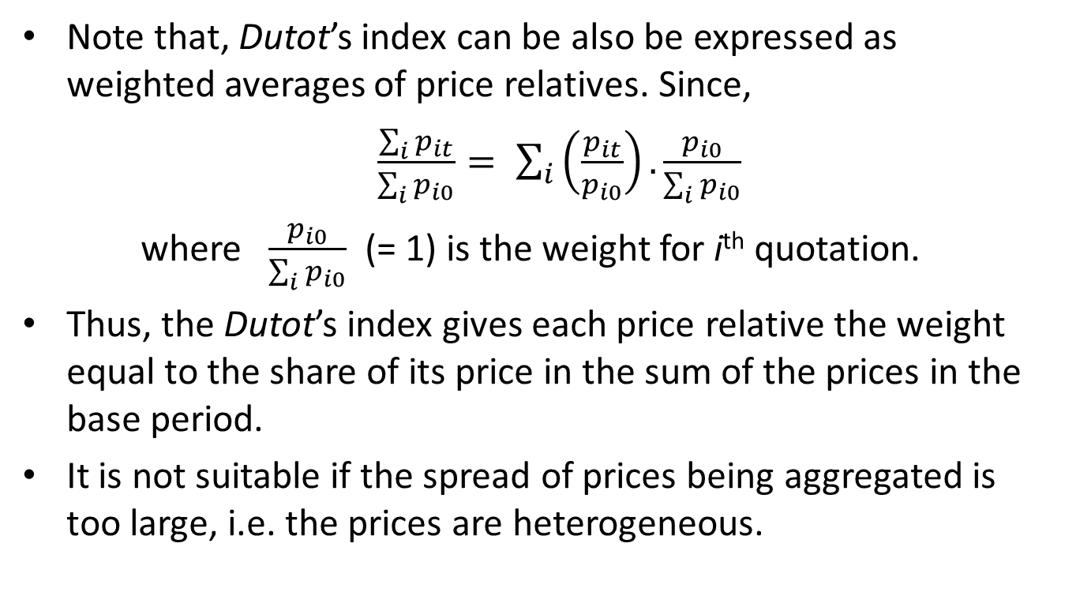
Second Step – Dutot’s for elementary index
General Procedure of Index Aggregation
Note that, Dutot’s index can be also be expressed as weighted averages of price relatives. Since,
$\frac{\sum_{i}{p_{it}}}{\sum_{i}{p_{i0}}}= \sum_{i}{\left(\frac{p_{it}}{p_{i0}}\right).}\frac{p_{i0}}{\sum_{i}{p_{i0}}}$
where $\frac{p_{i0}}{\sum_{i}{p_{i0}}}$ (= 1) is the weight for i^{th} quotation.
Thus, the Dutot’s index gives each price relative the weight equal to the share of its price in the sum of the prices in the base period.
It is not suitable if the spread of prices being aggregated is too large, i.e. the prices are heterogeneous.

Slide 14
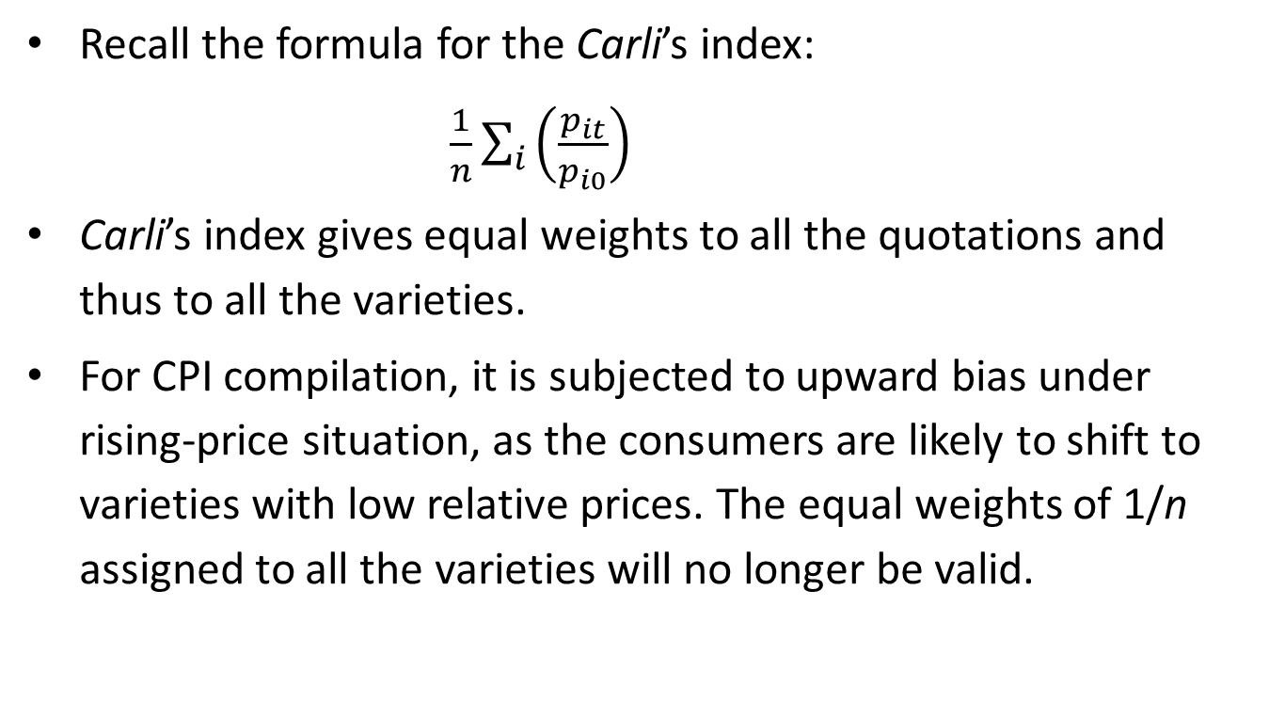
Second Step – Carli’s for elementary index
General Procedure of Index Aggregation
Recall the formula for the Carli’s index:
$\frac{1}{n}\sum_{i}{\left(\frac{p_{it}}{p_{i0}}\right)}$
Carli’s index gives equal weights to all the quotations and thus to all the varieties.
For CPI compilation, it is subjected to upward bias under rising-price situation, as the consumers are likely to shift to varieties with low relative prices. The equal weights of 1/n assigned to all the varieties will no longer be valid.

Slide 15
Second Step – Jevon’s for elementary index
General Procedure of Index Aggregation
Jevon’s index is the geometric average of the price relatives – both calculations will yield the same results.
It is being introduced by more and more countries for calculation of elementary index.
The Jevon’s index gives each price relative the same (multiplicative) weights.

Slide 16
Third Step – computation of higher-level index (1)
General Procedure of Index Aggregation
The elementary aggregates are combined to produce the sub-group and group indices, and eventually the overall index.
For this, some kind of index number formula and weights are used.
  expenditure or population (for CPI)
  value of production (for PPI).
Generally, the Laspeyres type index is used by statistical offices for higher-level indices.

Slide 17
Third Step – computation of higher-level index (2)
General Procedure of Index Aggregation
Weighted arithmetic mean of elementary price indices is used for higher-level indices.
Each of elementary aggregates (product or product group) is given a “weight”, based on
  consumption expenditure or
  output or sales
  during the reference (base) period for the weights.
The elementary price indices are multiplied by their respective “weights” to obtain higher-level aggregate price index.

Slide 18
Example 17: Process of Aggregation (1)
General Procedure of Index Aggregation
Consider a hypothetical situation where the overall price index is compiled from just three broad groups of products – cereals, other food and non-food – with weights 20%, 45% and 35% respectively.
The broad group cereal consists of only products (elementary aggregates) – rice and flour. For rice, 8 quotations are collected every month and for flour 6 quotations.
The table on the next slide shows the price quotations for rice and flour.

Slide 19
Example 17: Process of Aggregation (1)
General Procedure of Index Aggregation
Elementary aggregate - Cereals | Period / price relative | Quotation no. |  |  |  |  |  |  |  | elementary price index (Jevon's)
 |  | 1 | 2 | 3 | 4 | 5 | 6 | 7 | 8
Rice | base year | 25 | 27 | 25 | 26 | 22 | 23 | 25 | 24
 | current month | 33 | 32 | 36 | 34 | 30 | 31 | 35 | 32
 | price relative | 1.3 | 1.2 | 1.4 | 1.3 | 1.4 | 1.3 | 1.4 | 1.3 | 133.5
Flour | base year | 42 | 40 | 43 | 39 | 37 | 44 | x | x
 | current month | 51 | 55 | 58 | 49 | 53 | 50 | x | x
 | price relative | 1.2 | 1.4 | 1.3 | 1.3 | 1.4 | 1.1 | x | x | 129.0
Calculate these values in your workbook
Calculate these values in your workbook
First, the price relatives for each of the quotations are obtained as the ratio of current-period price to that of the base period. This is the first step.
Next – the second step – the elementary price indices for rice and flour are calculated as unweighted geometric mean of the price relatives.

Slide 20
Example 17: Process of Aggregation (2)
General Procedure of Index Aggregation
The third step usually consists of different stages of aggregation to obtain higher level price indices.
Once the elementary price index for rice and flour are obtained, we can calculate the price index for the ‘Cereals’ broad group as follows (with the given weights of 60% and 40% for rice and flour respectively):
Elementary aggregate in ‘Cereals’ broad group | weights(%) within ‘Cereals’ group | elementary index
Rice | 60 | 133.5
Flour | 40 | 129.0
 | Price index of cereals: |  | 131.7
Calculate these values in your workbook

Slide 21
Example 17: Process of Aggregation (3)
General Procedure of Index Aggregation
The value of index 131.7 is obtained as weighted arithmetic average of elementary price indices of rice and flour.
Now, let’s assume the price index for the broad groups ‘other food’ and ‘non-food’ are similarly obtained as 135.3 and 145.2.
Finally, all the group price indices are combined, using the assigned weights of 20%, 45% and 35% respectively for ‘cereals’, ‘other food’ and ‘non-food’, to obtain the overall price index as follows:
broad group | Weights (%) | Broad group index
Cereals | 20 | 131.7
Other food | 45 | 135.3
Non-food | 35 | 145.2
 | Overall price index: |  | 138.0
Calculate the value in your workbook

Slide 22
Choice of Base Period
  Desirable properties of all the reference periods
  Rebasing – how frequently?
Notes:
22

Slide 23
Choice of Base or Reference period
Constructing Price Index – Base Period
A base period is a conventional time interval such as a year, a month, etc.
The following consideration are kept in mind while selecting a base period.
  Base period should be a period of normal and stable economic conditions. But a period which is normal in one respect may be abnormal in some other respects. Thus, sometimes an average of two or more years is taken as the base period.
  The base period should not be too distant from the given period.
  ) Sometimes a year of some economic importance for the country is also taken as base.

Slide 24
Desirable properties of reference periods
Constructing Price Index – Base Period
All the reference periods – Index reference period, Weight reference period and Price reference period – should desirably
  be long enough to cover a seasonal cycle, which is normally a year
  have economic conditions that can be considered to be reasonably normal or stable
  not be too distant from each other.
  An index series may also be re-referenced to another period by simply dividing the series by the value of the index in that period, without changing the rate of change of the index.

Slide 25
Example 18: Re-referencing a Price Index
Constructing Price Index – Base Period
Consider the following price index series with index reference period as the year 2005.
To obtain the series with base year re-referenced to 2010, we have to divide the values of price index with base year 2005 by the value of price index of 2010 (125.0) and multiply by 100.
(Re-referenced) base year | Price index
 | 2005 | 2006 | 2007 | 2008 | 2009 | 2010 | 2011 | 2012
2005 | 100.0 | 102.4 | 108.3 | 115.0 | 119.7 | 125.0 | 130.2 | 138.5
2010 | 80.0 | 81.9 | 86.6 | 92.0 | 95.8 | 100.0 | 104.2 | 110.8
Calculate these values in your workbook
Calculate the series with base year re-referenced to 2010. One has to divide the values of price index with base year 2005 by the value of price index of 2010 (125.0) and multiply by 100.

Slide 26
Why Rebasing?
Rebasing
In a changing world, it does not take very long before an index becomes out-of-date, for two main reasons:
  the weights no longer reflect the patterns of expenditure, output or trade
  new products come on to the market that did not exist before.
  The index ceases to represent the present-day price change.
Notes:
National Accounts - Basic Concepts
Aug. 2011
PDOS-
26
26

Slide 27
Updating Product Coverage
Rebasing
For an elementary aggregate, prices of only a set of selected specific products is assumed to capture the price movement of the entire elementary aggregate.
But, products become obsolete and new products come to the market.
This introduces bias in the elementary indices, particularly when the price movement of the “new” products is very different from the ones already in the basket of goods or services of the elementary aggregate in question.
Notes:
National Accounts - Basic Concepts
Aug. 2011
PDOS-
27
27

Slide 28
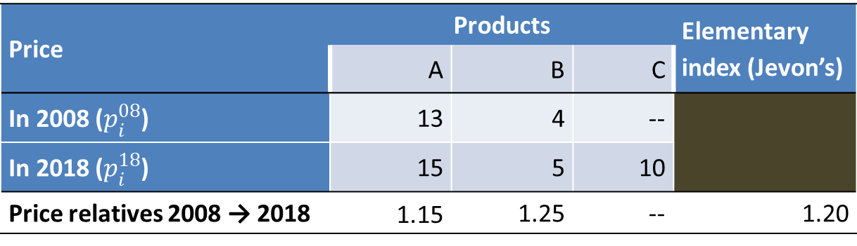
Example 19: Bias in elementary index due to “new” product coming to the market
Rebasing
Introduction of Product C, after the 2008 (base period), but the price index do not reflect the effect of price change of product C.
Price | Products |  |  | Elementary index (Jevon’s)
 | A | B | C
In 2008 ($p_{i}^{08}$) | 13 | 4 | --
In 2018 ($p_{i}^{18}$) | 15 | 5 | 10
Price relatives 2008 → 2018 | 1.15 | 1.25 | -- | 1.20
Notes:
National Accounts - Basic Concepts
Aug. 2011
PDOS-
28
28

Slide 29
Rebasing weights
Rebasing
Usually, while rebasing a price index series, an entirely new set of units or outlets are selected for price collection.
Most countries use a fixed-weight index and do not change the selected set of outlets or units till the next rebasing is done.
This leads to progressively increasing biases in the index numbers, with the actual consumption pattern shifts away from base year weighting structure.
Notes:
National Accounts - Basic Concepts
Aug. 2011
PDOS-
29
29

Slide 30
Example 20: Changes in group index with changes in weighting structure
Rebasing
The weights in the base period and the current period are very different. The price index with 2008 weights is very different from the one with current weights.
weight / cost | products |  |  | total
 | A | B | C
Weight (w_{i}⁰⁸) in 2008 | 0.5 | 0.4 | 0.1 | 1.0
Prices (p_{i}⁰⁸) in 2008 | 13 | 4 | 5
Weight (w_{i}¹⁸) in 2018 | 0.3 | 0.3 | 0.4
Prices (p_{i}¹⁸) in 2018 | 15 | 5 | 10
Price relatives 2008→2018 (pr) | 1.15 | 1.25 | 2.00
pr * w_{i}⁰⁸ | 0.58 | 0.50 | 0.20 | 1.28
pr * w_{i}¹⁸ | 0.35 | 0.38 | 0.80 | 1.52
Calculate these values in your workbook
Notes:
National Accounts - Basic Concepts
Aug. 2011
PDOS-
30
30

Slide 31
End of Session V

